Slide 1


Transforming Classroom Culture

Slide 2

Presented by
Dr. Liz Norell
Associate Professor, Political Science
Chattanooga State Community College

Slide 3
What are we transforming?

Slide 4

Notes:
We begin with a key question:
How do we create a classroom environment filled with energy, enthusiasm, curiosity, and a true sense of belonging?
Photo by Kampus Production from Pexels

Slide 5

Notes:
... And help bring students who are distracted, disengaged, or even overwhelmed …

Slide 6

Notes:
Back into the emotional and mental state that allows them to learn?
Because you and I both know – this student, right here? She’s not absorbing as much information as we’d like her to. As SHE’D like herself to.

Slide 7

Notes:
The answer is: You start with yourself.
Harriet Schwartz writes in Connected Teaching about the inescapable power of the professor in a classroom.
To abdicate that power is to leave our students without a rudder.
It is we who have the responsibility to “create learning spaces and relationships that balance challenge and support … and to prioritize student learning and development.” (p. 40)
Photo by Nadine Wuchenauer from Pexels

Slide 8

Notes:
Sociologist Erving Goffman wrote about the presentation of self – the notion that we present ourselves differently in different contexts.
So Professor Norell is different than friend Liz or the colleague in the faculty office next door.
It’s as though we are inhabiting a character – indeed, Goffman talked about “front region” (i.e., the stage) and “back stage” selves, the difference being whether we are within seeing or hearing distance of our audience.
In these performances, Goffman writes, “we find performers often foster the impression that they had ideal motives for acquiring the role in which they are performing, that they have ideal qualifications for the role, and that it was not necessary for them to suffer any indignities, insults, and humiliations, or make any tacitly understood ‘deals’ in order to acquire the role.” (p. 46)
As a faculty member in a classroom, we want to exude authority and competence – for good reason – and so we put on this persona of subject matter expert. To admit a gap in our own knowledge or a failure in working with students would be to break that illusion of total authority and competence … in other words, to be vulnerable. In theatrical terms, to break the fourth wall.
Photo by cottonbro from Pexels

Slide 9

Notes:
For me, presence is when the distance between your different presentations of self shrinks – when you are changing less about yourself from one context to another.
Of course, there will always be some differences between how you present yourself with friends versus with your students. As there should be.
But when you’re not putting on a totally different character while teaching, less of your cognitive bandwidth is used on yourself, freeing it up to be used with your students.
In other words: The less you have to moderate your behavior, speech, and personality, the more you can be present with and attentive to your students.
But this also means that, rather than donning the cloak of a character (“Totally Competent Professor”), you must come to understand who you are at a deeper level than most of us have before.
Photo by Anna Shvets from Pexels

Slide 10

Notes:
You have to know who you are, and feel comfortable with that person, before you can bring your authentic self into the classroom.
Photo by Martin Kirigua from Pexels

Slide 11

Notes:
YOU. Yes, you. (click)
How are you most comfortable in your own skin?
What are you passionate about?
Photo by Lucas Pezeta from Pexels

Slide 12

Notes:
What compels you to step into a classroom (physical or virtual)?
What matters most to you?
How do you want to be known?
Photo by Elle Hughes from Pexels

Slide 13

“Understanding my identity is the first and crucial step in finding new ways to teach: Nothing I do differently as a teacher will make any difference to anyone if it is not rooted in my nature.”
Parker Palmer, The Courage to Teach, page 74
Notes:
This isn’t just about bandwidth, though.
It’s that our effectiveness as a teacher comes when we are able to communicate with authenticity … the kind that comes when we know ourselves deeply.
I love Parker Palmer’s book, which (after multiple people recommended it) I read recently. This quote really crystallized what I’ve been thinking about for years: if we aren’t teaching from an authentic place, we will be less effective. And to be authentic, we must have invested the time to know what authenticity means for us.
Photo by Gelgas Airlangga from Pexels

Slide 14
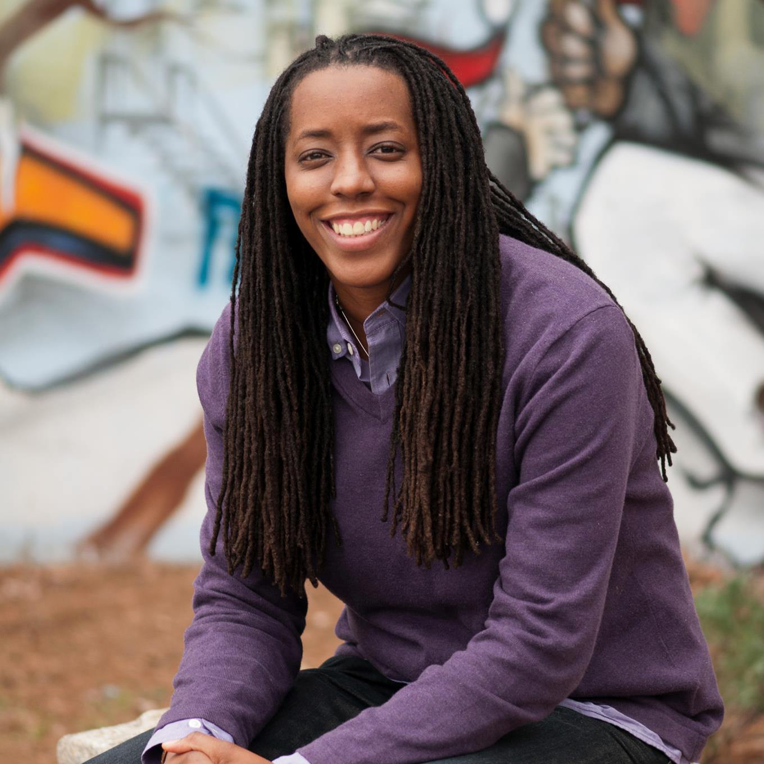
“What good is an education if you must shed who you are?”
Bettina Love, We Want To Do More Than Survive, page 44
Notes:
Or, as Bettina love writes in her outstanding book, We Want To Do More Than Survive: Abolitionist Teaching and the Pursuit of Educational Freedom, “What good is an education if you must shed who you are?” (p. 44)

Slide 15
The role of emotion

Slide 16

Notes:
Authenticity means that we not only allow emotion into our classrooms, but we harness it to create more meaningful learning experiences.
Too many of us imagine that we teach in an emotion-free space, that we’re present to the intellectual development of our students without allowing emotion to encroach.
But the fact is, emotion is always present. To ignore that fact is to engage in INauthentic teaching AND to lose out on a source of very rich learning.
Why?
Photo by Andrea Piacquadio from Pexels

Slide 17

Notes:
Sarah Rose Cavanagh has done terrific work on how to harness emotion in the classroom. Her book, The Spark of Learning, is grounded in the science of emotion – and she tells us that our brains privilege emotion over other kinds of information (such as sensory input or rational thought, if such a thing even really exists divorced from emotion – and it probably doesn’t).
Cavanagh says we have limited capacity for attention, and most of our day is spent in less than a fully attentive state. We get tired, or we daydream, or our attention is distracted by the constant hum of thoughts … you know, like, “Crap! Did I forget to turn off the coffee pot this morning?” or “I hope my son is doing okay after his bump on the head yesterday,” or “Don’t forget to pick up milk on the way home!” or “I have so much grading to do this weekend” or “I really need to get to bed earlier tonight” or “I wonder what’s going to happen on my favorite TV show tonight?” or … well. You get the picture.
These thoughts swirl. Constantly.
Photo by Matthias Cooper from Pexels

Slide 18

Notes:
These thoughts swirl. Constantly. We get lost inside them, and they pull us away from whatever task we’re allegedly attending to at the moment.
The fact is: For each of us, most of the time, “a good portion of [our] limited attention is directed inward, rather than outward” (Cavanagh, p. 35).
What helps us break out of that state of distraction? (Which is, we should note, TOTALLY NORMAL)
Emotion.
Emotion helps us focus on something outside of ourselves.
Care to engage in an experiment with me?
Photo by Sharon McCutcheon from Pexels

Slide 19

Notes:
(pause for 3 seconds)
How does this picture make you feel?
Photo by Anna Shvets from Pexels

Slide 20

Notes:
(pause for 3 seconds)
Or this one?
Photo by Aleksandr Balandin from Pexels

Slide 21

Notes:
(pause for 3 seconds)
Or this one?
Photo by Marcelo Chagas from Pexels

Slide 22
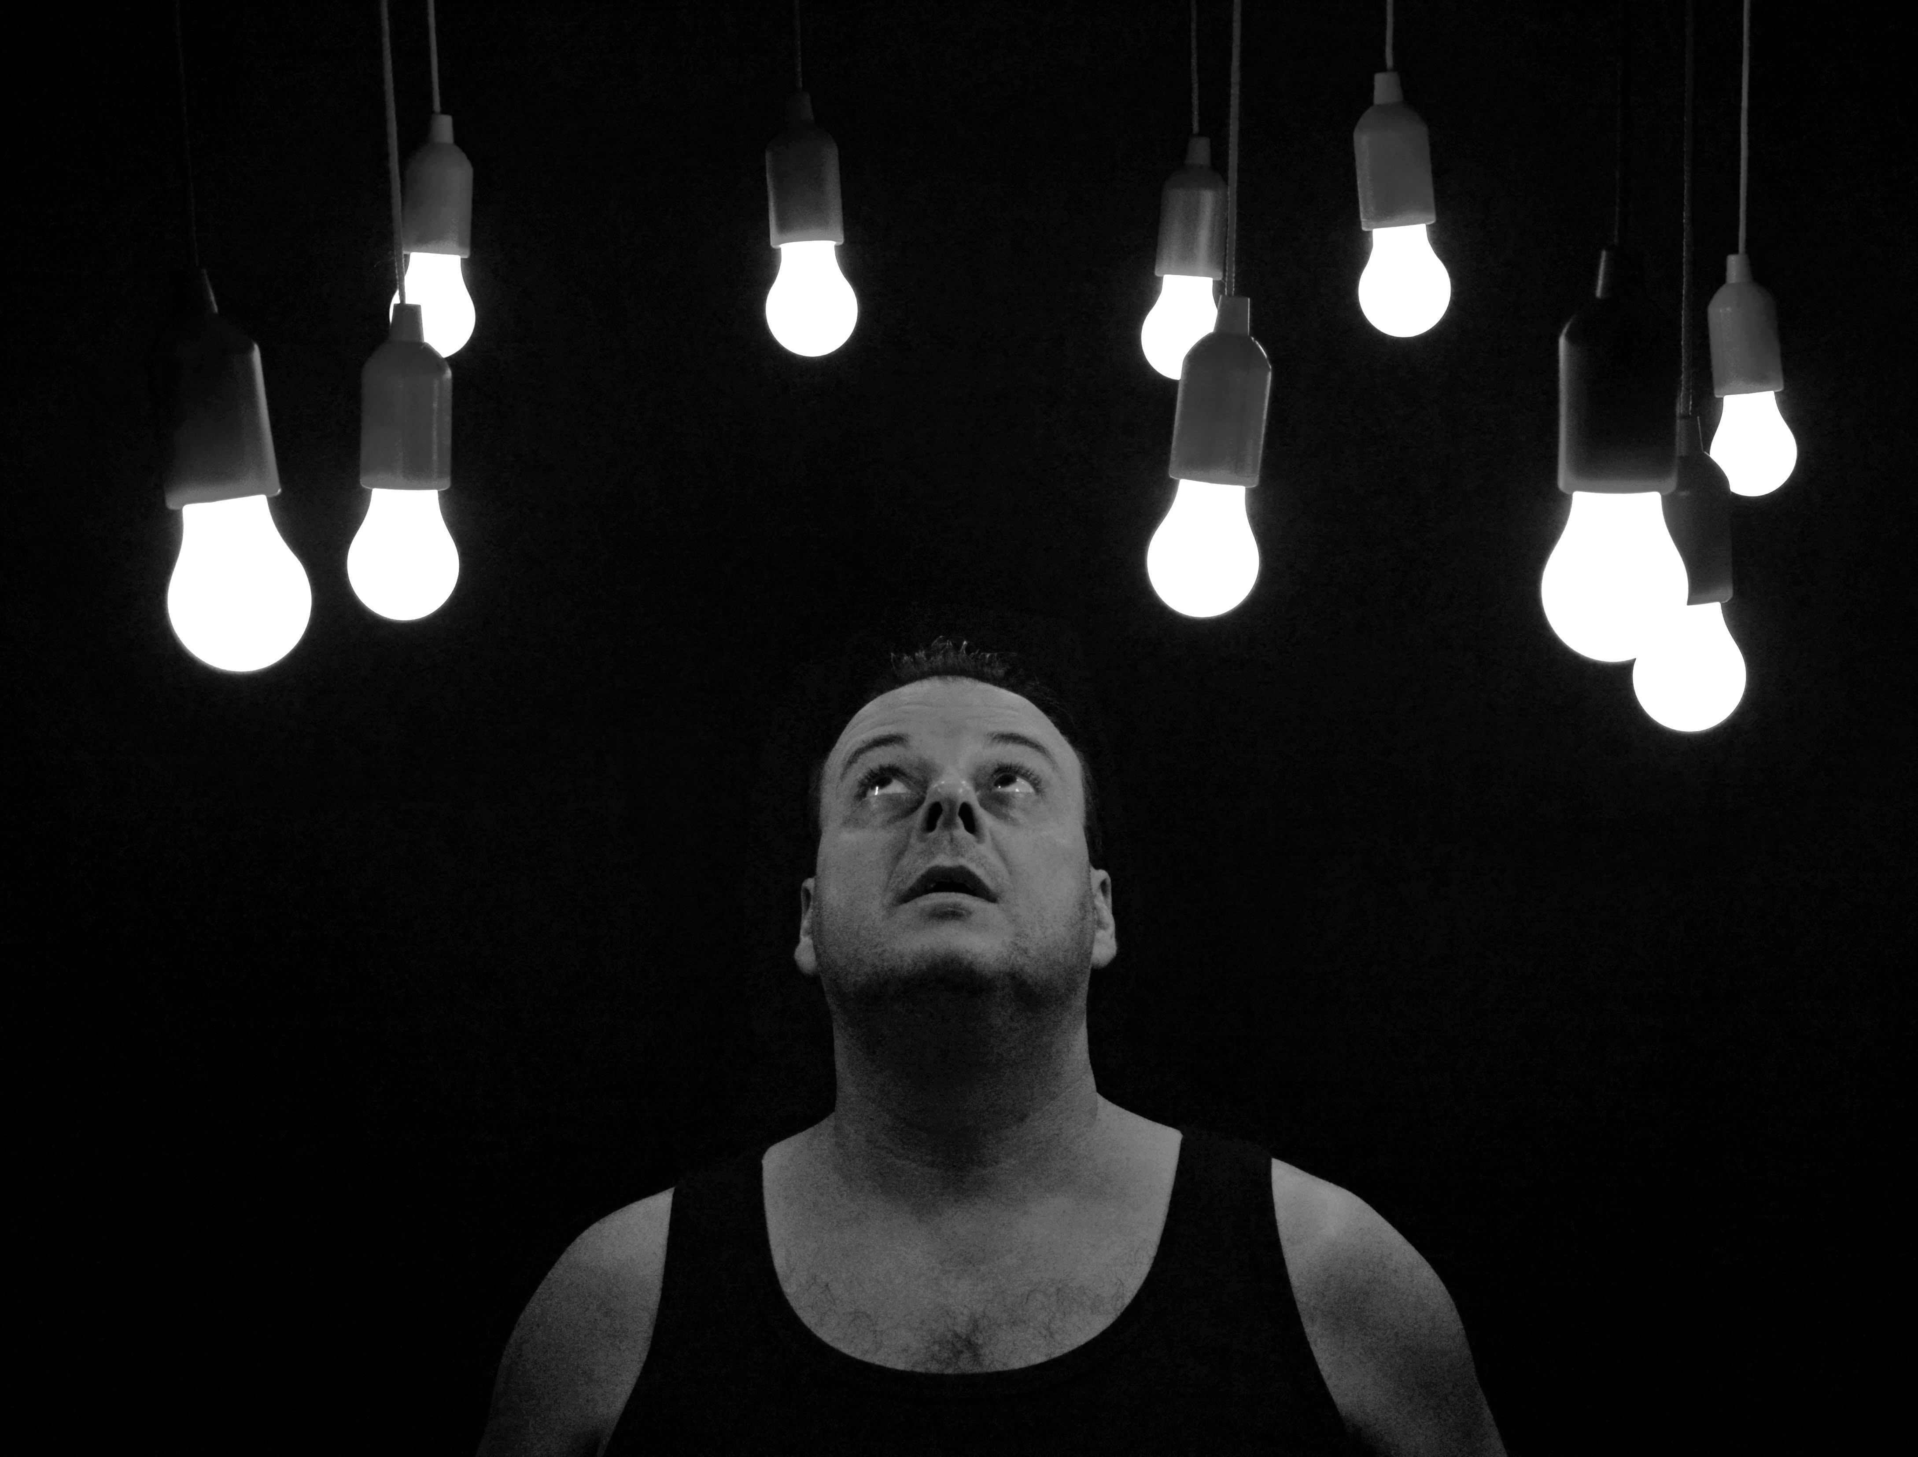
Notes:
And while you were looking at those pictures, were you thinking about your to-do list?

Slide 23

Notes:
Or take a moment here and try to find Waldo.
(wait about eight seconds)
Did you find him?
Awesome.
Let’s move on.

Slide 24
Notes:
The thing is, if we want to harness the power of emotion – the power to focus our students’ attention and to form longer-term memories.
(click)
Think back to this photo from a few slides ago. The two men pictured here won’t soon forget this moment, because of the heightened emotion they feel. The emotion serves to focus attention, chase away competing background thoughts, and imprint the moment in our memories.
The trick? Using this in our classroom.
Photo by Nashua Volquez-Young from Pexels

Slide 25
Notes:
Just kidding. Here’s Waldo.
(It took me SEVERAL MINUTES to find him. At least eight times, I said to myself, “I don’t think he’s actually in this one. It must’ve gotten cut off.”

Slide 26
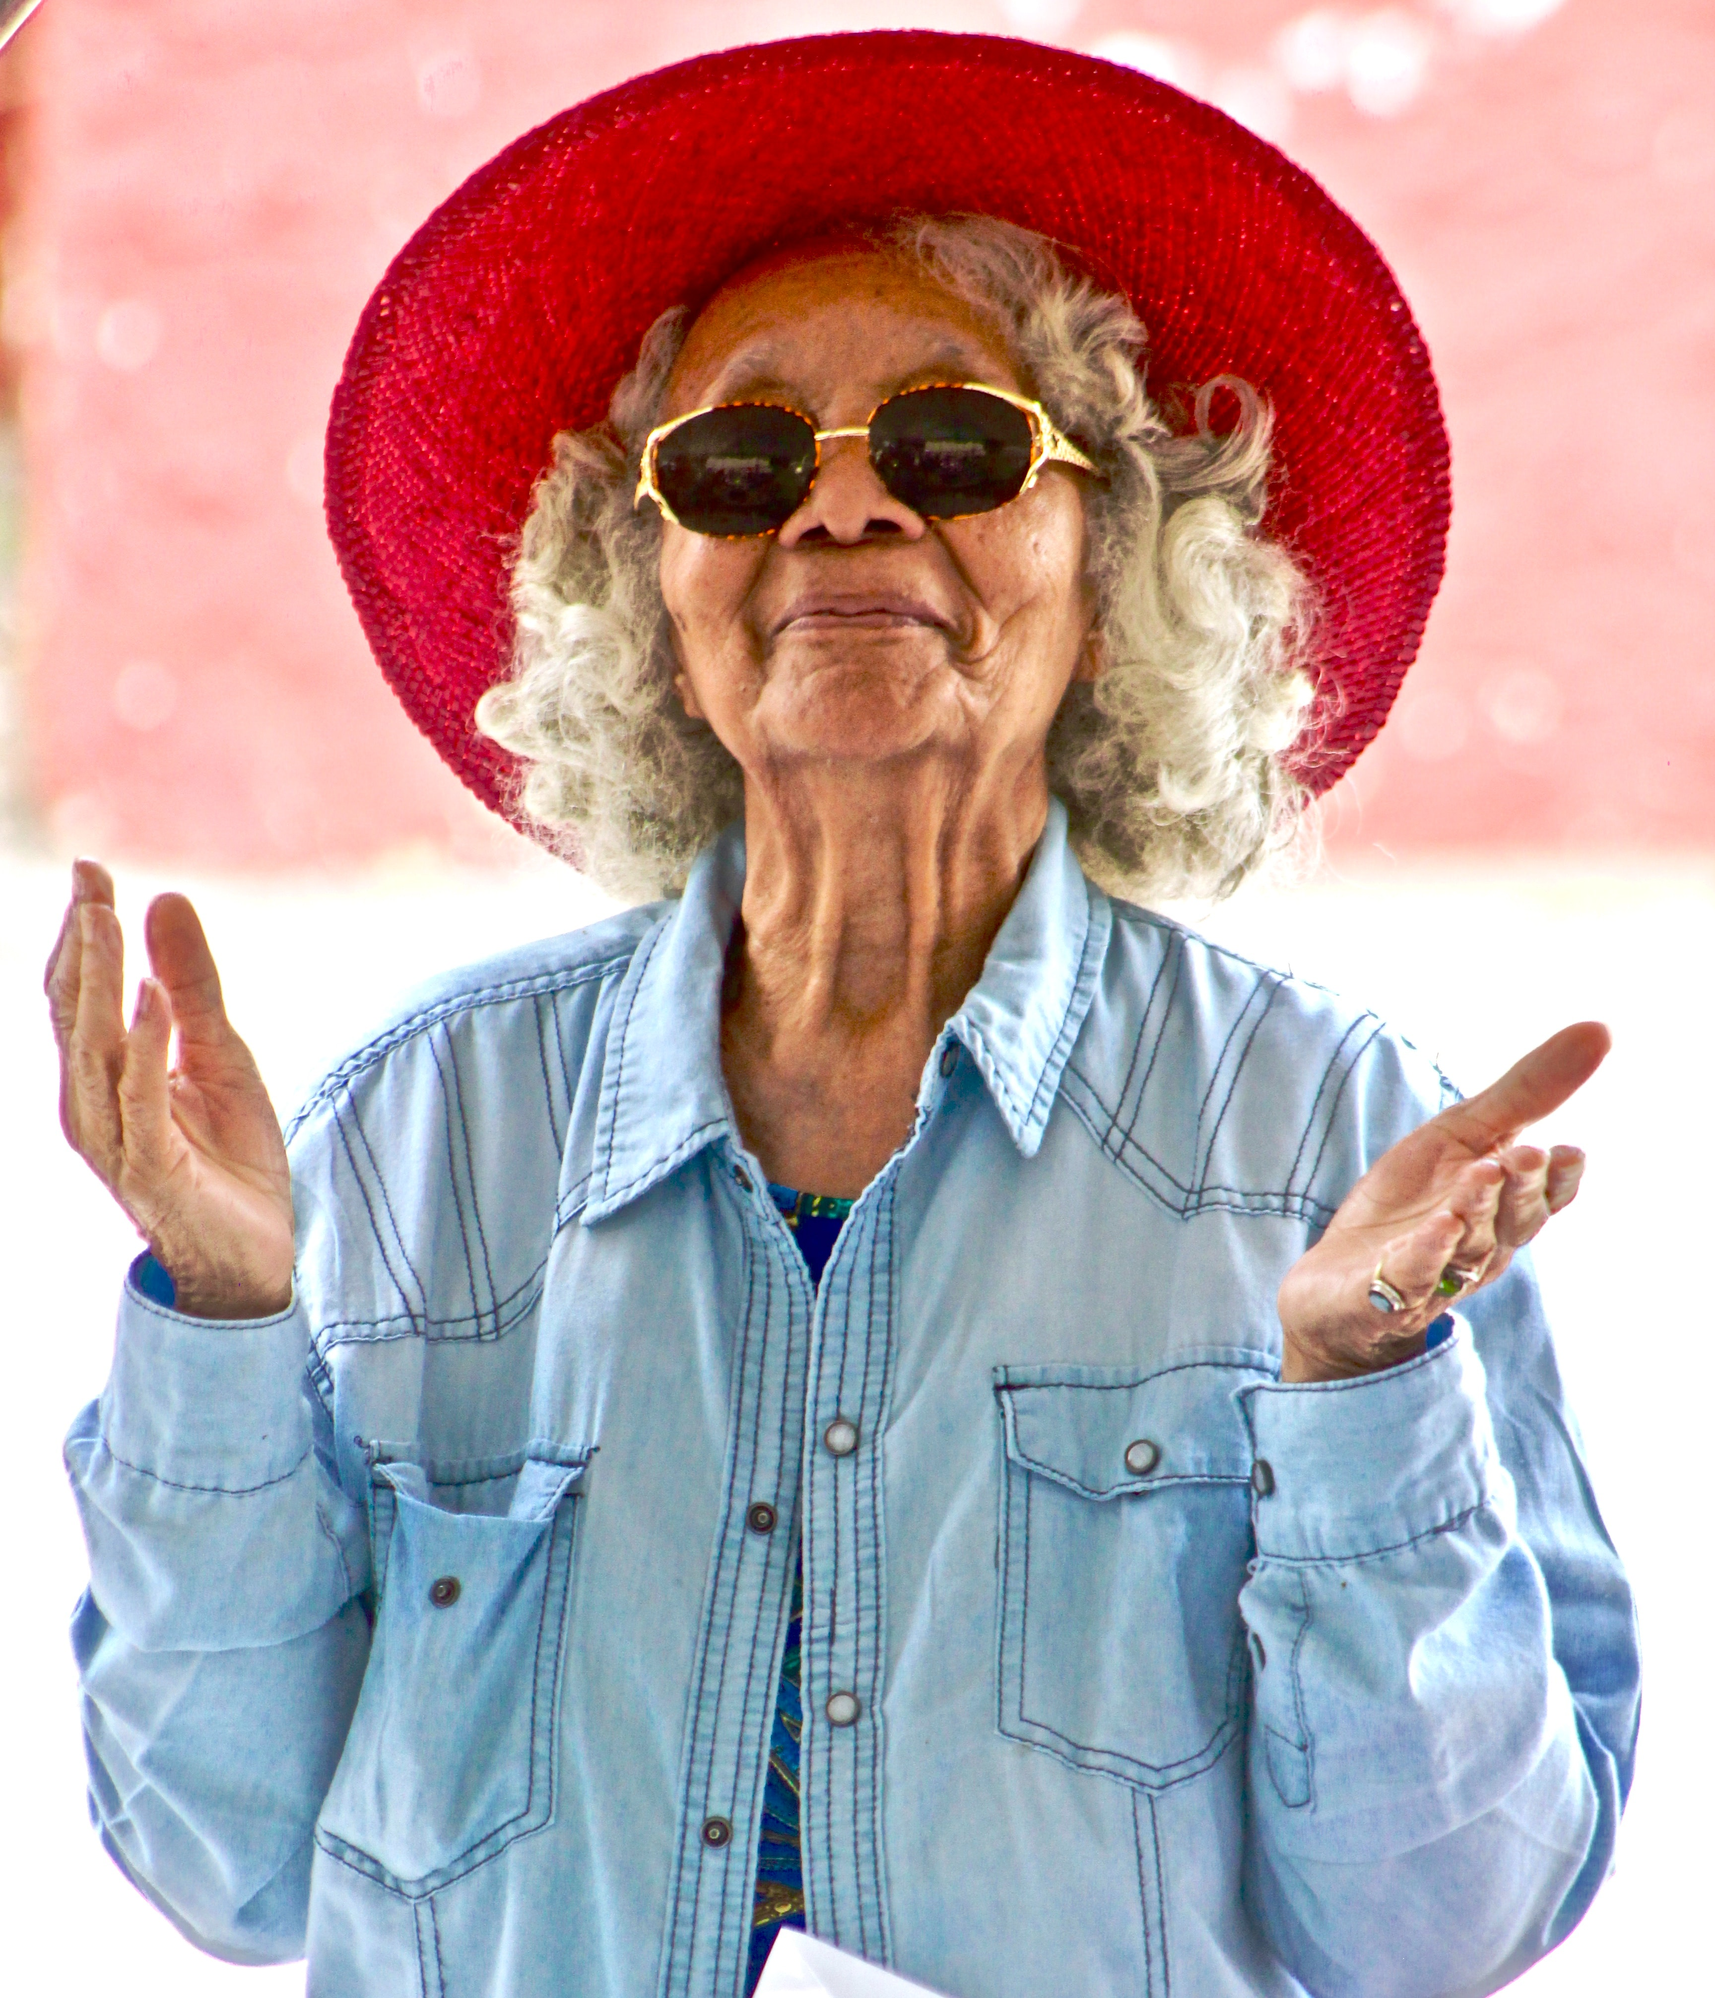
“Being vibrant often means being vibrantly yourself."
Sarah Rose Cavanagh,
The Spark of Learning, page 8
Notes:
Vibrant emotions are great – but you can’t step into an identity that isn’t authentic.
If you’re a quiet introvert who feels most comfortable teaching with Power Points because it gives students something to look at instead of looking at you?
You’re not going to magically turn into a captivating discussion leader that moves around the classroom energetically … not overnight, and probably not ever.
There is no single way to be vibrant in a classroom. The vibrancy comes when you are truly authentic and truly present.
Photo by Nashua Volquez-Young from Pexels

Slide 27

Notes:
COVID has made us all hyper-aware of how pathogens spread through the air. We emphasized wearing masks as a way to prevent the spread.
It’s not just germs and viruses that spread between us, though.
One of the most fascinating veins of research is around emotional contagion – the way we ‘catch’ emotions from one another.
This is absolutely key:
When we bring fear, imposter syndrome, inauthenticity, or other anti-social emotions into our classrooms,
When we allow our internal struggles and dialogues to persist,
When we are unhappy or unmotivated or frustrated or burned out,
We infect our students with our negative emotions.
We shut down positive emotional states.
We infect the classroom.
And we often cannot turn it around.
Think about a time when you had a checked-out student in your class. Or a student who was angry they had to take your class at all.
How did that impact others?
Photo by Karolina Grabowska from Pexels

Slide 28
Notes:
You cannot NOT communicate.
When you’re near someone who is angry or sad or disengaged, you know it.
When you’re around someone who is happy, excited, or curious, you know it.
We simply MUST figure out how to be engaged and excited and curious in our classrooms if we want our students to be, too.
Photo by Andrea Piacquadio from Pexels

Slide 29
So… how do we do this?

Slide 30

A few possible tools
Mindfulness
Enneagram
Playing Big
Anti-racism
Notes:
Photo by Ivan Samkov from Pexels

Slide 31

Notes:
If you don’t have a regular meditation practice, you might imagine that meditation looks something a little like …
(click)
This.

Slide 32

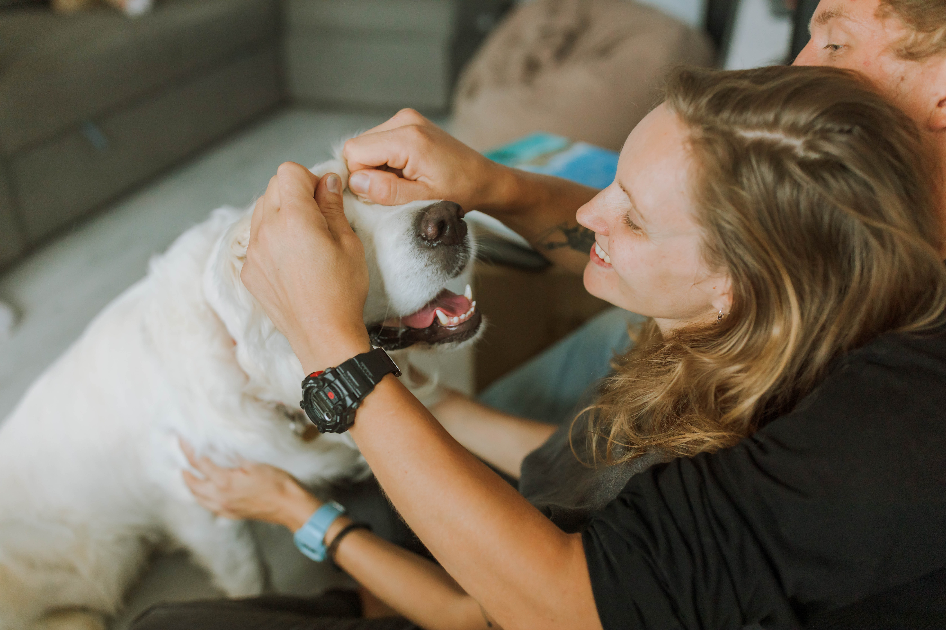
Notes:
But the truth is, meditation practice often looks more like this.
Left photo by Enrique Hoyos from Pexels
Right photo by Anastasia Shuraeva from Pexels

Slide 33
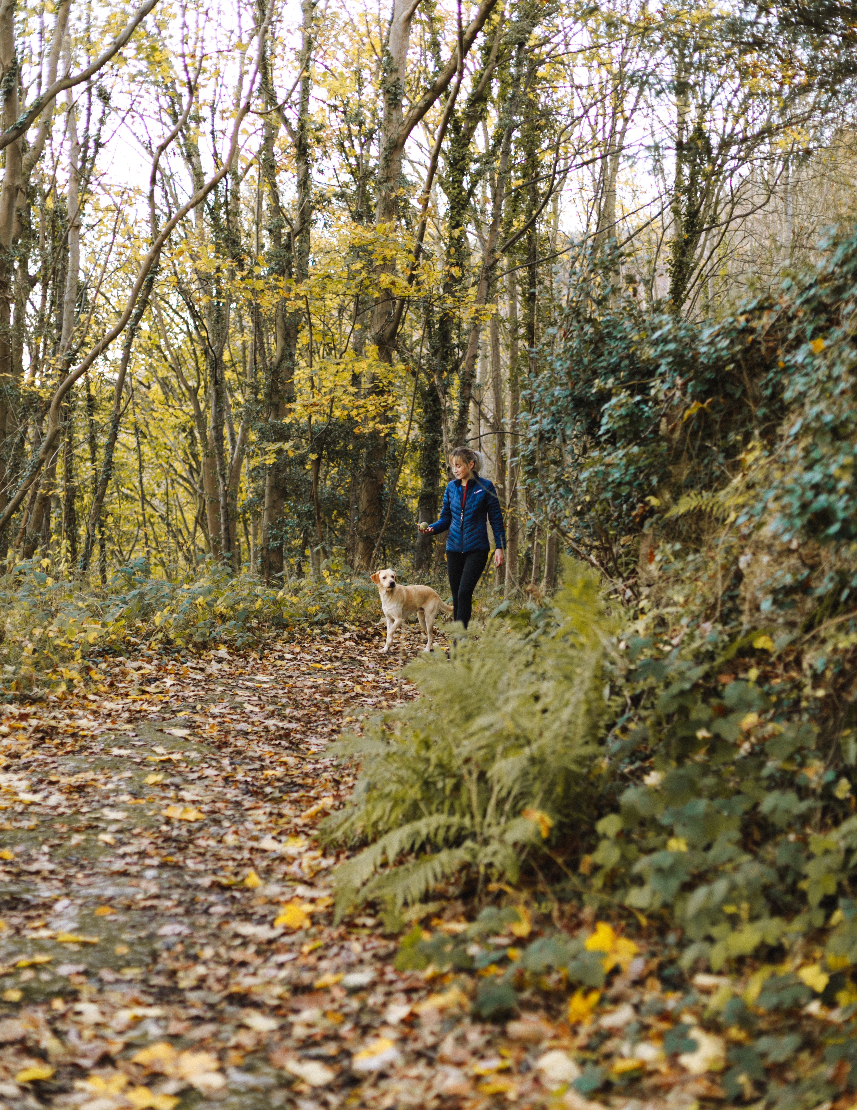

Notes:
Or like this
Photo by Humphrey Muleba from Pexels (on left)
Photo by Andrea Piacquadio from Pexels (on right)

Slide 34

Notes:
Meditation can happen anywhere, so long as you can try to clear your mind and find some inner quiet.
The goal of meditation is not to STOP THINKING – our brains won’t allow it.
It’s to be aware of your thinking, to observe your thinking, and gently trying to center your focus (over and over again, because the brain will not stop drifting) on something still.
Photo by Ketut Subiyanto from Pexels

Slide 35
(Directed to yourself)
May I be happy.
May I be well.
May I be safe.
May I be peaceful and at ease.
(Directed to others)
May you be happy.
May you be well.
May you be safe.
May you be peaceful and at ease.
Metta Meditation
also known as ‘loving-kindness’ meditation
Notes:
Metta means positive energy and kindness to others. It’s a type of meditation that is less about trying to still your thoughts and more about directing intentional thought to yourself and others. In many ways, it is not all that different from religious practices of prayer. In a metta meditation, though, you’re trying to focus your thoughts and energies inward, to embody love and positive thought.
Metta begins with directing this to ourselves – to embrace who we are, IN THIS MOMENT, without feeling like we need to change ourselves in any way.
Meditation helps us embrace the present, as it is the only thing we can truly know.
Let’s try one together. (click)

Slide 36
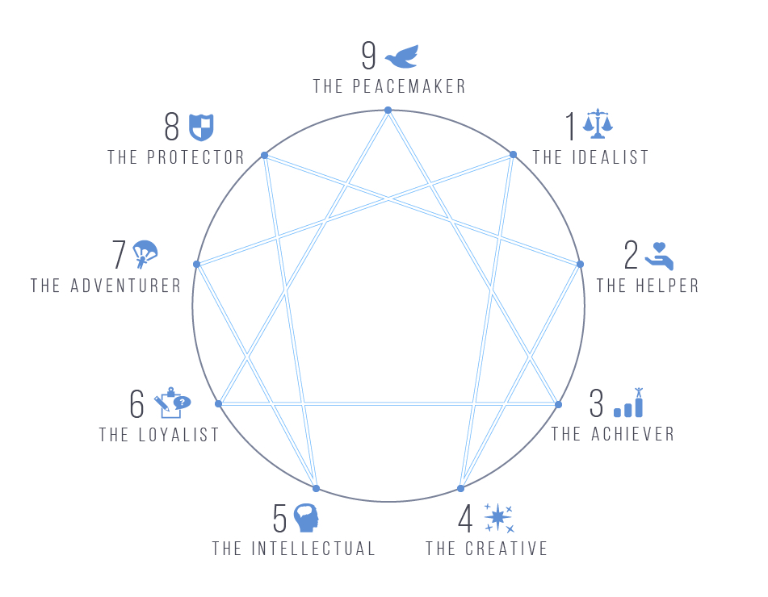
Notes:
The Enneagram is an increasingly popular tool for developing greater self-awareness.
While the scientific evidence behind different “personality tests” is sometimes debatable, as tools, these frameworks are useful to the extent that they help us come to greater self-understanding. What I love about the Enneagram is that it helps me see patterns of actions in myself, and over time, that awareness allows me to catch myself in one of those patterns and decide whether I want to persist in it.

Slide 37
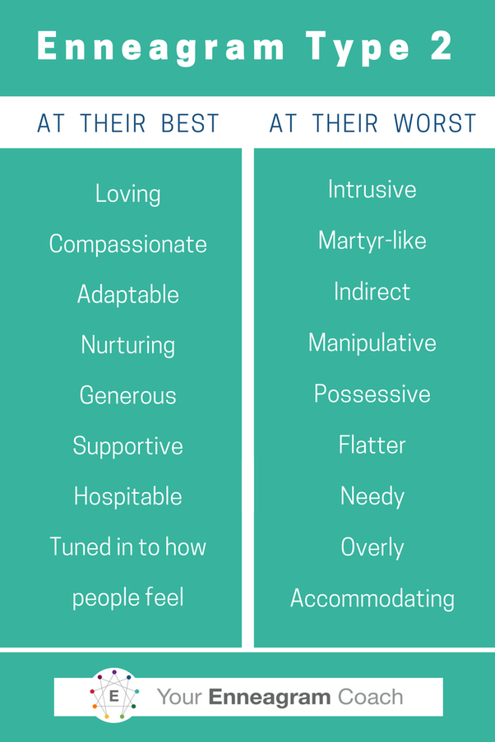
Liz Norell
Enneagram 2
Notes:
Here’s a concrete example: My dominant Enneagram type is 2.
The 2 is the “helper,” a person motivated to find love and purpose by helping others.
(Totally weird that I’d become an educator, right?)
(click)
2s are intuitive, generous, and nurturing – all things I definitely identify with.
They’re also so desperate to be loved that they can be possessive – so when two of my friends get together without me? I feel threatened.
They will hustle so hard to be THE PERSON who fixes everything because they worry nobody will love them anymore if they stop helping.
(These are tough things for me to admit, but I’ve done the work to understand this is what motivates me.)
2s lose themselves in the helping and forget to take care of themselves.
Knowing this about myself helps me in my teaching. When a student comes to me with an issue, it would be easy for me to try to solve all their problems – and sometimes, I do!
But I need to be sure that I’m doing this for the right reasons, and not just because I have this deep-seeded need to be seen as THE MOST HELPFUL PERSON IN HISTORY.
We’re going to do a really quick exercise to help you get a first hypothesis on what Enneagram type you might be. I caution you to hold this lightly, as it can take some time to find your place on the Enneagram. And, it’s really important to know / keep in mind that every one of us has all nine of these energies in us. One is your more dominant one, and it’s the one that comes out when you’re under stress or feel uncertain.

Slide 38
A
B
C
I have tended to be fairly independent and assertive; I’ve felt that life works best when you meet it head-on. I set my own goals, get involved, and want to make things happen. I don’t like sitting around—I want to achieve something big and have an impact. I don’t necessarily seek confrontations, but I don’t let people push me around, either. Most of the time I know what I want, and I go for it. I tend to work hard and play hard.
I have tended to be quiet and am used to being on my own. I don’t usually draw much attention to myself socially, and it’s generally unusual for me to assert myself all that forcefully. I don’t feel comfortable taking the lead or being as competitive as others. Many would probably say that I’m something of a dreamer—a lot of my excitement goes on in my imagination. I can be quite content without feeling I have to be active all the time.
I have tended to be extremely responsible and dedicated. I feel terrible if I don’t keep my commitments and do what’s expected of me. I want people to know that I’m there for them and that I’ll do what I believe is best for them. I’ve often made great personal sacrifices for the sake of others, whether they know it or not. I often don’t take adequate care of myself—I do the work that needs to be done and relax (and do what I really want) if there’s time left.
Notes:
Take a moment to read over these three descriptions. Choose the one that sounds MOST like you.
Remember: You’ll see pieces of yourself in each of these, probably, but find the one that is most closely associated with you.
Write down that letter.

Slide 39
X
Y
Z
I am a person who usually maintains a positive outlook and feels that things will work out for the best. I can usually find something to be enthusiastic about and different ways to occupy my time. I like being around people and helping others to be happy—I enjoy sharing my own well-being with them. (I don’t always feel great, but I try not to show it to anyone!) However, staying positive has sometimes meant that I’ve put off dealing with my own problems for too long.
I am a person who has strong feelings about things—most people can tell when I’m unhappy about something. I can be guarded with people, but I’m more sensitive than I let on. I want to know where I stand with others and who and what I can count on—it’s pretty clear to most people where they stand with me. When I’m upset about something, I want others to respond and to get as worked up as I am. I know the rules, but I don’t want people telling me what to do. I want to decide myself.
I tend to be self-controlled and logical—I am uncomfortable dealing with feelings. I am efficient—even perfectionistic—and prefer working on my own. When there are problems or personal conflicts, I try not to bring my feelings into the situation. Some say I’m too cool and detached, but I don’t want my emotional reactions to distract me from what’s really important to me. I usually don’t show my reactions when others “get to me.”
Notes:
Do the same here –
Read over these three descriptions. Choose the one that sounds MOST like you.
More than one may feel resonant, but choose the one that feels closest to your way of being.
Write down that letter.

Slide 40
AX = 7 The Enthusiast Upbeat, accomplished, impulsive | AY = 8 The Challenger Self-confident, decisive, domineering | AZ = 3 The Achiever Adaptable, ambitious, image-conscious
BX = 9 The Peacemaker Receptive, reassuring, complacent | BY = 4 The Individualist Intuitive, aesthetic, self-absorbed | BZ = 5 The Investigator Perceptive, innovative, detached
CX = 2 The Helper Caring, generous, possessive | CY = 6 The Loyalist Engaging, responsible, defensive | CZ = 1 The Reformer Rational, principled, self-controlled
Notes:
Put those two letters together and find your cell here.
A’s are in the first row,
B’s in the second,
C’s in the third.
Incidentally, I’ve provided a couple of handouts on the Enneagram to get you started. Be sure you check those out. They’ll have resources on digging deeper and figuring out how this might help you in your teaching.

Slide 41

Notes:
There are terrific resources online to dig deeper. I am particularly fond of The Enneagram Institute’s site, which has in-depth descriptions of each type:
https://www.enneagraminstitute.com/type-descriptions

Slide 42
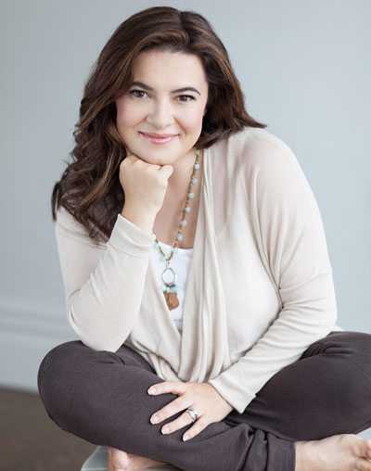
Playing Big
Tara Mohr
Notes:
Author and coach Tara Mohr designed the Playing Big model to help women play bigger in their lives -- and to do so on their own terms.
While the tools of Playing Big are geared toward women, men definitely benefit from hearing what women can do to become more present and authentic. AND, I believe the pervasively toxic culture of higher education creates conditions in which men can benefit from some acquaintance with these tools.

Slide 43


Notes:
Playing Big tool: inner critic
(click)
Self-doubt and self-criticism are hallmarks of the imposter syndrome that plagues so many of us. They spring from an “inner critic” that, for many, sounds like a loop of negative thoughts in our minds. What I especially appreciate about Mohr’s framework is the emphasis on the inner critic as a tender place of vulnerability and fear within us all. Ultimately, the inner critic’s job is to keep us from failing, from hurting, from suffering. If we don’t take risks, we lose nothing—right? The compassionate response to the inner critic is to acknowledge the fear with which it’s leading; for example, you might say, “I appreciate your concern, but I’m strong enough to handle disappointment.”
The inner mentor,
(click)
by contrast, is the quieter part of us, the part that knows what we want to do, but is so often drowned out by the shouting voice of the inner critic. Mohr provides a free guided inner mentor meditation that has been transformational for me. Others may call this kind of meditation the “future self” exercise. The activity involves first relaxing fully, then envisioning a visit to yourself 20 years into the future. When I’ve imagined that conversation unfolding, I have always felt a palpable sense of calm. If that seems implausible, imagine yourself, today, zooming back 20 years and giving your past self some broad advice about what to prioritize and what to let go. Powerful, isn’t it?
Photo by Andrea Piacquadio from Pexels (left)
Photo by Monstera from Pexels (right)

Slide 44

Notes:
Another Playing Big tool: HIDING.
There are LOTS of ways we hide from our core desires. The one that immediately resonated for me was what she calls “this-before-that” thinking. As the name implies, when we engage in this kind of thinking, we imagine that there is some accomplishment or milestone we much reach before we can strive for the really big goal. Examples of how I’ve engaged in this-before-that hiding are: “Once I get my Ph.D., then I can start researching this other question that’s tugging at my curiosity.” or “After I’ve been teaching for X years, then I’ll have the credibility to write a teaching book.” or “I will wait until I’ve got tenure to try to change the culture at my college.” Each of these puts off the work that my heart desperately wants to do, because that work requires a pretty significant intellectual, career, or emotional risk. What if I fail?
Another? Tara calls it “ever-more education.” Maybe I just need to get this one other degree, you might say. Oh, I saw a really interesting certificate program on Facebook the other day—maybe I should do that? I can’t tell you how many graduate certificates and second doctorates I’ve considered; I can tell you that I’ve probably weighed obtaining every social science or education-adjacent master’s degree that exists. This is another way to delay the bigger actions we yearn to take but resist out of fear.
Consider this alternative: Maybe you already know enough. Maybe your unique experiences and perspective are enough to get started. Maybe you don’t need to accomplish something else or obtain more education before you try.
Photo by Craig Adderley from Pexels

Slide 45

Notes:
One more Playing Big tool: LEAPING!
Leaping requires us to take a small but meaningful step—a leap!—toward our ultimate goals.
What does your heart yearn for?
What would you do if you weren’t afraid of failing?
Photo by Mary Taylor from Pexels

Slide 46
The defining characteristics of a leap are that it:
Connects to something around which you want to play bigger.
Will allow you to gather more information on an unknown part of that thing.
Can be described with a short phrase.
Could be finished within 1-2 weeks.
Makes you feel the kind of fluttery, because-I-am-so-excited fear (and not the heavy-sense-of-doom kind of fear that paralyzes).
Puts you and your work in front of your intended audience.
Notes:
Here’s how you know something is a “leap”:

Slide 47

Notes:
We’ve talked about meditation, the Enneagram, and Playing Big.
Now I want to talk about anti-racism work.
But first, I want to acknowledge that I am a White woman who has lived a fairly comfortable life … one filled with privileges I have largely taken for granted … and largely not been able to see. I’m not an expert on racial justice, anti-racism, or social justice. What I’m going to share how this kind of study and action has helped me know myself better … then bring that greater self-knowledge into the classroom. I’m deeply uncomfortable with the suggestion that I have unique insights. My own advocacy for this work has sprung from participation in a number of reading groups and communities of practice. I’ve read, listened to the wisdom and experience of others, and tried to approach this with the most open mind and open heart I can.
Photo by Life Matters from Pexels

Slide 48
“We cannot have conversations about racism without talking about Whiteness.”
“White folx cannot be coconspirators until they deal with the emotionality of being White.”
Bettina Love, We Want To Do More Than Survive, p. 118, 144
Notes:
The fact is, we have for TOO LONG outsourced the difficult conversations about race to the very people who are traumatized by racism – in America, and elsewhere.
Even though it is uncomfortable for me to do so, even though I won’t always get it “right,” it is my responsibility as a White woman to use my privilege to insist upon these conversations.
(click) Dr. Bettina Love tells us that these conversations will not help us if we do not talk about Whiteness.
(click) and as a White woman, I cannot fully work to empower and liberate my students of color if I haven’t dealt with my own Whiteness first. (click)
I’m going to share several book titles that have impacted how I think about race. I encourage you to seek out these authors and their work, including their social media, videos, TED talks, and more. They are inspiring Black voices that have helped me understand what my role in creating a more just classroom space that creates opportunities for all of my students to succeed.

Slide 49
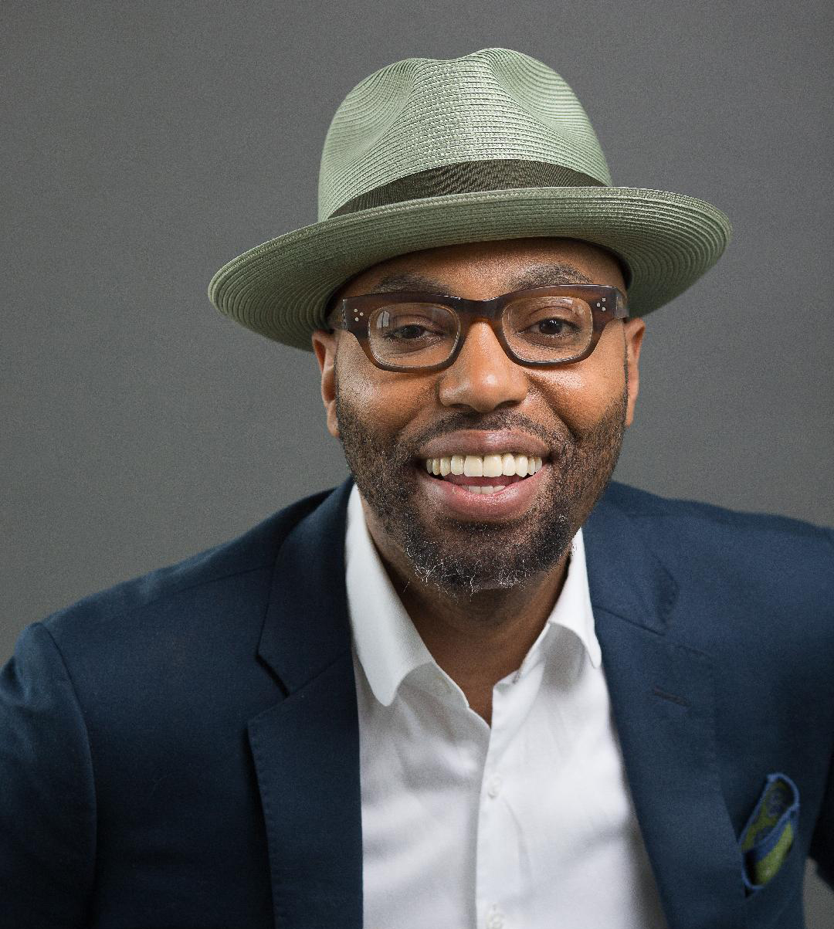
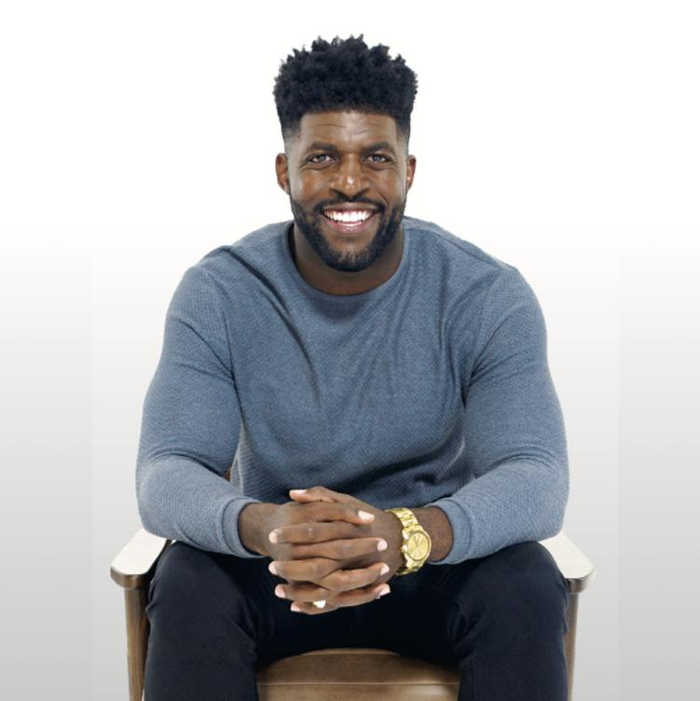
Notes:
Dr. Chris Emdin, For White Folks Who Teach in the Hood … and the Rest of Y’all Too: Reality Pedagogy and Urban Education: I love the way he talks about getting to know his students on THEIR terms, and how that can shift an entire classroom’s culture.
Dr. Bettina Love, We Want To Do More Than Survive: Abolitionist Teaching and the Pursuit of Educational Freedom: I adore Dr. Love’s language around becoming a coconspirator. She also has incredibly powerful data on the systemic roots of racism that continue to impact our students of color.
Emmanuel Acho, Uncomfortable Conversations With a Black Man: With humor and grace, Acho invites discomfort in and offers it a cold beverage. His stories are accessible and relatable.

Slide 50

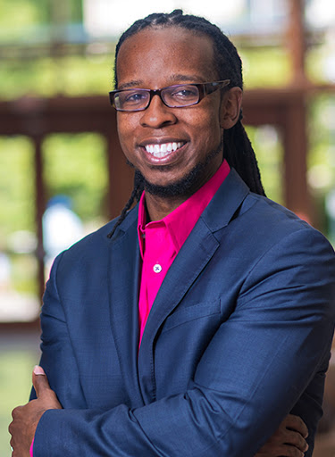
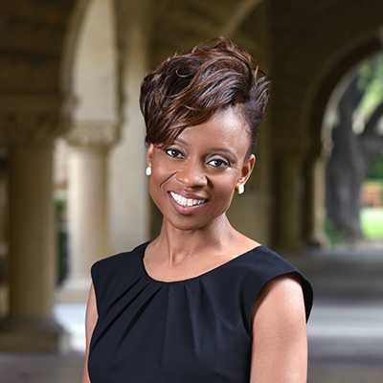
Notes:
Dr. Beverly Daniel Tatum, Why Are All the Black Kids Sitting Together in the Cafeteria? And Other Conversations About Race: One of my favorite moments of this book was Dr. Tatum’s simple but powerful observation around identity – namely, that majority populations don’t see their majority characteristics, like race, as part of their identity. When pressed, White students often just say, “I’m … normal?”
Dr. Ibram X. Kendi, Stamped: Racism, Antiracism, and You: I loved the YA version of this book because it was easy to digest and understand. Think of it as a gateway drug (but of the best kind) to his comprehensive history of racism.
Dr. Jennifer Eberhardt, Biased: Uncovering the Hidden Prejudice that Shapes What We See, Think, and Do: I will never forget a scene from this book when Dr. Eberhardt was pulled over on her way to an important graduate school moment because she had an expired tag. She spent a night in jail… until her advisor showed up and they suddenly treated her entirely differently.

Slide 51
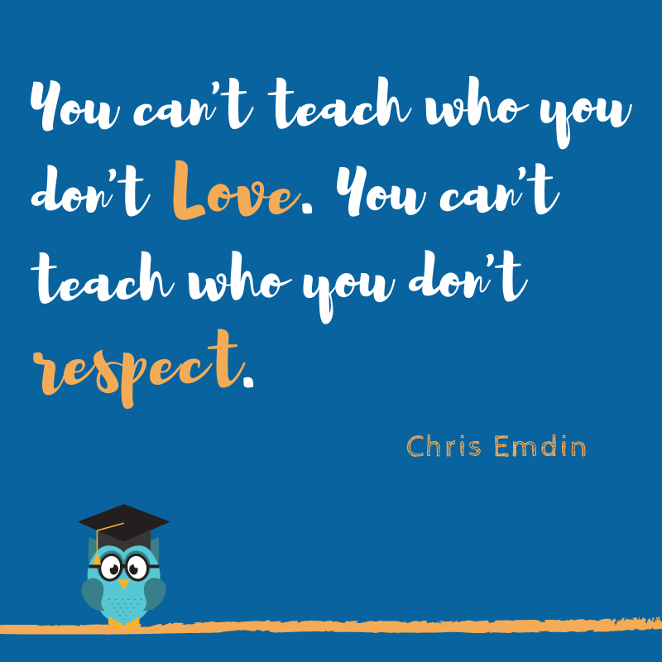
Notes:
This quote from Chris Emdin is one of my favorites. He says, “You can’t …”

Slide 52




Student anxiety
Greater learning
Positive emotions
Community & care
Notes:
When we can put these tools into practice – find our own authentic voices, bring them into the classroom, reduce the variation in our presentation of self, all in service of being PRESENT for our students – a few things start to happen:

Slide 53

How can you use these tools in your own life and teaching?
Notes:
I invite you to take a moment to think about how you might implement some of this in your own work – your teaching, your self-exploration, your mindset.
You might even pause this video while you jot down a few ideas.
Photo by Andrea Piacquadio from Pexels

Slide 54

Thank you!
Dr. Liz Norell
elizabeth.norell@ chattanoogastate.edu
@liznorell
Notes:
I so appreciate your time and engagement with these important – and challenging! – issues. I hope you’ve found much in this presentation to stir your thoughts.
I’d love to hear your thoughts! Please feel free to email me anytime with your feedback or questions. And if you want to nerd out with the Enneagram, or really any of the tools I’ve shared here, I welcome nerdy conversations anytime! You can also find me on twitter at liznorell.
One final word: I’m working on a book proposal that goes even deeper on these topics. If this work resonated with you, I hope you’ll stay connected for news about where that book lands.

