Slide 1
A quick primer on North korea
POLS 2050 – Comparative World Politics

Slide 2
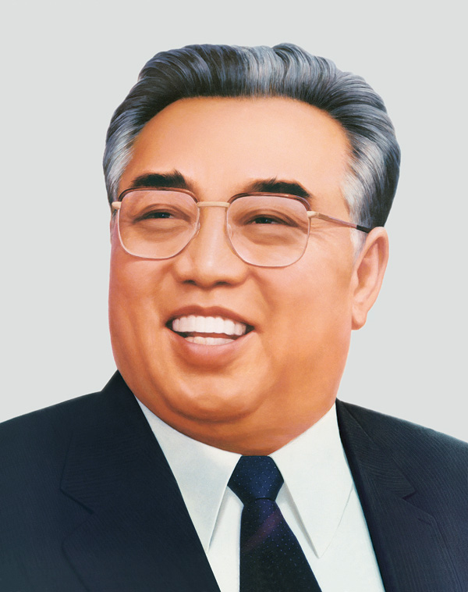
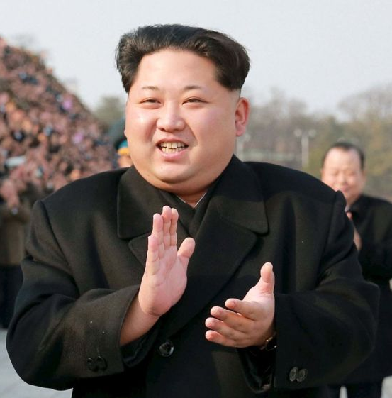
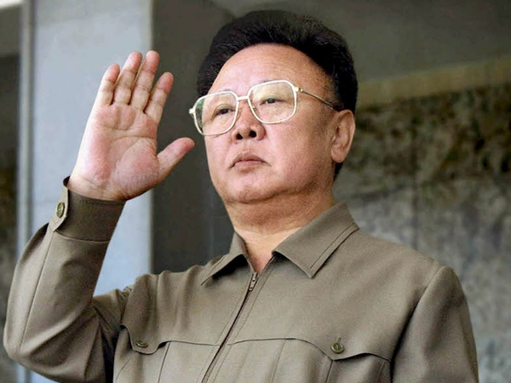
Kim Jong-il
Dear Leader
Kim Il-sung
Great Leader
Sun of the Nation
Eternal President
Kim Jong-un
Supreme Leader

Slide 3
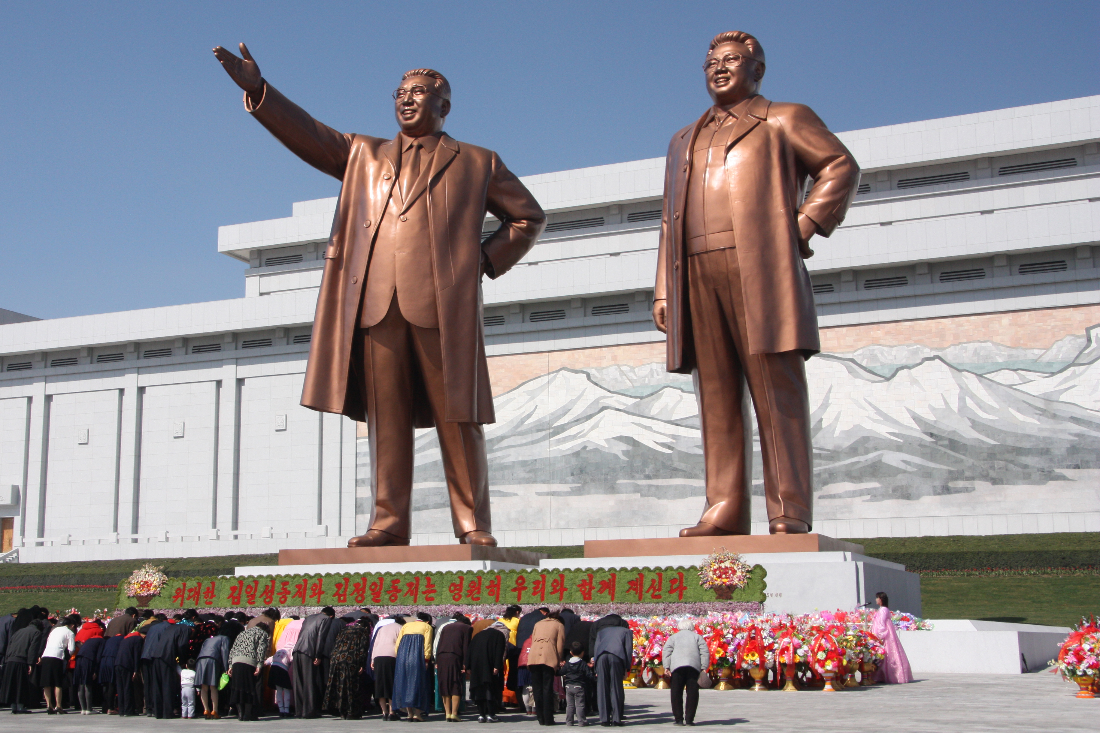

Slide 4
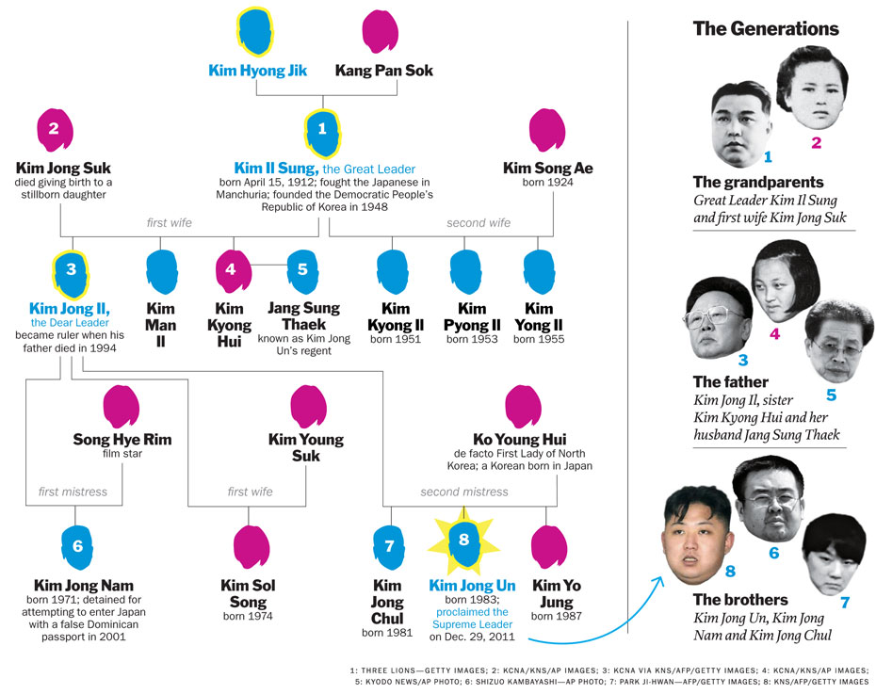
4) Kim Kyong Hui became first female four-star general
7) Kim Jong-chul was allegedly not considered to succeed his father because of his “unmasculine” characteristics
6) Kim Jong Nam tried to go to Tokyo Disneyland in 2001 and fell out of favor

Slide 5
Fights over North Korea
Japan occupied the entire Korean peninsula before and during World War II
After the war, the USSR took control of the north; the US took control of the south (38th parallel)
1948: The Democratic People’s Republic of Korea was established (DPRK), with Soviet backing
1950: South Korea declares independence. North Korea invades to reunite peninsula.
  The United States joined the war to defend the South, pushing the troops back into the northernmost reaches of the country.
  This alarmed China, who joined forces with North Korea to push the South and its allies back to the 38th parallel.
  An armistice ended the war in 1953.

Slide 6
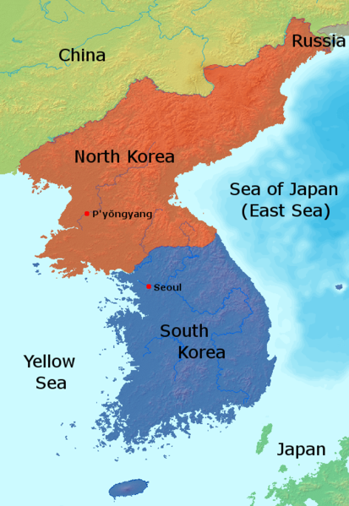

Slide 7
Nuclear weapons?
In 1985, North Korea joined the international Nuclear Non-Proliferation Treaty, agreeing not to produce nuclear weapons. One year later, the Yongbyon nuclear reactor became operational.
By 1993, the International Atomic Energy Agency (IAEA) accused the North of violating the Non-Proliferation Treaty. When the IAEA demanded the right to inspect, NK threatened to quit the treaty.
In 1994, after the death of Kim Il-sung, NK & USA sign an Agreed Framework. NK agreed to freeze its nuclear program in return for heavy fuel oil and two nuclear reactors for power generation.
  North Korea violated this agreement almost immediately.

Slide 8
Who wants what?
USSR / Soviet Union: The Soviets installed Kim Il-sung, an ethnic Korean who spent many years in Russia, hoping he would rule the country in the Stalinist model. However, Kim Il-sung almost immediately took things much, much farther.
China: China sees the North Korean regime as an important buffer between democratic South Korea and its communist government. Consequently, it will endure a lot of nonsense from North Korea as long as the regime remains stable.
South Korea: Fifty years ago, South Koreans dreamed of reunification. Today’s average South Korean is in favor of reunification in theory, but such a move would likely tank the South Korean economy and lead to a great deal of unrest.

Slide 9
Who wants what? (cont’d)
The United States: Above all else, the US opposes a nuclear North Korea. Unfortunately, that ship has sailed. At this point, the US wants to contain NK’s further development of nuclear weapons and to prevent NK from selling its nuclear technology to rogue actors or nations.
Japan: Like other neighbors, Japan just doesn’t want North Korea to become unstable or to develop nuclear weapons.
North Korea: The leaders of North Korea recognize they are in a vulnerable position. Any instability would likely result in a loss of their power, and likely also their lives. They need to maintain nuclear technology as (essentially) blackmail… to ensure they can engage in brinksmanship to extract food and fuel aid. And also not get killed.

Slide 10
Other issues
Total lack of internet / news / connection to the outside (world for citizens)
Exceedingly well-developed surveillance system, including close-knit neighborhood monitors who check your house nightly
Human rights violations—specifically, extremely hard, government-mandated work, almost no money, rarely any meat, diminishing rations of rice, and grossly outrageous income inequality
Lack of personal, intellectual, or physical freedom
Ancient technology and few modern medical services. For example, the entire country has one mammogram machine that rarely, if ever, gets used. When asked, North Koreans claim they don’t get cancer.
Malnourishment on such a broad scale that northerners are substantially shorter than their southern neighbors… in just a few generations.

Slide 11
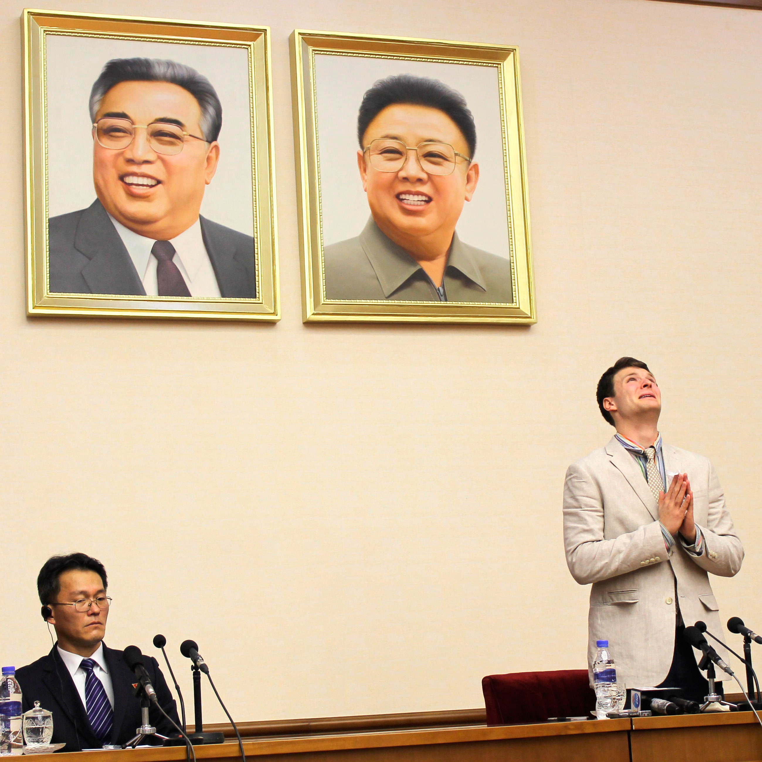
Otto Warmbier 1994-2017

Slide 12
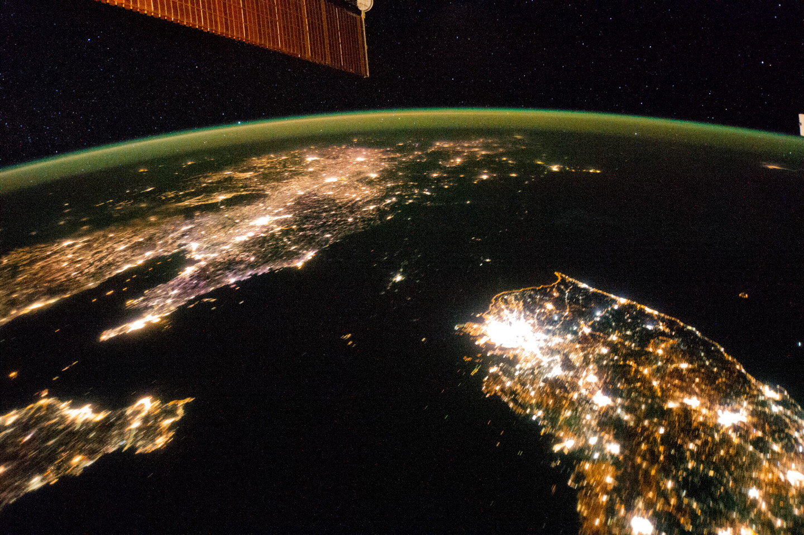

Slide 13
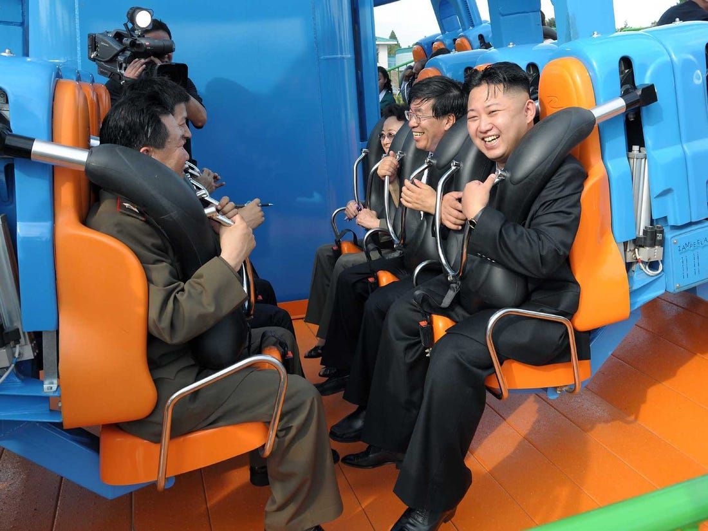

Slide 14
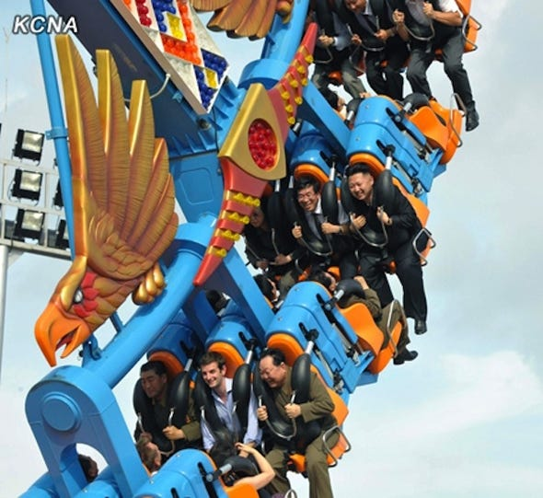

Slide 15
Juche – ten principles
We must give our all in the struggle to unify the entire society with the revolutionary ideology of the Great Leader Kim Il-sung.
We must honor the Great Leader comrade Kim Il-sung with all our loyalty.
We must make absolute the authority of the Great Leader comrade Kim Il-sung.
We must make the Great Leader comrade Kim Il-sung's revolutionary ideology our faith and make his instructions our creed.
We must adhere strictly to the principle of unconditional obedience in carrying out the Great Leader comrade Kim Il-sung's instructions.
We must strengthen the entire party's ideology and willpower and revolutionary unity, centering on the Great Leader comrade Kim Il-sung.
We must learn from the Great Leader comrade Kim Il-sung and adopt the communist look, revolutionary work methods and people-oriented work style.
We must value the political life we were given by the Great Leader comrade Kim Il-sung, and loyally repay his great political trust and thoughtfulness with heightened political awareness and skill.
We must establish strong organizational regulations so that the entire party, nation and military move as one under the one and only leadership of the Great Leader comrade Kim Il-sung.
We must pass down the great achievement of the revolution by the Great Leader comrade Kim Il-sung from generation to generation, inheriting and completing it to the end.

Slide 16
Madeleine Albright discusses visit
http://www.cc.com/video-clips/uyohb5/the-daily-show-with-jon-stewart-madeleine-albright-pt--2

