Slide 1
How to keep your sanity during …. interesting political times
Dr. Liz Norell
November 2021
Notes:
Overview of talk & its goal
Who I am, what I do, and why

Slide 2
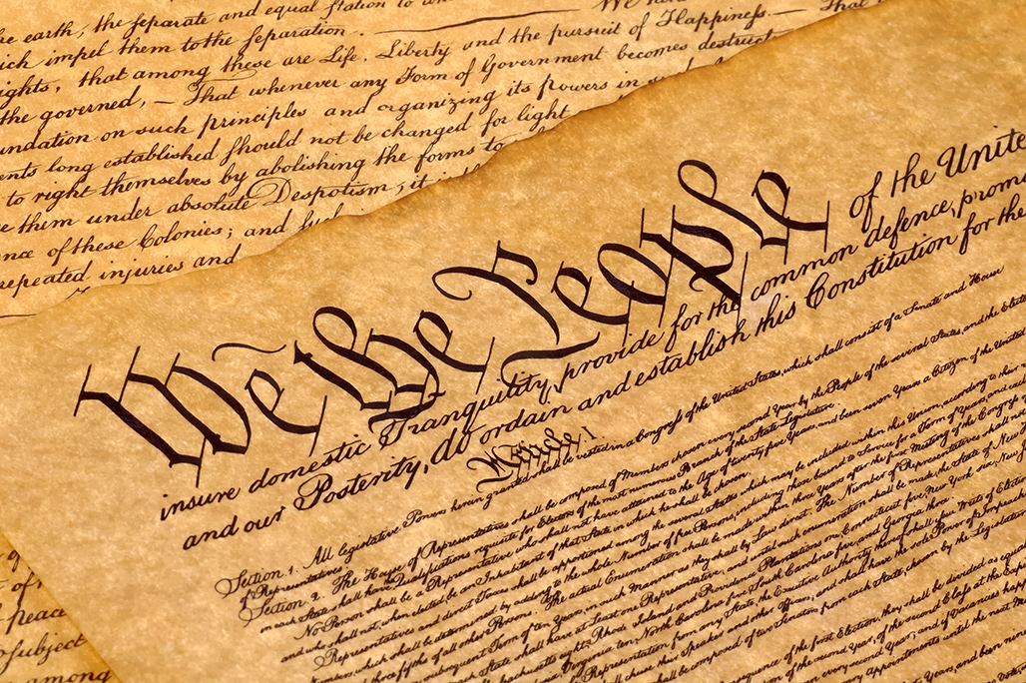
Notes:
Preamble..

Slide 3
We the People of the United States, in Order to form a more perfect Union, establish Justice, insure domestic Tranquility, provide for the common defence, promote the general Welfare, and secure the Blessings of Liberty to ourselves and our Posterity, do ordain and establish this Constitution for the United States of America.
Notes:
But what do these words mean? What do they mean to you?
(chat)
Now, I want you to really settle in. Let's breathe a little.
Feeling calm?
Good.
Take a look at this next slide and pay close attention to the thoughts and feelings that arise.

Slide 4
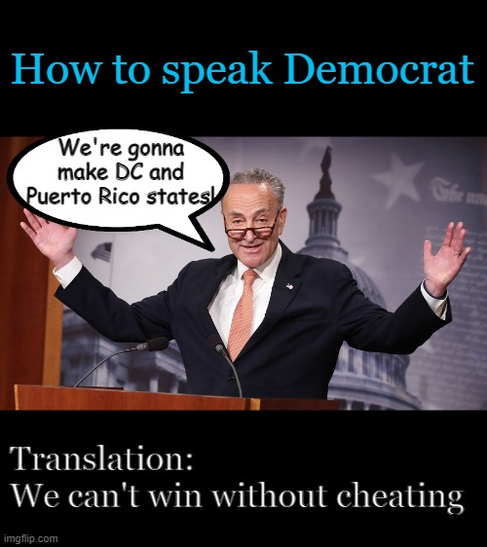
Notes:
Notice how this meme makes you feel. What emotions can you detect right now? Quickly!

Slide 5
Notes:
How about another?
What emotions arise when you see this one?

Slide 6
Notes:
To talk about what’s happening here, we need to talk about some biology and psychology ---- all about stress.
Lots of causes of stress, e.g. exam, divorce, death of loved one, moving house, loss of job.

Slide 7
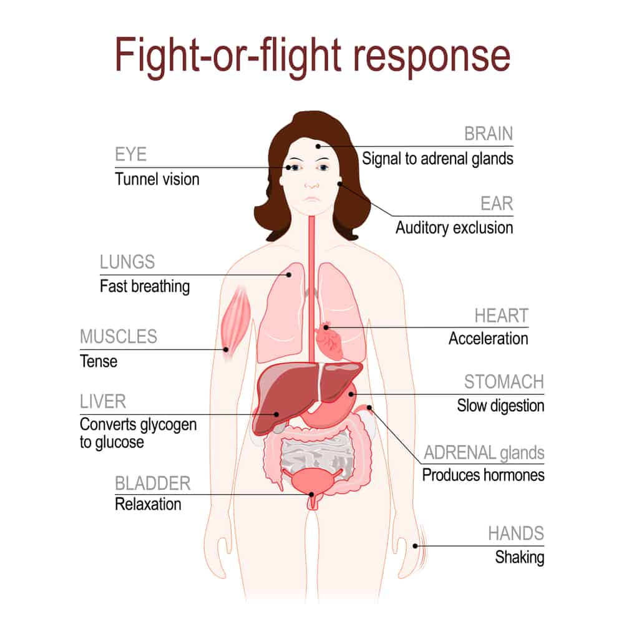
Notes:
Sudden and severe stress generally produces – via the sympathetic nervous system – a series of chemical changes in the body. This begins with the release of adrenaline and cortisol into the bloodstream.
Increase in heart rate
Faster (and shallower) breathing
Tunnel vision – we lose track of things happening outside of this moment / event
Sweating / balmy hands
Decrease in digestive activity (don’t feel hungry)
Liver releases glucose for energy
ALL OF THESE THINGS HAPPEN WHEN WE ENCOUNTER CHALLENGES TO OUR CORE BELIEFS.

Slide 8
Notes:
Exposing yourself to information that agrees with your beliefs makes you MORE sure you’re right.
But what about information that contradicts your beliefs?

Slide 9
Notes:
That’s right. As long as we consume information and allow those emotions to play out unexamined, we’re basically ALWAYS going to be even more sure that we were right all along. The alternative is too uncomfortable to contemplate.
So what do we do? That’s why we’re here today – and I now present to you: five things you can do to preserve your sanity AND avoid the Bad Place (of political reactions).

Slide 10
Rule #1: Step Run away from 24-hour news networks.
Notes:
I cannot stress this enough. I’ll talk about media more broadly in just a moment, but for now, let’s start with the worst of the worst: CNN, MSNBC, Fox News.
If threats to your political sanity were ranked, political memes would be like a bucket full of legos left strewn throughout your house by your kids. No, not YOUR kids – they’re angels – but, like, evil, demon children that sneak into your house while you sleep and wreak havoc on your calm.
In this ranking system, 24-hour news networks would be like someone knocking down every door and window of your house at the same time, unleashing a machine-gun hail of bullets while simultaneously releasing murder hornets, angry wasps, every poisonous snake variety, and a pack of rabid wolves. There is no hope. You just lay down and let the chaos consume you. That’s 24-hour news.

Slide 11
Notes:
Let’s watch this brief clip of a fight from the classic movie Stand by Me. Imagine you are Morgan Freeman in this scene. What emotions would you feel?

Slide 12
Notes:
If we were in person …
Since we’re not, let me tell you about this book, by media scholar Diana Mutz.
ASK AUDIENCE: How big is your TV at home?

Slide 13
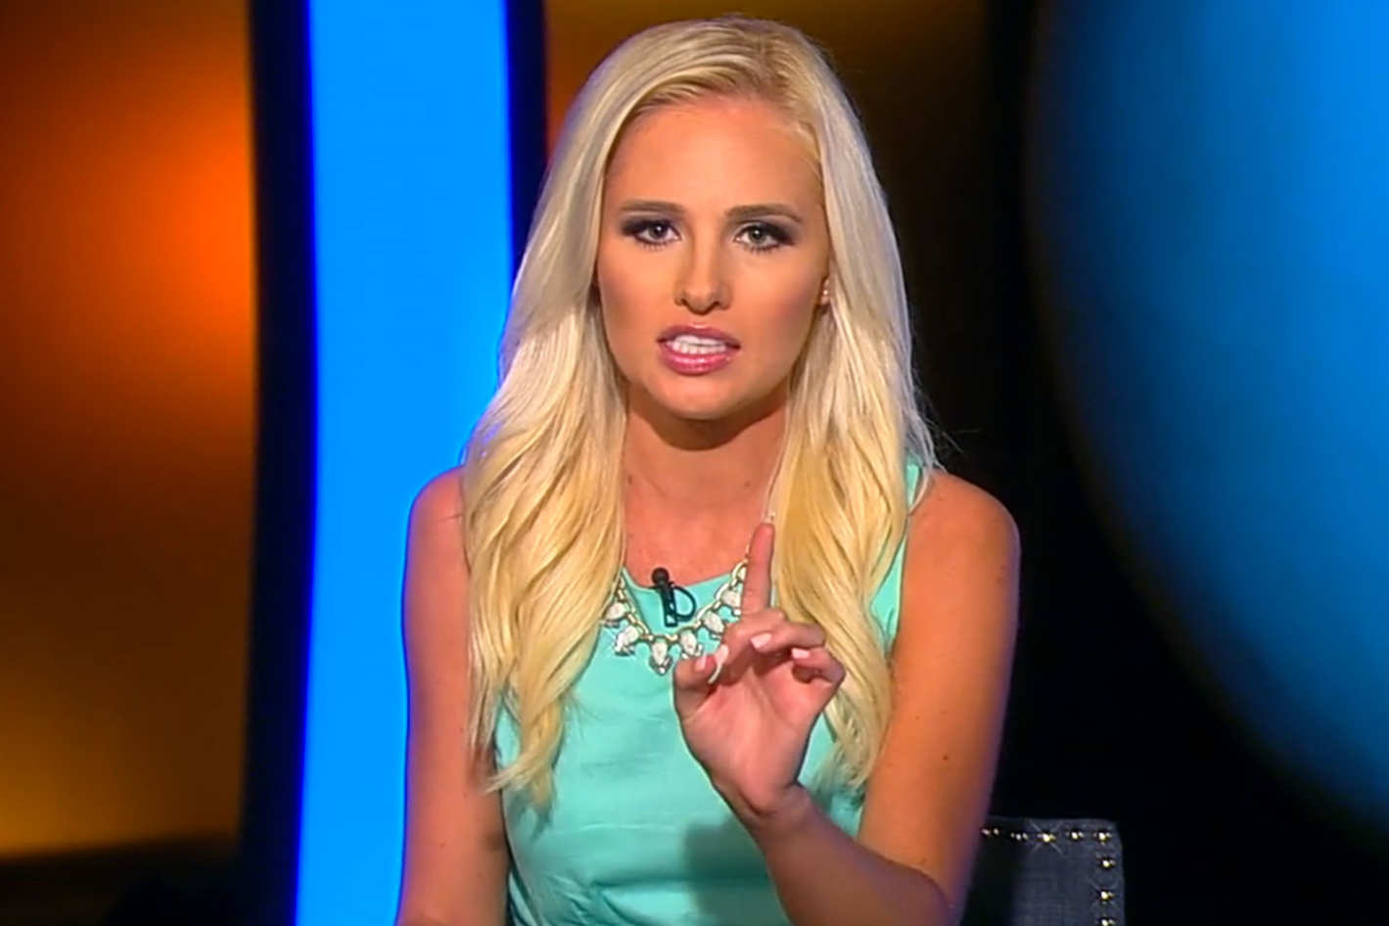

Slide 14
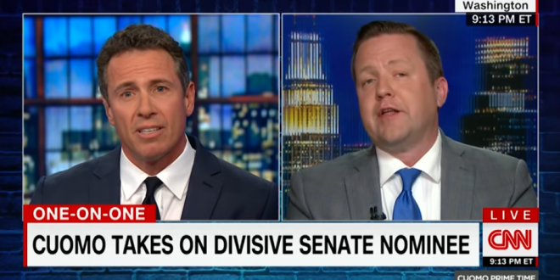

Slide 16
Notes:
These shows are DESIGNED to get you riled up. It's a feature.
When you’re angry, you keep watching.
You forget to eat.
Your heart rate goes up.
You feel amped up. Jittery.
…. So what? Well, let’s think through what’s NOT HAPPENING while all these stress hormones are flooding your system.

Slide 17
Notes:
When it comes to media, you’re either
The consumer, which means you’re paying for information, or
The product, which means you’re not paying at all (or not much) for information, and what’s ACTUALLY being sold is your attention. Your eyeballs. And that media is designed to maximize how much anger you feel—how much the media can cause your vision to narrow, your hearing to selectively shut down, your attention to focus narrowly and (ideally) endlessly on that source of information.

Slide 18
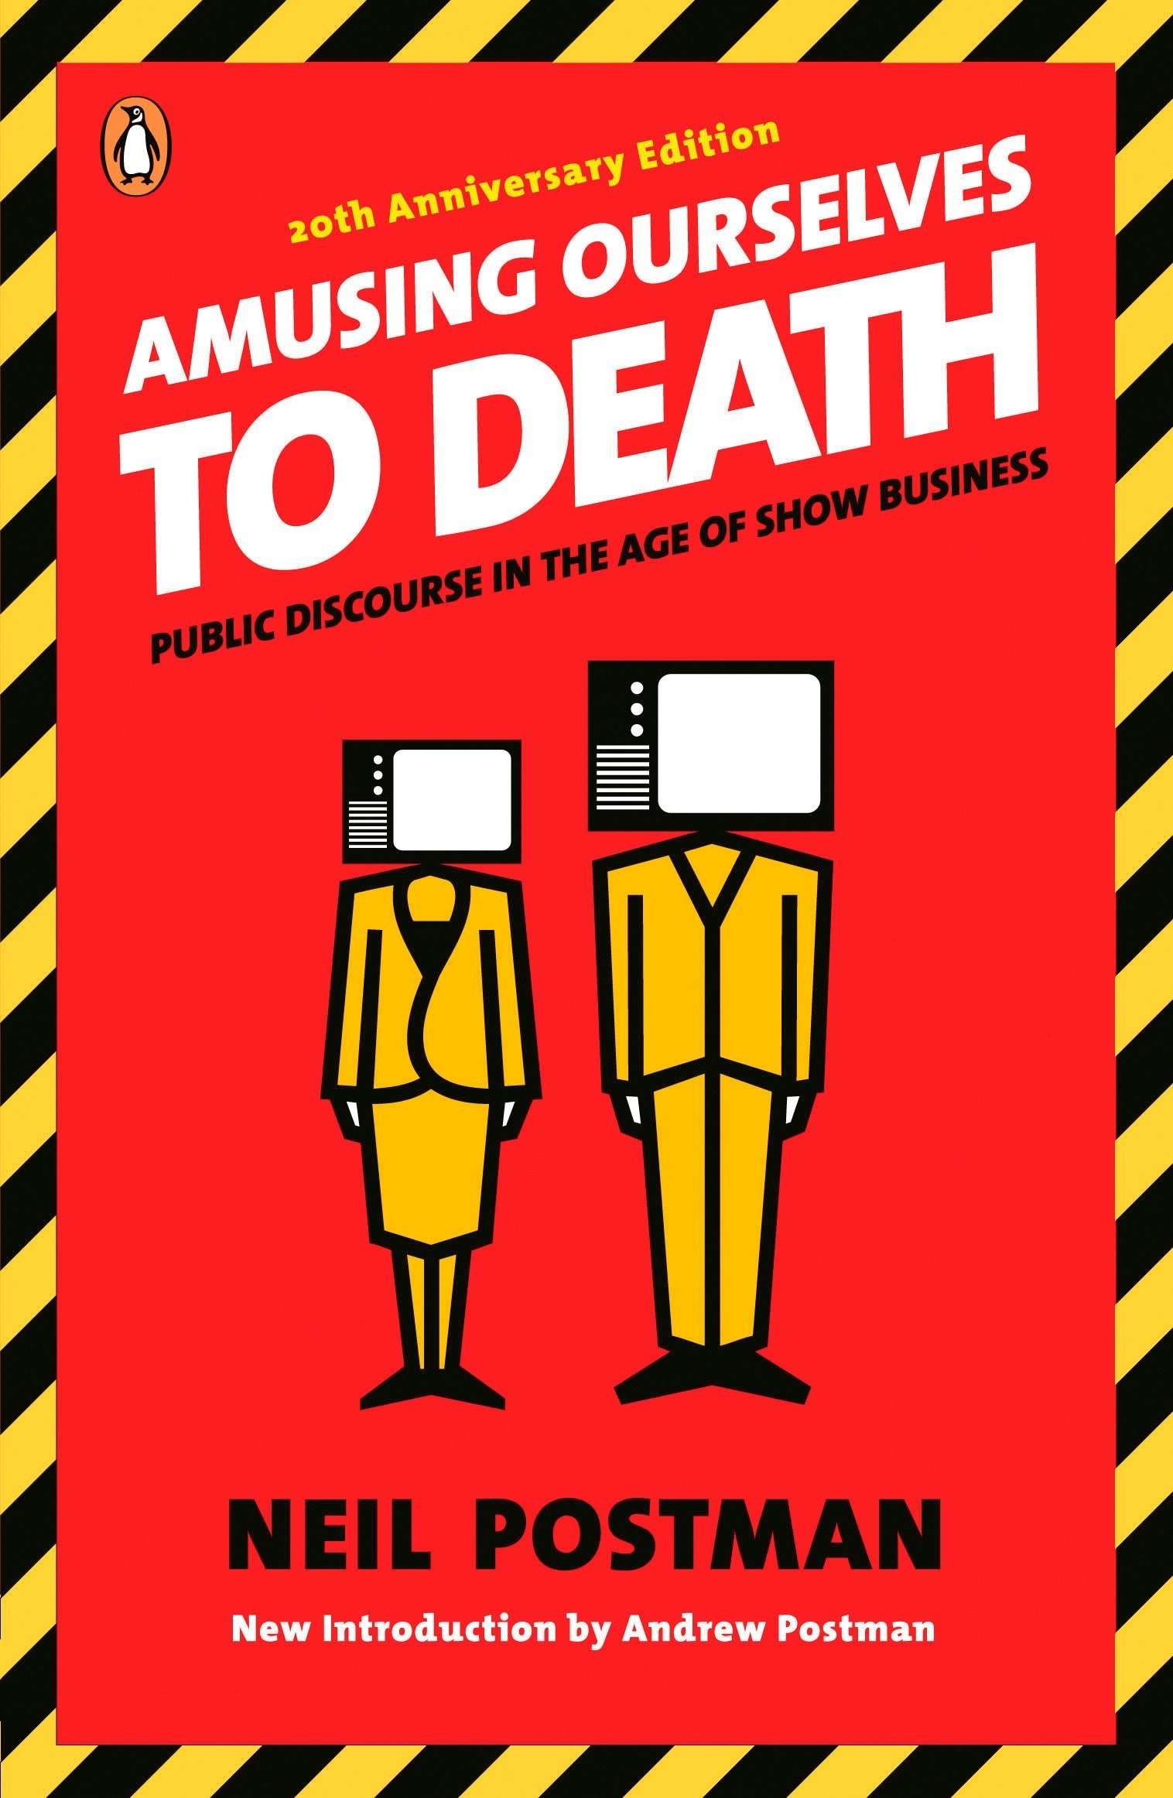
Notes:
This is not a new idea. In fact, I’m going to introduce you to Neil Postman, who wrote this book in … are you ready for this? 1984. !!!!!

Slide 19
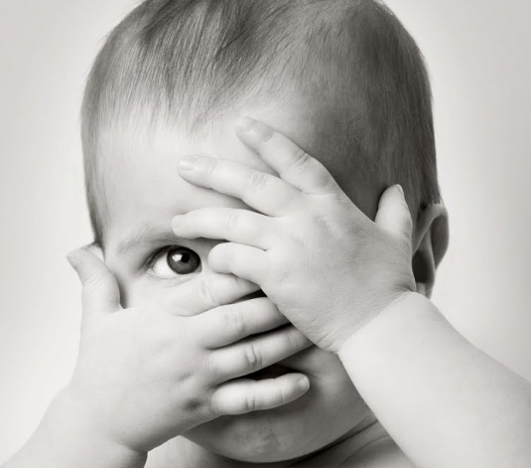
Notes:
Postman describes the evolution to an electronic world as a “peak-a-boo world,” where events and information appear, then disappear, with little to no coherence or sense. The “now … this” framing of our news completely obscures our ability to construct meaning moment to moment.
The average news story in 1984, Postman shares, was about 45 seconds… a length of time impossible to convey any measure of seriousness. Absent seriousness, we’ve just got entertainment.
And indeed, like peak-a-boo, the news is now “endlessly entertaining.”
(Incidentally, Pew Research estimated the median length in 2012 at 41 seconds.)

Slide 20
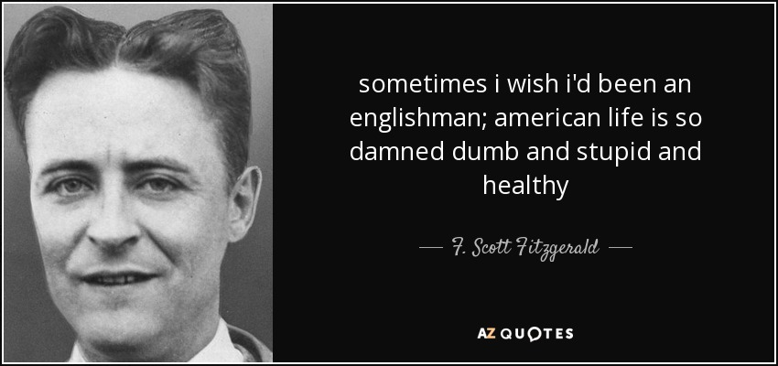
Notes:
“The result of all this is that Americans are the best entertained and quite likely the least well-informed people in the Western world.” (p. 106)
Or, as F. Scott Fitzgerald put it …

Slide 21
Notes:
“Television is altering the meaning of ‘being informed’ by creating a species of information that might properly be called disinformation. I am using this word almost in the precise sense in which it is used by spies in the CIA or KGB. Disinformation does not mean false information. It means misleading information – misplaced, irrelevant, fragmented, or superficial information – information that creates the illusion of knowing something but which in fact leads one away from knowing.” (p. 107)
“When news is packaged as entertainment, that is the inevitable result. … we are losing our sense of what it means to be well informed. Ignorance is always correctable. But what shall we do if we take ignorance to be knowledge.” (p. 108)
I’ll talk more about what media you can consume later. But for now, rule #1: avoid 24-hour news, and most TV news, as your sources of information. Be very wary about gathering information from any source you do not pay for. It’s primary focus IS NOT to entertain you.

Slide 22
Rule #2: Make understanding others your primary goal.
Notes:
This is probably the biggest lesson of my talk today. If you want to keep your sanity, you have to start by shifting your focus AWAY from the feels-so-good sensation of being right and TOWARD the harder business of understanding others.

Slide 23
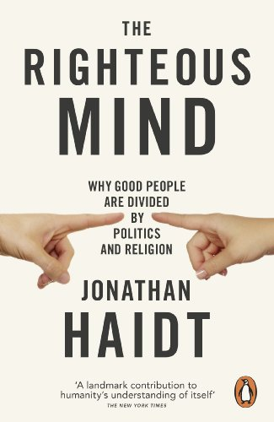
Notes:
I’m going to talk about one of my very favorite authors, Jonathan Haidt. He has done incredible work around these ideas, and I wholeheartedly endorse his books, videos, and his organization, Heterodox Academy, of which I am a proud member.
Liberals score MUCH higher in a personality trait (one of the BIG FIVE) called openness to new experience. (The others are conscientiousness (a conservative trait), extraversion, agreeableness, and neuroticism.)
Five (later, six) moral foundations:
Harm/care
Fairness/reciprocity
Ingroup/loyalty
Respect/authority
Purity/chastity
[Liberty]

Slide 24
Notes:
“Our righteous minds were designed to:
Unite us into teams,
Divide us against other teams, and
Blind us to the truth.”
So what do we do….?

Slide 25
Notes:
We have to step out of the fight for good and evil. We have to find some moral humility. We need both liberals and conservatives in the US – liberals advocate change, conservatives understand that order is fragile and easily destroyed. If we have too much of either, we descend into anarchy or authoritarianism. We simply cannot afford to have one side stronger than the other. That doesn’t feel good. But it’s necessary.
Rule #1: avoid 24-hour news
Rule #2: make understanding your primary goal
Next up is rule #3 …

Slide 26
Rule #3: Cultivate empathy. Hearken back to humanity.
Notes:
This sounds like a lot of touchy-feeling warm-and-fuzzy feeling, I know, but it’s vitally important. We are a social species. We are designed—as Jonathan Haidt told us—to find our teams, unite in opposition to some enemy, and survive together. From our species’ inception, we have been very tribal. So the task before us is to leverage that knowledge into everyday reminders that each person we encounter is a whole constellation of experiences, beliefs, values, and desires that we cannot reduce to a single meme or stereotype. You cannot know what motivates someone by knowing just one or two things about them.

Slide 27
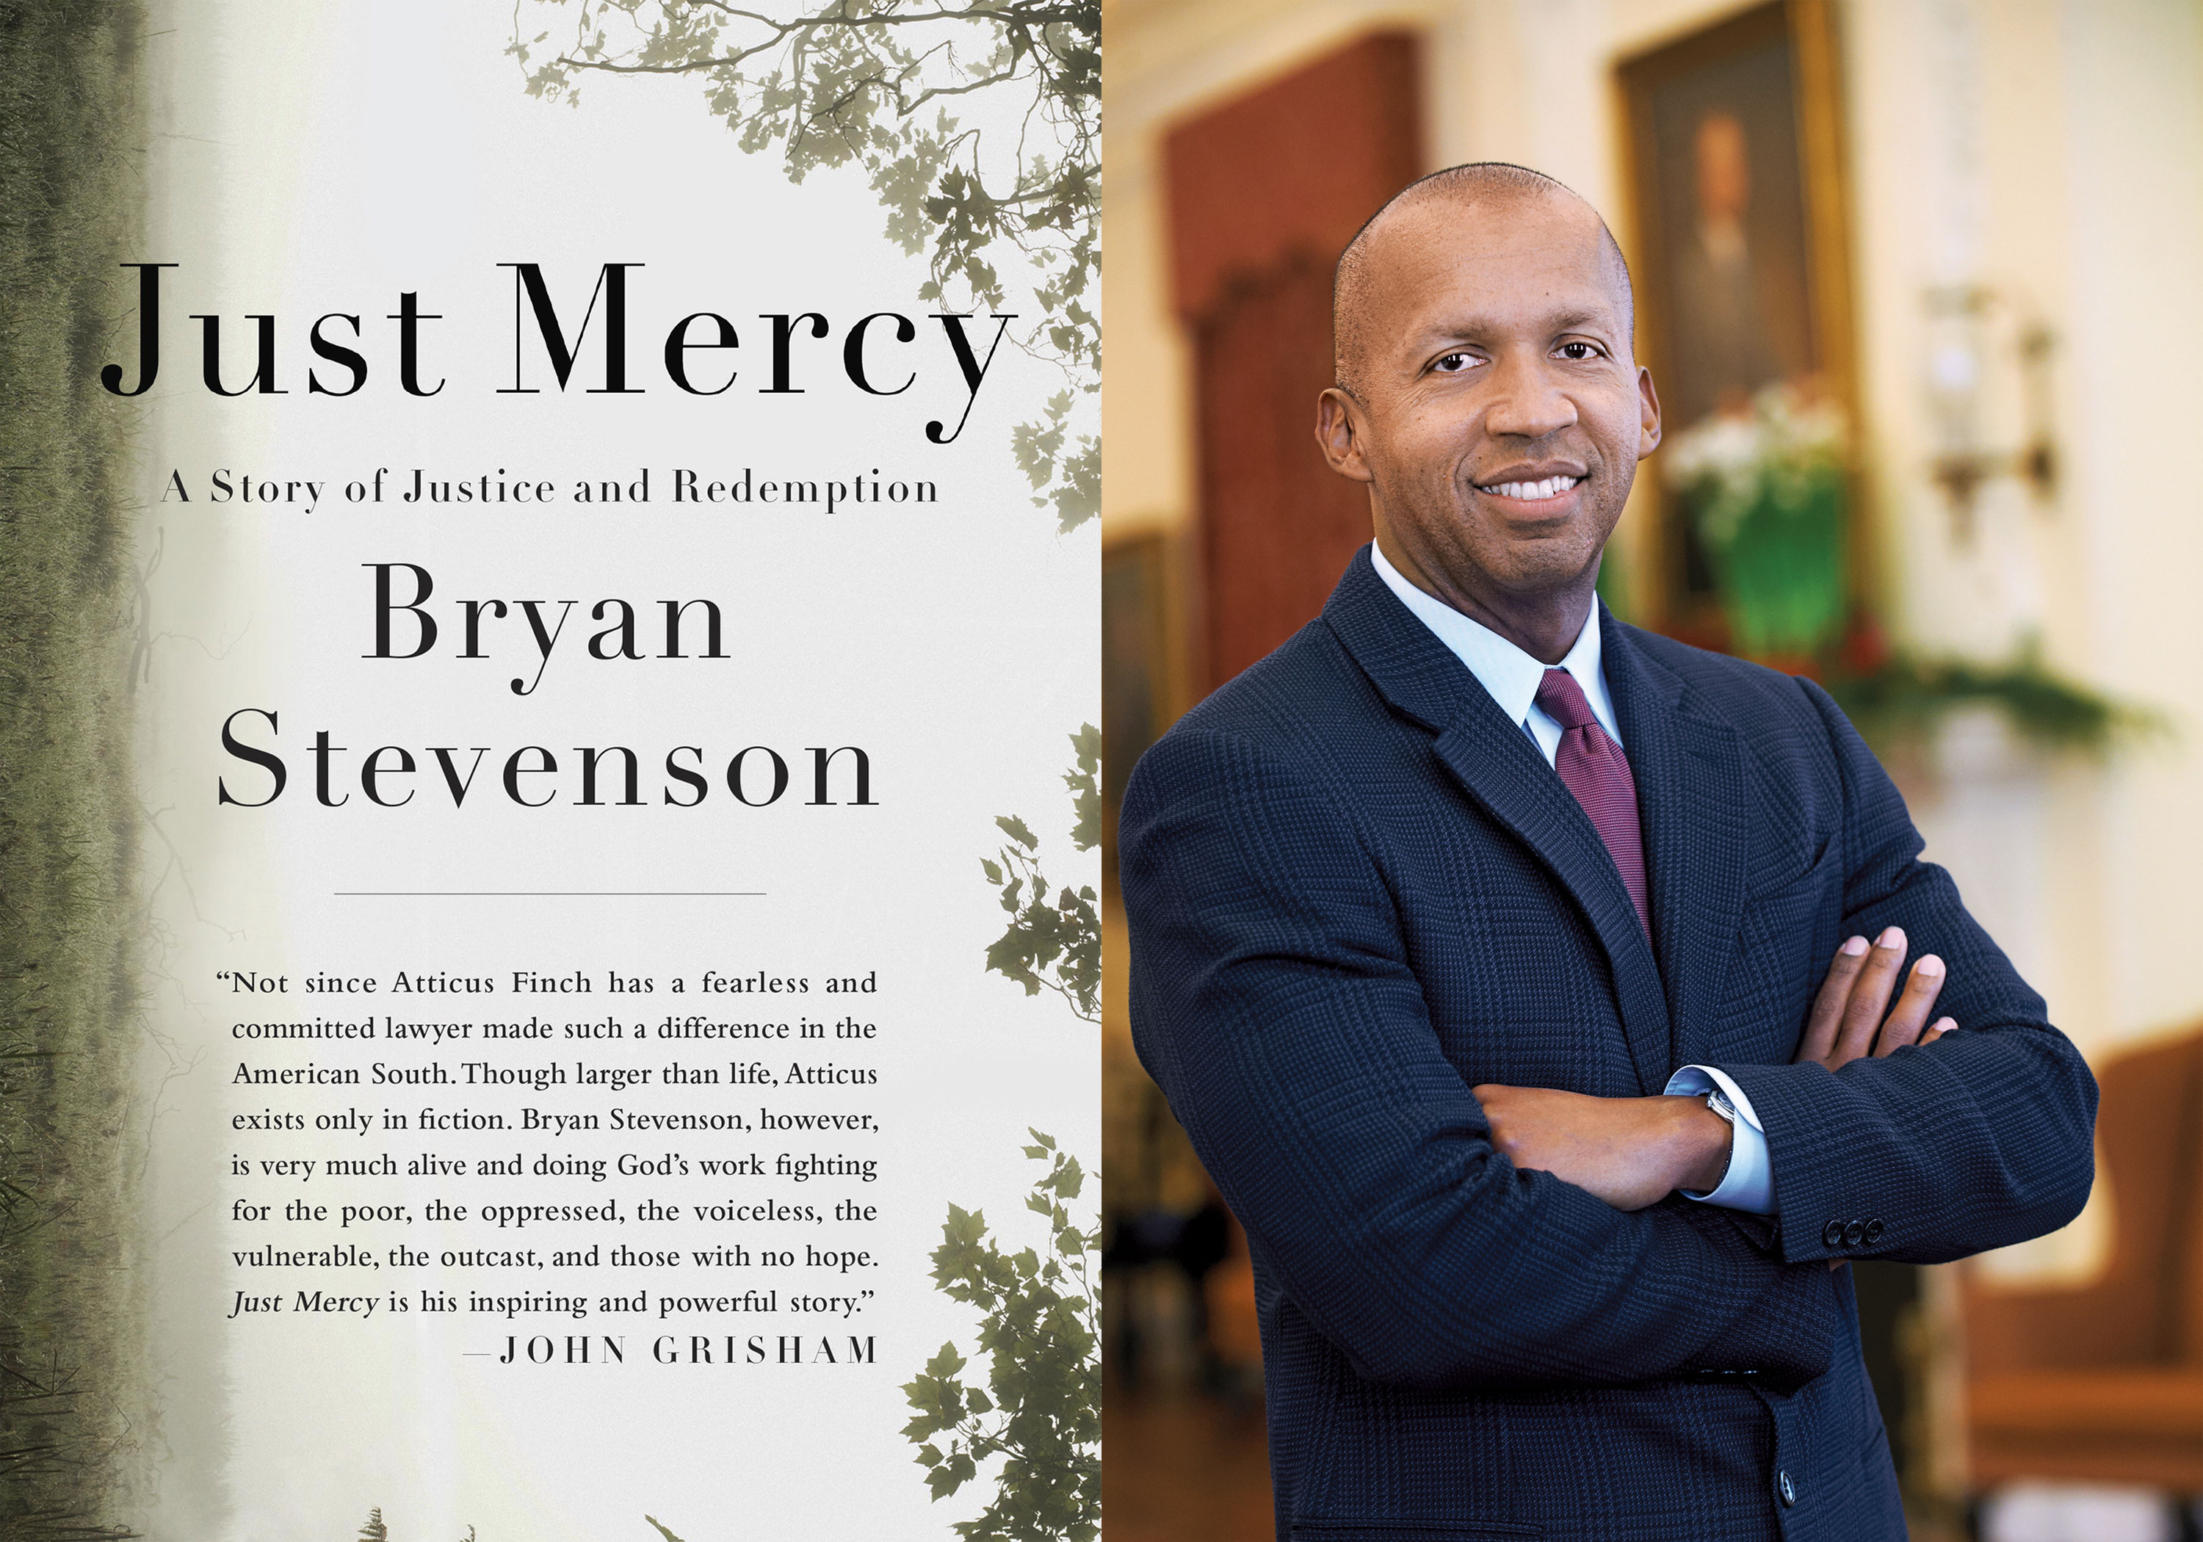
Notes:
One of the best examples of this I’ve seen is Bryan Stevenson’s work – his book Just Mercy remains the core text of my American government course. In his book, he tells story after story of clients he’s worked with in the past. He humanizes them. He finds it within him to empathize with their struggles, even as he holds them responsible for their actions.

Slide 28
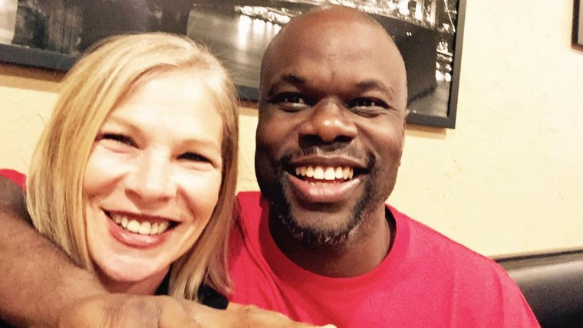
Notes:
Let me tell you one of those stores – the story of Ian. When he was 13, he was living in one of the most violent housing projects in Tampa—or, indeed, the entire state of Florida. He was hanging out with a group of older teens when they approached Debbie (on the left) in an attempted robbery. Ian had a gun and started shooting. One of his bullets hit her jaw, knocking out all of her bottom teeth and gums on one side. He was arrested, was tried as an adult, and was sentenced to life without the possibility of parole. He spent 18 years in uninterrupted solitary confinement, allegedly for his own safety at the adult prison.
He called Debbie on his second Christmas in prison—not even yet 16. He apologized. She was shocked. He started writing her letters. She said of Ian, “I thought, wow, this kid is smart. Let’s not waste this life. Let’s give him a chance. He was smart, he was remorseful.”
In 2010, the Supreme Court threw out life sentences for juveniles, and Debbie began advocating for Ian’s release. He had spent 20 years in prison at that point. Then in 2016, at the age of 39, Ian was released. He now has a book, My Time Will Come, and the two are still friends.

Slide 29
Notes:
As Stevenson writes, “We are all implicated when we allow other people to be mistreated. An absence of compassion can corrupt the decency of a community, a state, a nation. Fear and anger can make us vindictive and abusive, unjust and unfair, until we all suffer from the absence of mercy and we condemn ourselves as much as we victimize others” (p. 18, emphasis added).
Photo: road rage
As Debbie said to Today on NBC after Ian’s release, “We all make mistakes, we all try our best, and life is so short,” she said. “And if anybody knows how your life can be gone in one minute, it’s me. I understand that. We have to forgive, because it helps us heal.”

Slide 30
Notes:
“The opposite of hate also isn’t some mushy middle zone of dispassionate centrism. You can still have strongly held beliefs, beliefs that are in strong opposition to the beliefs of other people, and still treat those others with civility and respect. Ultimately, the opposite of hate is the beautiful and powerful reality of how we are all fundamentally linked and equal as human beings. The opposite of hate is connection” (p. 228, emphasis added).
#1: run from 24-hour news
#2: seek to understand others
#3: cultivate empathy, remember our shared humanity
Up next is #4 …

Slide 31
Rule #4: Draw a red line around dehumanizing language.
Notes:
Humans are not snakes, rats, or any other fear-inducing creature. Any language about anyone—regardless of their beliefs—that makes it easier for us to think of them as being somehow less human simply MUST NOT BE TOLERATED, period.

Slide 32
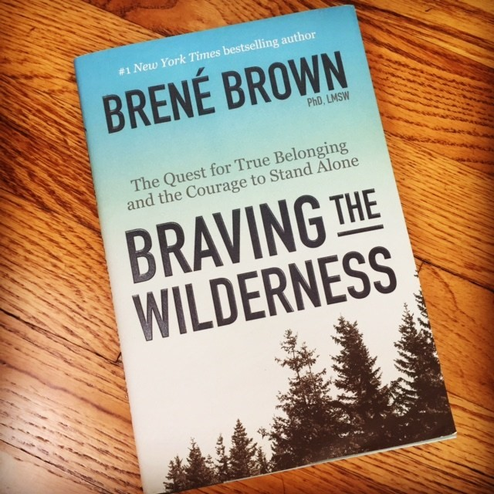
Notes:
“Dehumanizing and holding people accountable are mutually exclusive. Humiliation and dehumanizing are not accountability or social justice tools, they’re emotional off-loading at best, emotional self-indulgence at worst. And if our faith asks us to find the face of God in everyone we meet, that should include the politicians, media, and strangers on Twitter with whom we most violently disagree. When we desecrate their divinity, we desecrate our own, and we betray our faith.”
“When we engage in dehumanizing rhetoric or promote dehumanizing images, we diminish our own humanity in the process. When we reduce Muslim people to terrorists or Mexicans to “illegals” or police officers to pigs, it says nothing at all about the people we’re attacking. It does, however, say volumes about who we are and the degree to which we’re operating in our integrity.”
1. People Are Hard to Hate Close Up. Move In.
2. Speak Truth to Bullshit. Be Civil.
3. Hold Hands. With Strangers.
4. Strong Back. Soft Front. Wild Heart.”
And now, for our final rule…

Slide 33
Rule #5: Befriend your ‘enemy.’
Notes:
If this seems impossible, I’m going to share two examples that give me hope. Two examples of people we’d assume would be enemies, but who were actually quite good friends. The first is (in my mind) the most improbable – a publisher of pornography and a Southern Baptist televangelist.

Slide 34
Notes:
Here’s what Larry Flynt wrote about Jerry Falwell after he passed in 2007:
“My mother always told me that no matter how repugnant you find a person, when you meet them face to face you will always find something about them to like. The more I got to know Falwell, the more I began to see that his public portrayals were caricatures of himself. There was a dichotomy between the real Falwell and the one he showed the public. He was definitely selling brimstone religion and would do anything to add another member to his mailing list. But in the end, I knew what he was selling, and he knew what I was selling, and we found a way to communicate.”

Slide 35
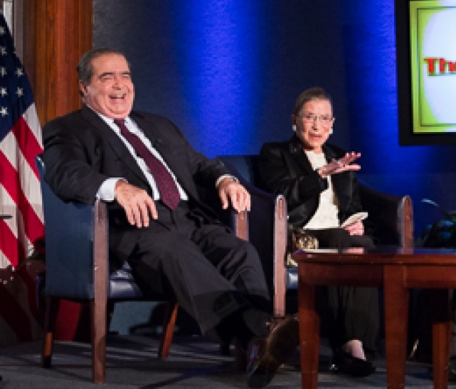
Notes:
This picture makes me sad—two people I admire so much, now snatched from us. On the left is Scalia, on the right RBG. Not where you’d expect them to be, right?! ☺

Slide 36
Skills for a civil & productive discussion
Listen carefully to correctly understand others. To prevent making assumptions; to avoid misunderstanding.
Appreciate diverse perspectives. To value differences; to connect with others.
Suspend judgment. To withhold personal biases; to connect with others.
Disagree agreeably. To stay true to your beliefs; to respect opinions that conflict with your own.
Check that your ideas have been clearly and logically expressed. To advocate for yourself; to connect with others.
Ask probing questions. To continue the conversation; to understand multiple perspectives.

Slide 39
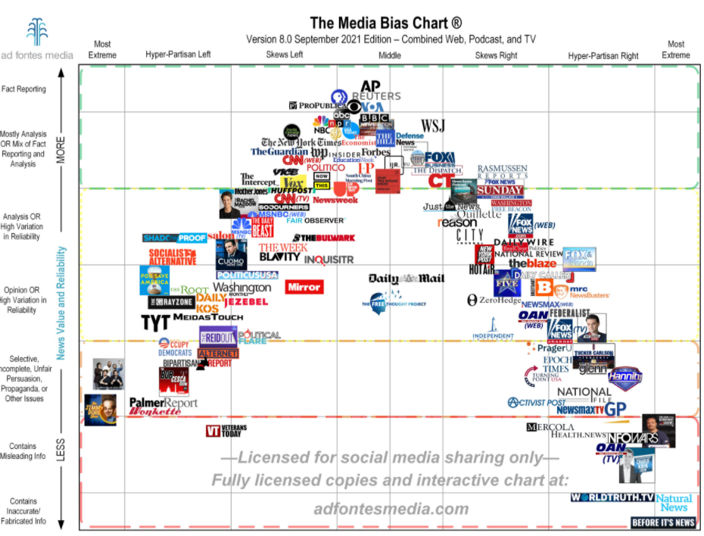
Notes:
https://adfontesmedia.com/static-mbc/

