Slide 1
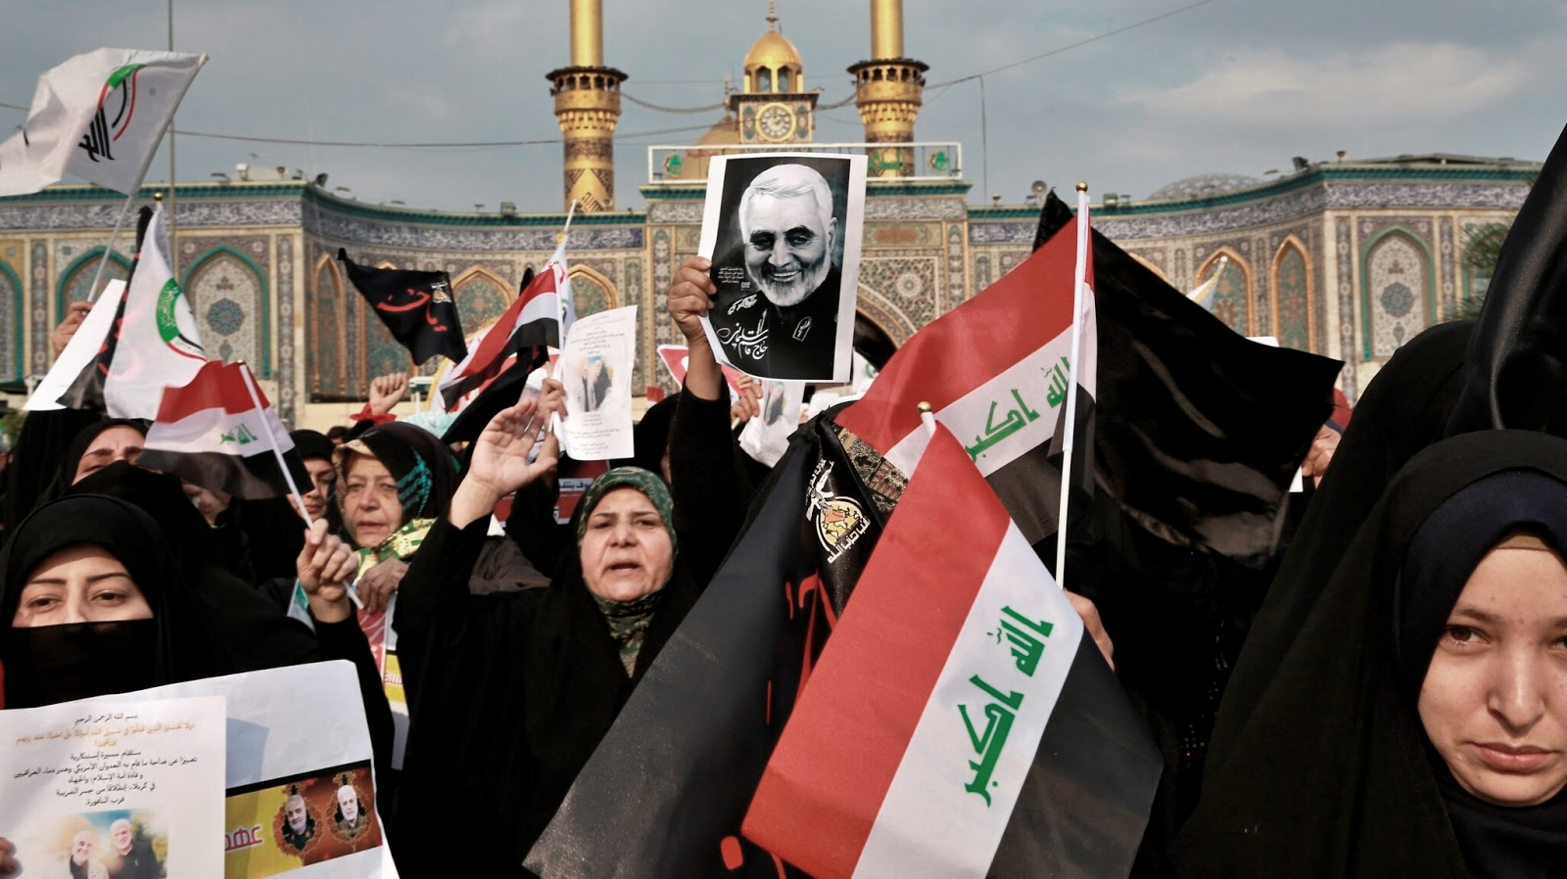
Iran, Explained
Dr. Liz Norell

Slide 2
Understanding Iran’s geography & economy

Slide 3
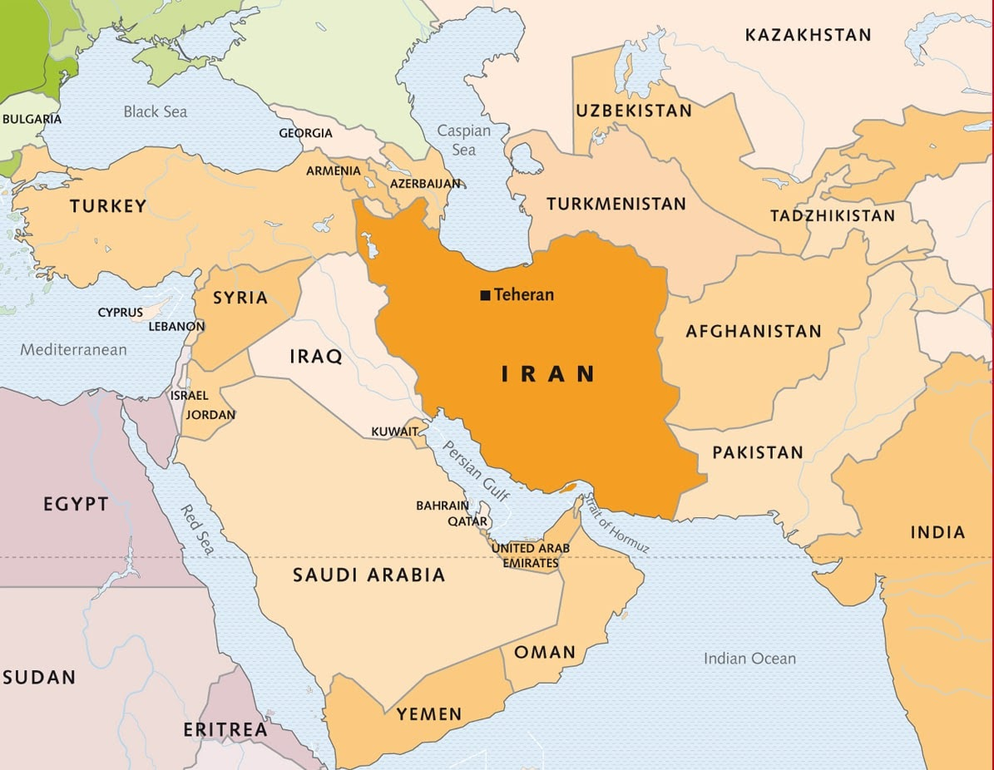

Slide 4
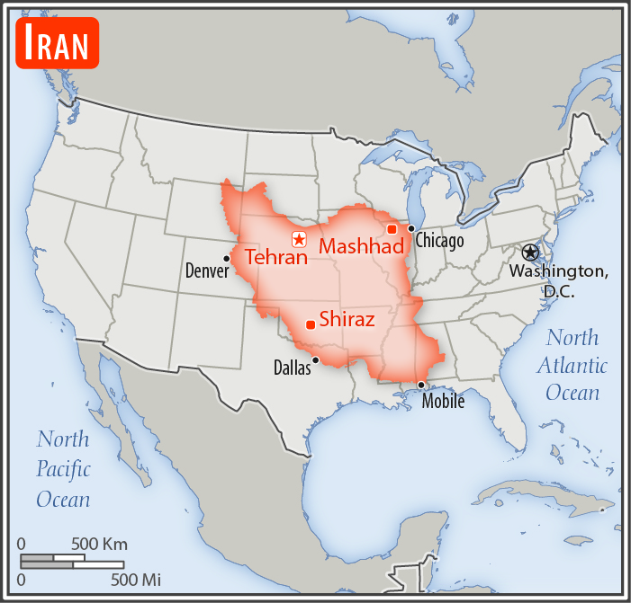
Putting Iran’s size into perspective

Slide 5
 | Iran | United States
Land mass (size) | 19th | 4th
Population | 17th | 3rd
Adult literacy (15+ years old) | 86% | 86%
Unemployment (2017 estimate) | 12.4% | 4.4%
Life expectancy | 74 years | 80 years
Living below poverty line | 19% (2007) | 15% (2010)
Gini index (measure of income inequality; higher # is better) | 43rd | 41st
Amount of government debt (measured as % of GDP; higher # is better) | 132nd (40% of GDP) | 36th (79% of GDP)

Slide 6
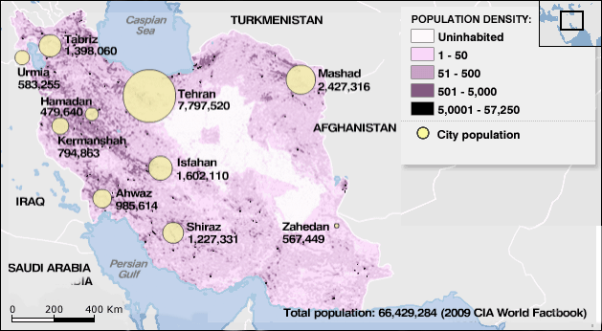
Where Iranians live

Slide 7
20th century
US / Iranian relations

Slide 8
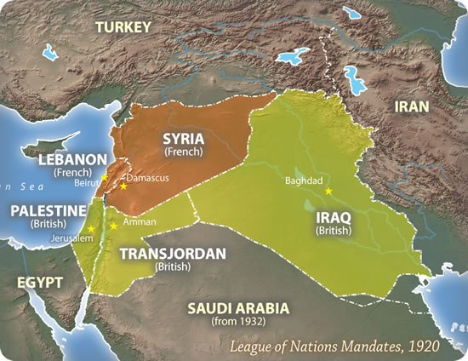
Context: Imperial history
After World War I / World War II, Western countries divided up much of the Middle East amongst themselves.
Iran was largely spared, but the threat of Western colonization or control has been a historic reality in the Middle East.

Slide 9
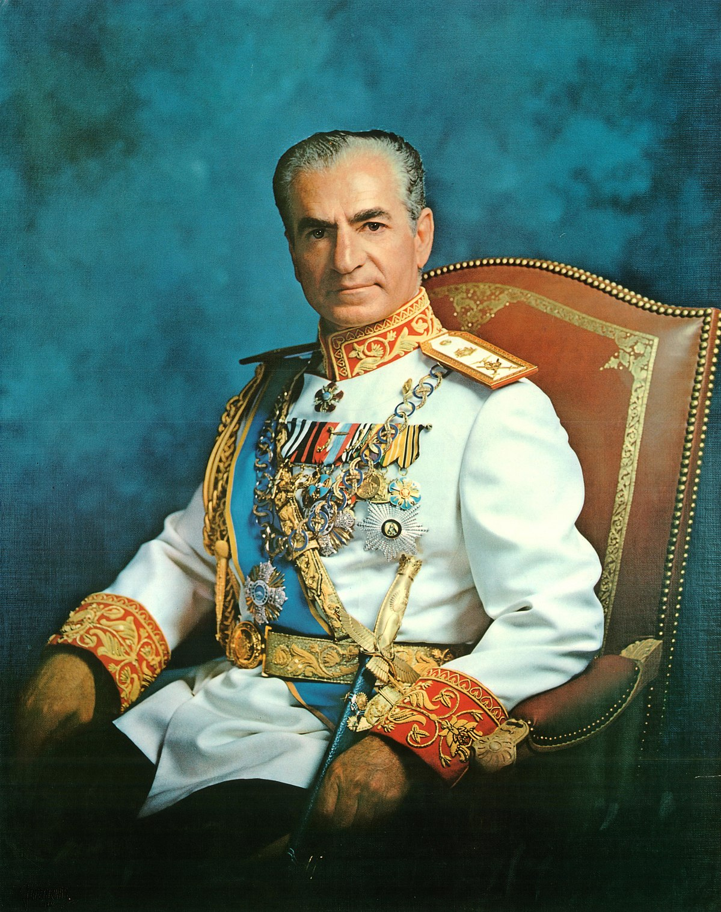
The Shah & the 1979 Revolution
Reza Shah Pahlavi (pictured) and his family are installed as rulers by the UK & US intelligence services. They rule (mostly continuously) from 1921-1979, when they are forced into exile after a revolution.
Ayatollah Ruhollah Khomeini becomes the Supreme Leader; a referendum establishes the Islamic Republic of Iran.
Students seize control of the US Embassy, taking 52 Americans hostage for 444 days.
Notes:
1907: Constitution introduced, limits absolute powers of rulers
1921: Military commander Reza Khan seizes power, then crowned (1926)
1935: Country officially named Iran
1941: Iran favors Axis powers in WWII, leading to an Anglo-Russian occupation of Iran. Shah’s son, Mohammed Reza Pahlavi, becomes leader.
1951: The oil industry, dominated by a British-owned company, is nationalized. In response, the UK imposes an embargo/blockade, halting oil exports and tanking the economy.
1953: Prime Minister Mossadeq is overthrown in a coup engineered by the British + American intelligence services. The Shah returns from exile.
1963: Shah launches a “White Revolution” program to modernize Iran.
1978: Shah’s policies alienate the clergy; authoritarian rule leads to riots, strikes, and mass demonstrations. The government imposes martial law.
1979: The Shah + family are forced into exile, and the Islamic clerical opposition leader returns after 14 years of exile in Iran + France.
The Islamic Republic of Iran is established after a referendum.
Islamic militants take 52 Americans hostage inside the US Embassy in Tehran, demanding the extradition of the Shah to face trial in Iran. (He was in the US for medical treatment.)
1980: The Iran-Iraq war begins; it lasts eight years.
1981: The day of Reagan’s inauguration, the American hostages are released after 444 days of capitivity.

Slide 10
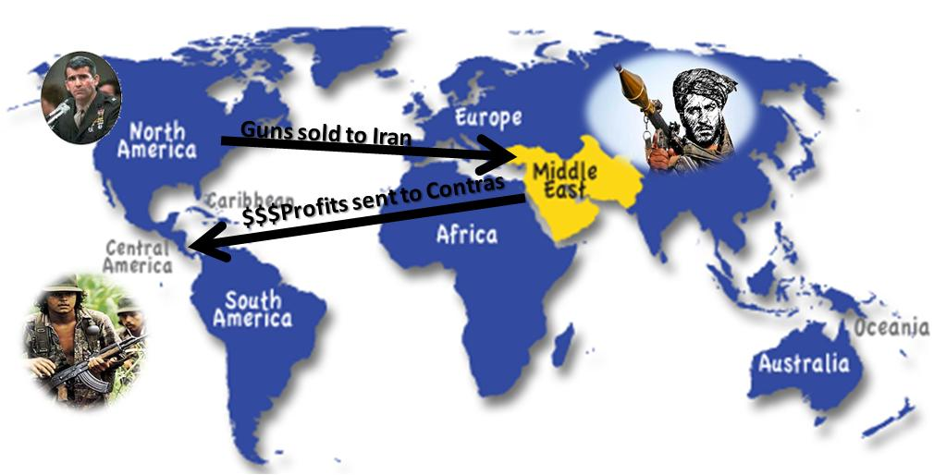
Iran-Contra Affair -- 1985
From http://bkushistory.pbworks.com/w/page/104442970/Iran%20Contra%20Timeline, accessed 23 January 2020.
Notes:
1985: Iran-Contra Affair
1989: Ayatollah Khomeini dies. President Khamene’I is appointed new supreme leader.
1995: US imposes oil/trade sanctions over Iran’s alleged sponsorship of terrorism, quest for nuclear arms, and hostility to the Israeli-Palestinian peace process.
1998: Iran sends troops to border with Afghanistan, after the Taliban kills eight Iranian diplomats and a journalist.

Slide 11
Tumultuous 21st century
1999-2000: Pro-democracy factions within Iran take control of the parliament and demand reforms.
2002: US President George W. Bush declares Iran is part of an “axis of evil.” Russia starts construction of a nuclear reactor in Iran.
2004: Conservatives regain control of the parliament.
2004-2011: Iran slowly builds its nuclear program, against the urgent opposition of the United Nations, the US, and the IAEA.

Slide 12
A brief history (cont’d)
2012: European Union implements boycott of Iranian oil. Iran’s currency (the rial) falls to a record low, losing 80% of its value in a single year.
2013: Reformist cleric Hassan Rouhani becomes president.
2014: Iran says it will assist Iraq in battling Sunni insurgents. Iranian Revolutionary Guards provide Iraqis with military training & advice.
2015: World leaders reach an agreement with Iran to limit nuclear activity, in exchange for lifting international economic sanctions.
2017: ISIS attacks the shrine of Ayatollah Khomeini, sowing greater discontent.

Slide 13
A brief history (cont’d)
2018: US withdraws from the 2015 nuclear deal, reimposing sanctions.
2019: US accuses Iran of attacking oil tankers in the Persian Gulf, which Iran denies.
2020: Quds Force commander Qasem Soleimani is killed in a US air strike at Baghdad Airport, leading Iranians to demonstrate support for their government…
… and the Iranian government accidentally shoots down a Ukrainian passenger jet, leading Iranians to demonstrate opposition to their government; 167 die, including 57 Canadian nationals.

Slide 14
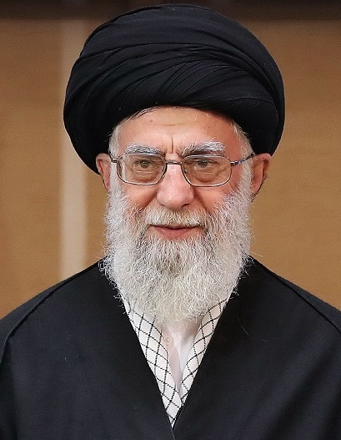
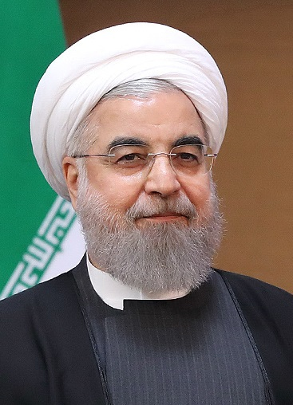
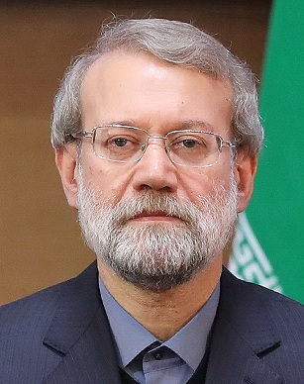
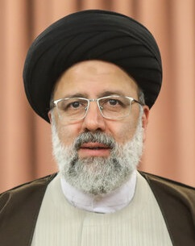
Who has power in Iran?
Supreme Leader
Ali Khamenei
President
Hassan Rouhani
Speaker of Parliament
Ali Larijani
Chief Justice
Ebrahim Raisi

Slide 15
Sources of international conflict

Slide 16
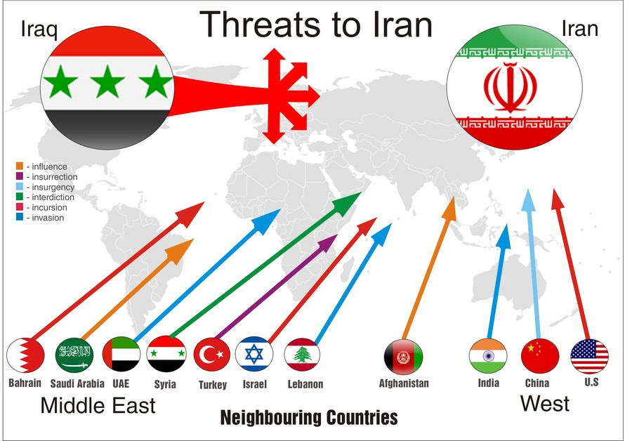

Slide 17
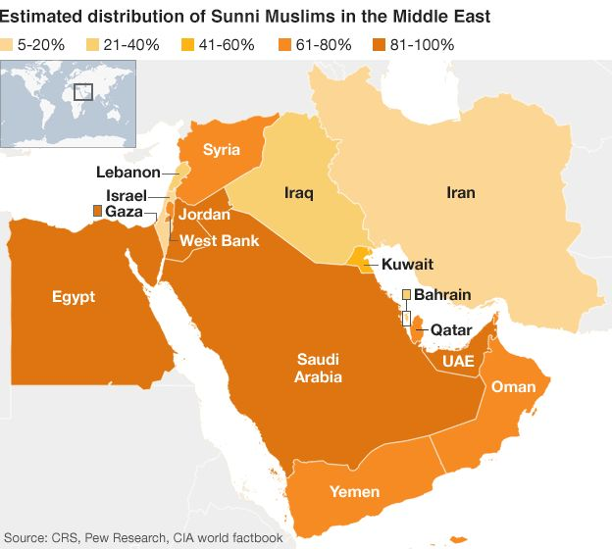
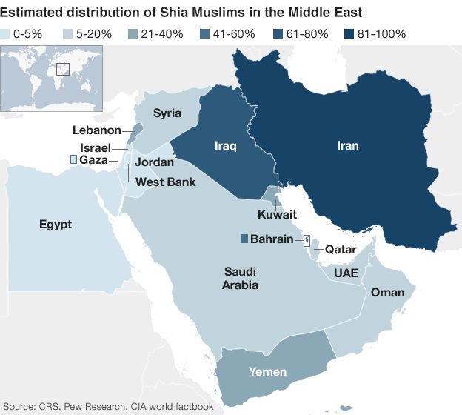
#1: Power of religious sects
Notes:
Muslim: 99.4%
Shia 90-95%
Sunni 5-10%
Others, including Zoroastrian, Jewish, and Christian: 0.3%
Unspecified 0.4%

Slide 18
Shia vs. Sunni Muslims
Shia Muslims are the majority sect worldwide (approx. 85-90%).
  They are the tiny minority in Iran.
  Shiites believe that the Prophet Mohammed anointed his son-in-law Ali as his rightful successor.
Sunni Muslims are about 10% of Muslims worldwide.
  Typically considered the orthodox sect of Islam.
  Sunnis believe that the Prophet’s close friend Abu Bakr should rightfully succeed him. They won, but a split was born.

Slide 19
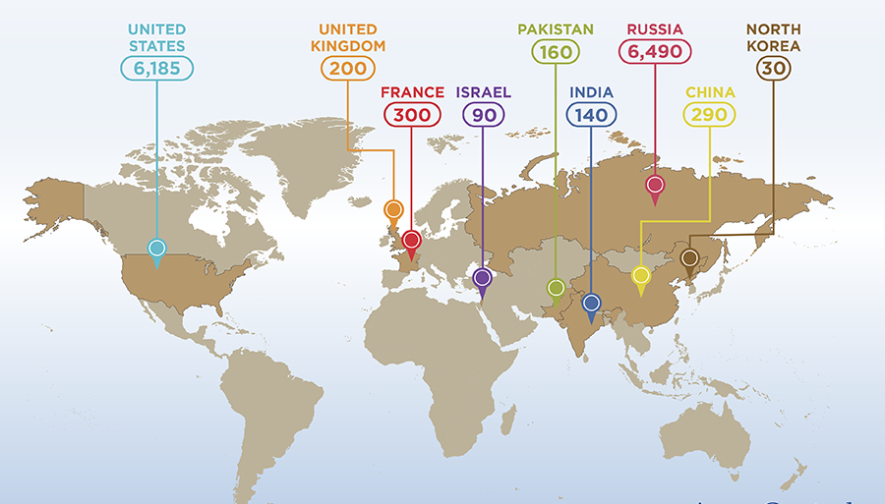
#2: Nuclear weapons development

Slide 20
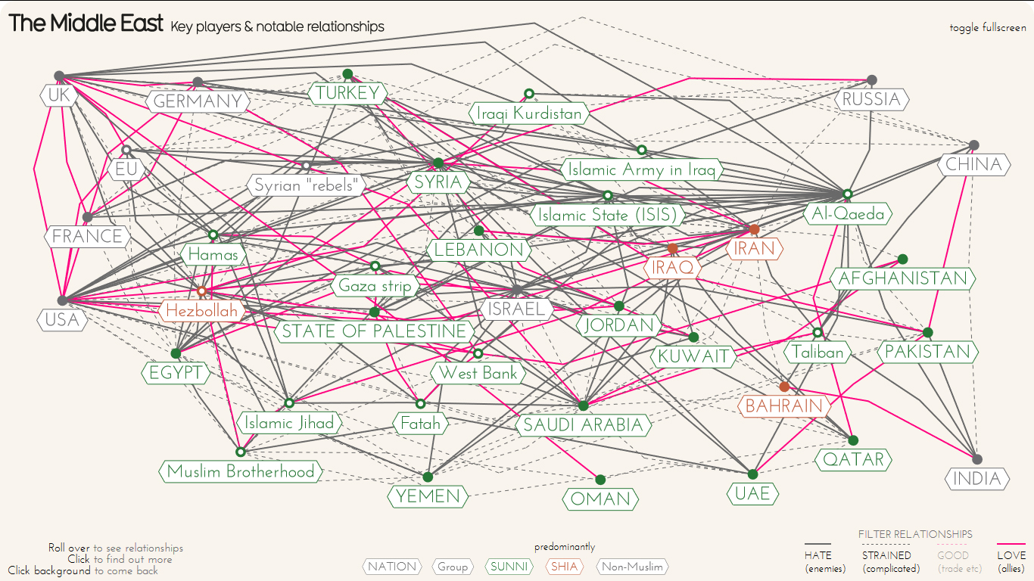
#3: “Terrorism”

