Slide 1
Seven Reasons Our Politics
Seem So Polarized
Dr. Liz Norell
University of Tennessee Chattanooga & Chattanooga State Community College
June 15, 2016

Slide 2
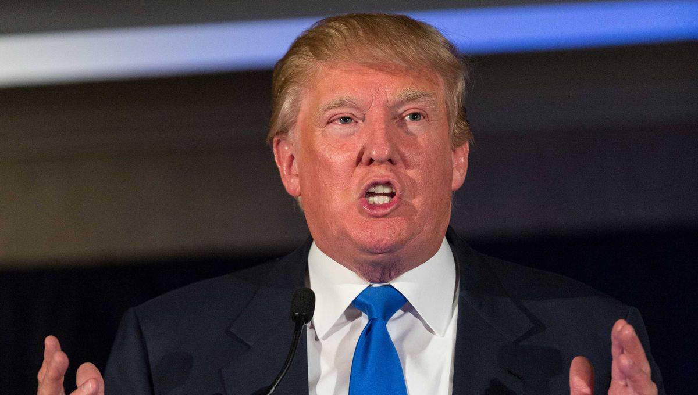
Let’s just get this out of the way.

Slide 3
My Biases
The terms “liberal” and “conservative” are meaningful … and correlated with party preference.
Ideology has substantial correlations with other personality and behavioral attributes.
Polarization isn’t necessarily bad…
… yet, our current brand of polarization is counter-productive, and it may even be harmful.
Government works best when those who devote their full-time attention to governing have the ability to make tough decisions the public may not understand or agree with.
Notes:
For #5 – two models of representation, trustee & delegate. I think members of government should be trustees on high-salience issues, and trustees on everything else.

Slide 4
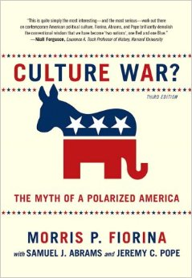
Culture War?
We are closely divided, not deeply divided.
It’s the ACTIVISTS who are polarized, not ordinary Americans.
The news media tend to emphasize conflict and political elites.
We confuse choices with preferences.

Slide 5
Seven Reasons
Gerrymandering
Super PACs
Geographic sorting
Partisan news media
Social media
Changes in DC culture
C-SPAN / “sunshine”
laws

Slide 6
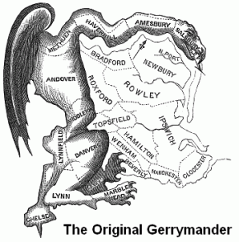
The First Gerrymander
Notes:
Elbridge Gerry, governor of Massachusetts (and, notably, James Madison’s VP from 1813-1814, the fifth VP of the US),
signed the Declaration of Independence and Articles of Confederation.
Attended the Constitutional Convention, but refused to sign it because it lacked a Bill of Rights
Gerrymandering happened in his second term as governor. Term coined in 1812.
From wikipedia:
In 1812 the state adopted new constitutionally mandated electoral district boundaries. The Republican-controlled legislature had created district boundaries designed to enhance their party's control over state and national offices, leading to some oddly shaped legislative districts.^{[83]} Although Gerry was unhappy about the highly partisan districting (according to his son-in-law, he thought it "highly disagreeable"), he signed the legislation. The shape of one of the state senate districts in Essex County resembled a salamander, leading a local Federalist newspaper to print a political cartoon calling it a "Gerry-mander".^{[84]} Ever since, the creation of such districts has been called gerrymandering.
Constitutional objections (also from Wikipedia);
Because of his fear of demagoguery and belief the people of the United States could be easily misled, Gerry also advocated indirect elections. Although he was unsuccessful in obtaining them for the lower house of Congress, Gerry did obtain such indirect elections for the U.S. Senate, whose members were to be elected by the state legislatures. Gerry also advanced numerous proposals for indirect elections of the President of the United States, most of them involving limiting the right to vote to the state governors and electors
NB: He’s the only signer of the Declaration who is buried in Washington, DC

Slide 7
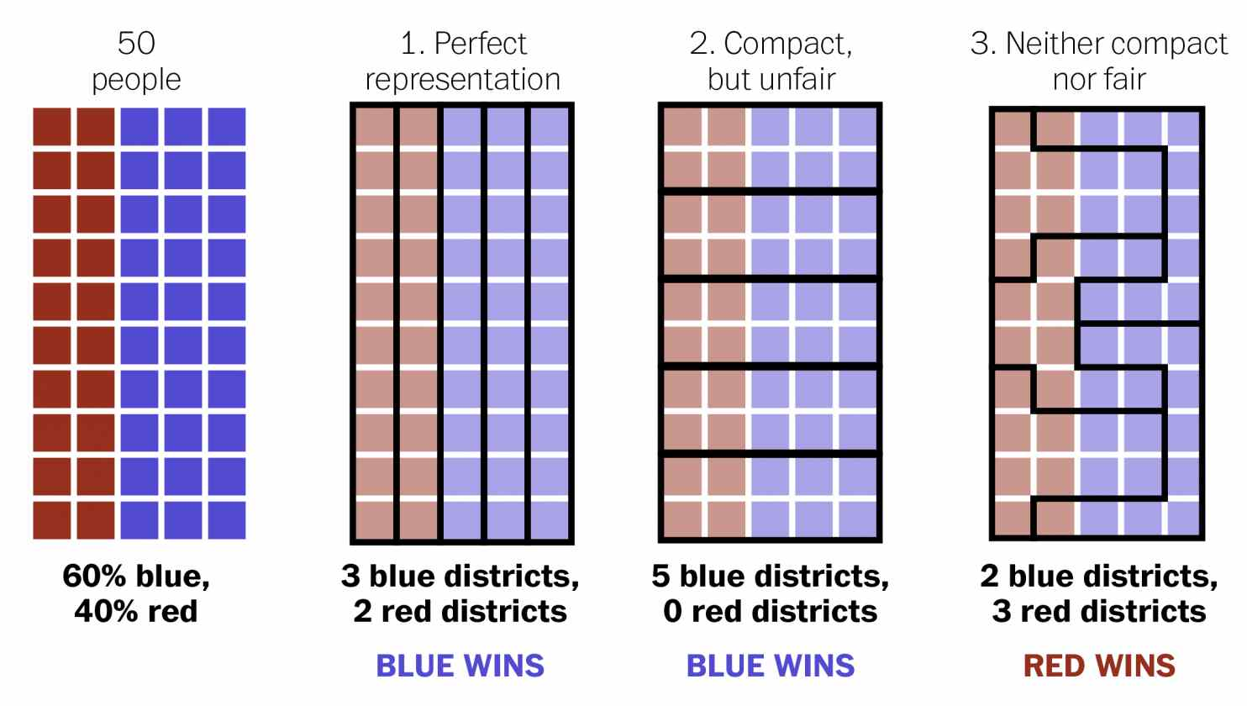
Gerrymandering Today
If time: https://www.youtube.com/watch?v=Mky11UJb9AY (5 mins)
Notes:
The Supreme Court’s rulings on gerrymandering
“the political thicket”
But … what of Senate? It’s polarizing at the same rate.

Slide 8
Gerrymandering
Verdict: No!

Slide 9
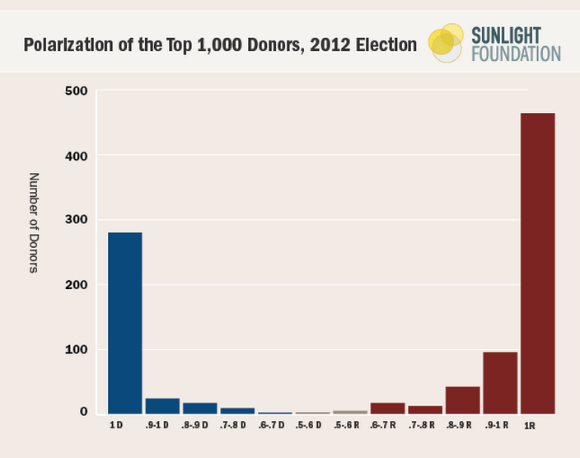
Super PACs
Notes:
First define what a Super PAC is.
When we think about money in politics, we tend to think about money buying votes. (elaborate on this if you want)
What we DON’T think about is how money fundamentally alters the job of being a member of Congress.
Money, in general, has proven so critical that otherwise qualified and attractive candidates simply don’t want the job. Members say they need to raise an average of $10-15,000 PER DAY to keep a House seat.
Members often spend 3-4 hours per day, in a 10-hour work day, raising money.
All because they fear last-minute Super PAC money swooping in at the last minute.
People who donate money tend to be pretty extreme, relatively speaking. (anim)
This makes some sense – those who are most motivated to speak out are those who have strong opinions, not those who are, as Jon Stewart once facetiously said, “raging moderates.” Such a thing doesn’t really exist.
Relevant points about SuperPACs:
They wreak havoc among all traditional players in the political system…. Political representatives hate them, because super PACs represent a loss of control over message
Super PACs create serious worry about flanking
Super PACs also have the potential to swoop in two weeks before the election with an attack ad that seriously injures the elected official’s credibility, with insufficient time to respond adequately

Slide 10
Super PACs
Verdict: Probably not.

Slide 11
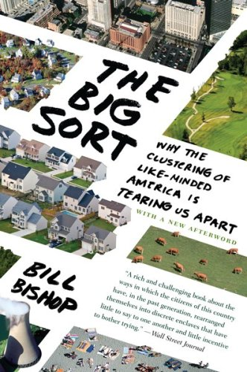
Geographic Sorting
Notes:
Tell Bill Bishop’s story about moving to Austin
Increasing geographic sorting by income, race, political ideology
With what impact? Lack of cross-cultural friendships, loss of social capital.
Great story about acceptance of LGBT culture – congressmen and others who might be predisposed to oppose gay rights, it turns out, sometimes have LGBT kids. This is the single best predictor of change in attitude – having a close family member or friend who comes out as LGBT.
But we know kids tend to have the same political ideology as their parents, and we rarely come into contact with people who have dramatically different economic, racial, etc. experiences.
This engenders a kind of distrust that’s dangerous.
But does it polarize us? Probably not alone.

Slide 12
Geographic Sorting
Verdict: Probably not.

Slide 13

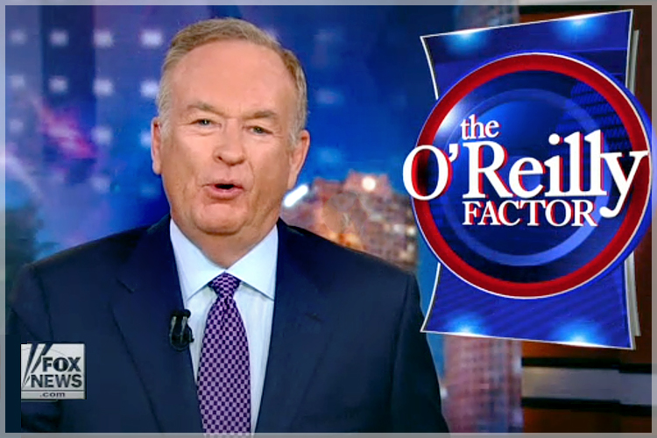
Partisan News Media
Notes:
BUT… you put that lack of cross-cultural contact with partisan news media, and now we have something worth discussing.
Why?
Well, people who aren’t liberal don’t tend to watch MSNBC. People who aren’t devoted conservatives rarely watch Fox News.
Who are these partisan media talking to, then? They’re talking to their own club.
Levendusky’s 2015 article finds that partisan media take already devoted partisans and makes them MORE extreme. Echo chamber.
When you watch a partisan news source that takes the opposing side of your perspective, it tends to make you MORE SURE that you’re right and they’re wrong.
There is no persuasion to speak of in partisan news … unless it’s the hardening of pre-existing beliefs. And that is dangerous.

Slide 14
Partisan News Media
Verdict: Somewhat.

Slide 15

Social Media
Notes:
These trends are even more personal and more compounded with social media platforms.
Let’s be clear: You’re not EVER going to change someone’s mind on facebook, twitter, instagram, etc.
You WILL make yourself, and possibly your friends, really, really mad.
In so doing, you’ll make each of you more certain that you’re right and your friend is wrong.
But what social media does is potentially more pernicious. When people disagree vehemently, they tend to un-friend, un-follow, or hide one another. This creates yet another echo chamber… and the stuff that gets shared tends to be the most extreme political speech. What’s more, it becomes tied up in our very identity. There’s little that’s more threatening than someone disagreeing with something we feel expresses a core part of ourselves.
Suddenly, your political opponents aren’t just civilly disagreeing with you. They’re fundamentally saying you are morally wrong.
That’s threatening, and we suffocate that criticism… and now we’re living in a world where our opinions are never challenged.

Slide 16
Social Media
Verdict: Not alone.
Notes:
These trends are even more personal and more compounded with social media platforms.
Let’s be clear: You’re not EVER going to change someone’s mind on facebook, twitter, instagram, etc.
You WILL make yourself, and possibly your friends, really, really mad.
In so doing, you’ll make each of you more certain that you’re right and your friend is wrong.

Slide 17
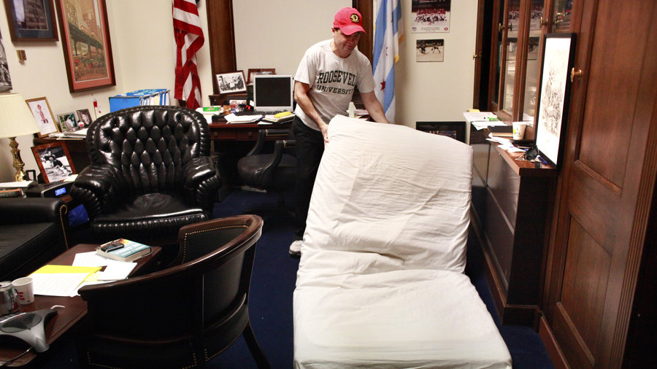
Changes in DC Culture
Notes:
Starting with the Republican revolution, spearheaded by Newt Gingrich, in 1994, a new generation of Republican lawmakers came to DC explicitly rejecting DC collaboration.
They stopped moving their families to DC, stopped socializing outside of work, stopped forming relationships.
The last of the “old guard” is now retiring, leaving Congress, or dying.
Members now say, with pride, that they sleep in their Capitol Hill offices.
The result? Less incentive to compromise with those your spouse socializes with on the weekend.
A culture of people with no investment in the city and little investment in the greased-wheels of DC.
Bipartisanship has taken a serious hit, and many members with long memories say this changed culture is a major reason why.

Slide 18
Changes in DC Culture
Verdict: Yes.

Slide 19
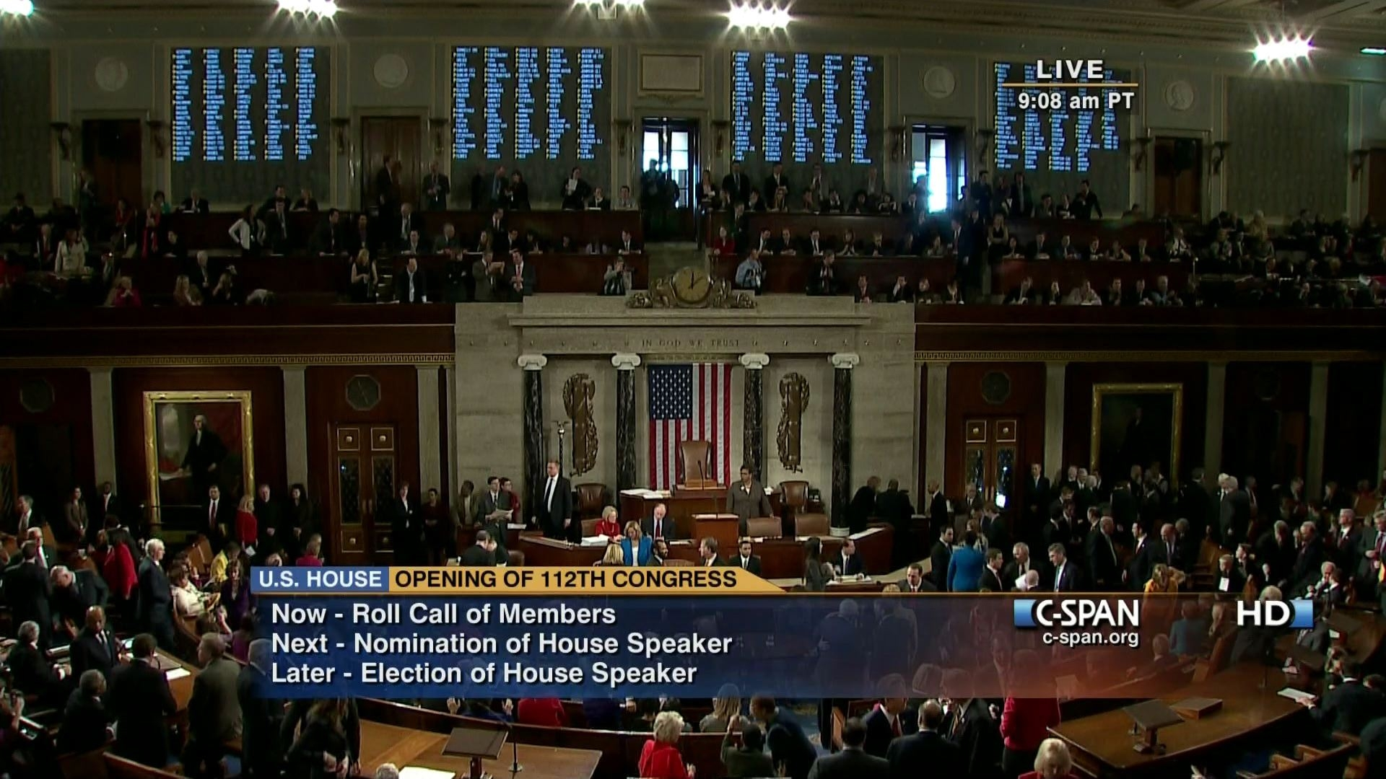
C-SPAN / Sunshine Laws
Notes:
What started as an effort to air out the “smoke-filled back rooms” of Congress has had seriously negative unintended consequences.
Adding C-SPAN to the legislative chambers means that many Americans’ primary image of Congress is a room that’s mostly empty. They think their MCs aren’t actually working.
Americans were able to see, so to speak, how the sausage is made. Sometimes it’s boring. Sometimes it borders on the raucous and uncivil. Sometimes it’s just outrageous. Preposterous.
Most importantly, though, “sunshine” laws hamstring elected officials from making private bargains that place good of the country above personal ambition. When interest groups see literally EVERY VOTE, every negotiation you make, and can turn those votes / negotiations into campaign issues, you have no wiggle room … particularly with Super PACs out there. Where once we saw compromise and voice votes without a recorded vote, allowing some cover for members, now we have total sunshine… and, I would argue, that’s to our detriment.

Slide 20
C-SPAN / Sunshine Laws
Verdict: Yes.

Slide 21
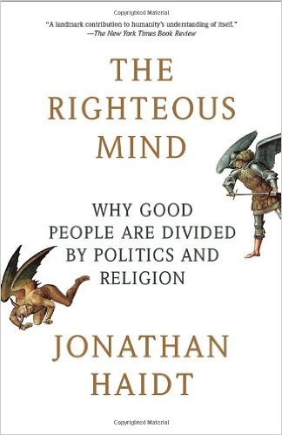
Want to Change Minds?
Read this book and/or watch Jonathan Haidt’s TED Talk, “The Moral Roots of Liberals & Conservatives”

Slide 22
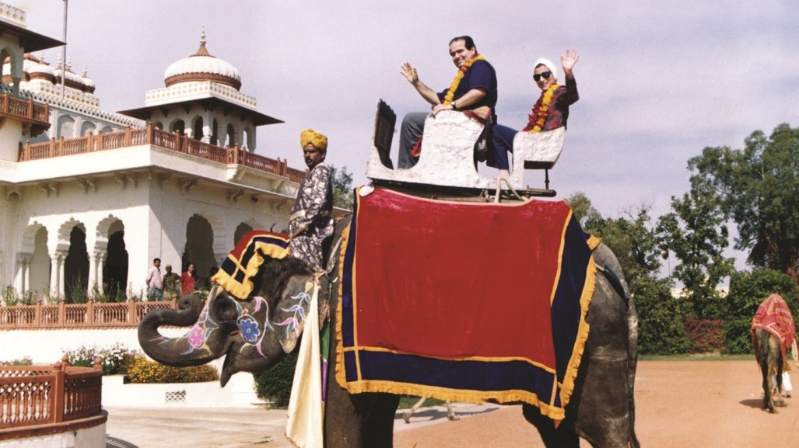
Concluding Thoughts

