Slide 2
Reimagining Your Syllabi with
Equity at the Center
Notes:
Welcome

Slide 3
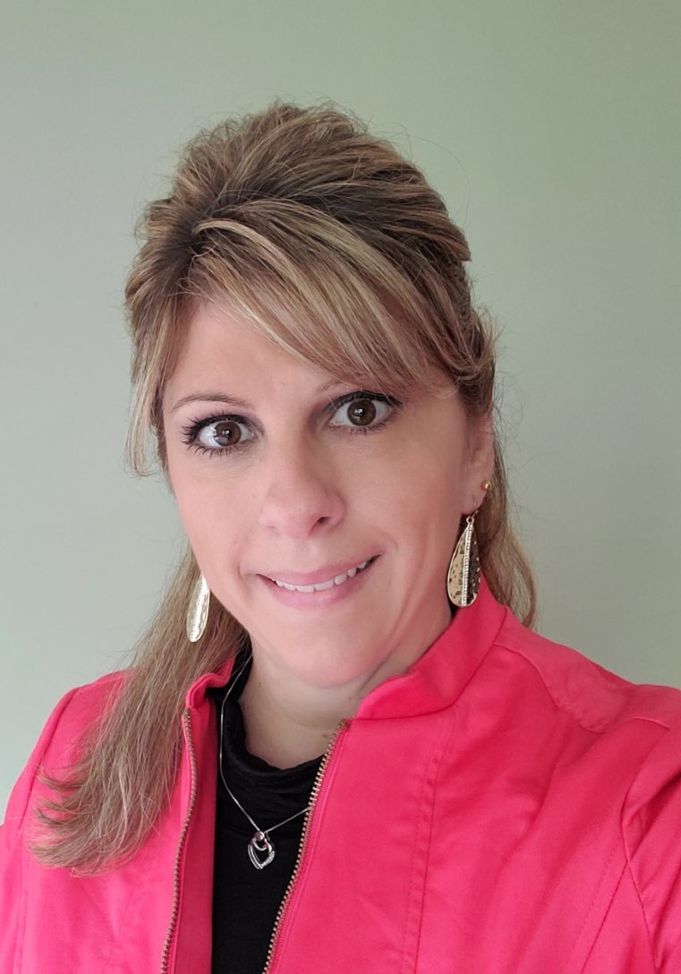

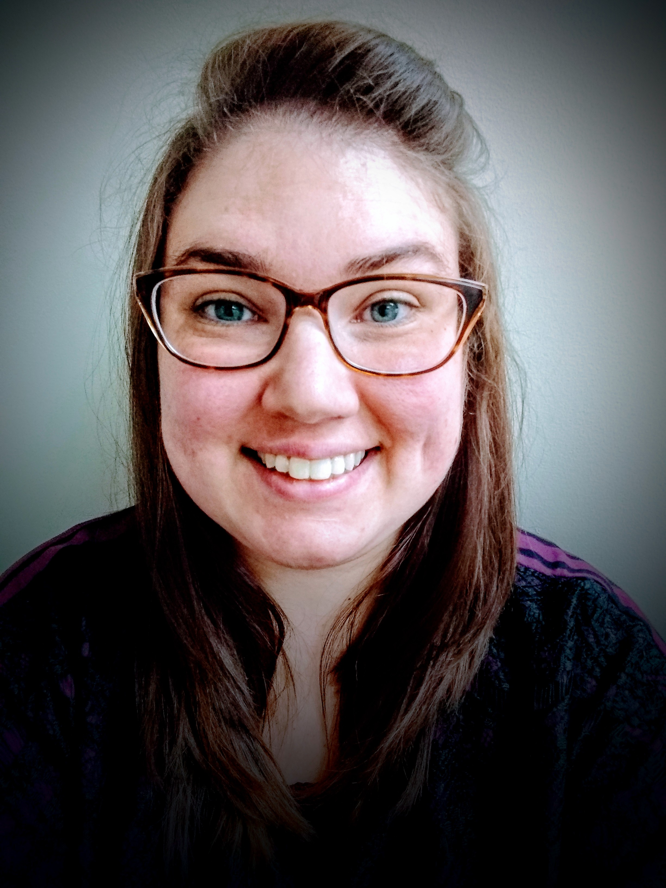
Panelists
Kendra Guffey
Assistant Professor, Math
Davidson-Davie Community College
North Carolina
Liz Norell
Associate Professor, Political Science
Chattanooga State Community College
Tennessee
Teresa deSousa Cull
Assistant Professor of Math
Gateway Community College
Connecticut
Notes:
Ruanda

Slide 4
Agenda
Reimagining Your Syllabi with Equity at the Center
Welcome and Introduction | Student Feedback
Design and Structure | Faculty Buy-in, Roll-out, and Scale Template
Language | Re-imaging Discussion
Integrating Supports | Q&A
Notes:
Ruanda

Slide 5
Participant Poll
Who's in the Room?
Please indicate your primary role
Notes:
Who's in the room ?
Faculty
Faculty Developers
Instructional Designers
Academic Affairs Professionals
Students
Administrators
Advisors
Staff
Other

Slide 6
Poll Results

Slide 7
Participant Poll
Where are you now?
A) First time thinking about my syllabi
B) I have begun the equitize syllabi process
C) I am far along in the equitize syllabi process
D) I am a leader and have done work to scale efforts on my campus
Notes:
1) Who's in the room ?
Faculty
Faculty Developers
Instructional Designers
Academic Affairs Professionals
Students
Administrators
Advisors
Staff
Other
2) Where are you now?
First time thinking about my syllabi
I have begun the equitize syllabi process
I am far along in the equitize syllabi process
I am a leader and have done work to scale efforts on my campus

Slide 8
Poll Results

Slide 9
SYLLABI: Power and Potential
Contracts
Learning Tools for Student Success
Communication Devices
Notes:
Syllabi are a key feature of every academic course, documents that serve multiple purposes.
syllabi are seen as contracts between students and the instructor and as records of what courses cover and how student outcomes and performance are evaluated for accountability purposes (Parkes & Harris, 2002).
Most contain Basic course information, course readings, content and format and performance evaluation
Syllabi, however, are also learning tools that can help students develop effective learning practices and strategies and communication devices that share how teaching will be approached (Grunnert, 1997; Parkes & Harris, 2002).
Because they serve these varied purposes makes them rich sources of information about teaching as a practice.
The syllabus is often the initial communication tool that students receive as well as being the most formal mechanism for sharing information with students regarding any course.
Despite their importance, the structures and formats of written syllabi tend to be handed down from one generation to the next, rarely considered as part of curriculum redesign
Cooper Union

Slide 10
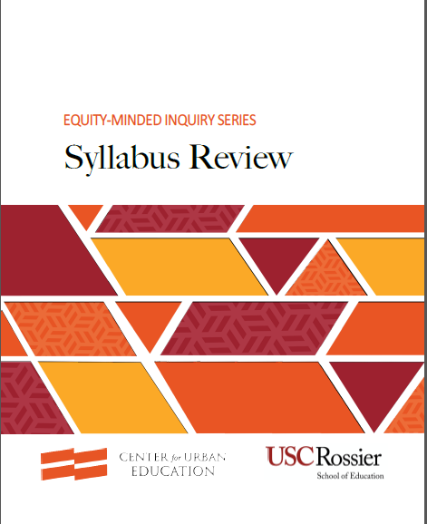
EQUITY – MINDED SYLLABI
Notes:
from the work that Estela Bensimon’s CUE shop at USC provides training for faculty to Equitize Syllabi
Syllabus review is an opportunity for structured inquiry and reflection, to assess aspects of teaching as reflected in syllabi, for example, course goals, class norms and rules, expectations for and evaluations of student learning, and forms of assistance and support.
As artifacts of practice that capture how faculty see the course, what they assume students should be able to accomplish, and what they will do to advance student learning, inquiry into syllabi has the potential to reveal the assumptions, attitudes, values, and beliefs that shape teaching.
In addition, examining the content and language of a syllabus can help make explicit who it is written for (e.g., students, faculty, institution), and thus, who it—and by extension, the faculty who created and uses it—serves.

Slide 11
Syllabus Review Goals
To make visible the use of language used in syllabi
To make visible who syllabi are designed to serve
To reflect upon the potential impact syllabi have on students
Notes:
Syllabi are artifacts of practice that can reinforce and reproduce the norms, rules of ed system designed for white, middle-to upper class, heterosexual, able-bodied and Christian students
While student populations in college have become increasingly diverse, most higher education policies and practices have not been reconfigured to equitably support, affirm, and validate students from racial or marginalized groups and the syllabus is no exception

Slide 12
Six Equity Minded Practices
Representing a range of racial/ethnic experiences and backgrounds in assignments, readings, and other materials.
Welcoming language that creates a caring and supportive classroom culture.
Validating students’ ability to be successful by communicating the belief that all students are expected to succeed.
Notes:
Representing a range of racial/ethnic experiences and backgrounds in assignments, readings, and other materials
Communicates the value of students’ racial/ethnic backgrounds as sources of learning and knowledge
Includes readings, activities, and assignments that are culturally relevant and inclusive
Includes assignments that ask students to draw on their experiential knowledge and/or knowledge from their communities
Include assignments that asks students to investigate real-world problems affecting their communities from which they come
Welcoming - Creating a classroom culture in which they feel cared for Communicate care and support
Use language and tone that makes students feel cared for and valued.
Convey sensitivity to students’ entering skill level, notes that aspects of the course can be challenging, and suggests that it is acceptable and beneficial for students to seek help, whether or not they are struggling.
Convey a willingness to work individually with students who need extra help.
Establish respect and inclusion as class norms
Set ground rules for respectful class discussion
Include a class anti-discrimination policy
Communicate commitment to talking through racist and discriminatory comments or behavior that arise in class or on campus
3. VALIDATING students’ ability to be successful Communicate belief that all students are expected to succeed
Articulate that students—regardless of their stated intentions—are capable of obtaining their educational goals.
Offer different types of assignments and forms of assessment that give students multiple ways to demonstrate their learning and strengths

Slide 13
Six Equity Minded Practices
4. Demystifying college policies and practices by presenting information free of academic jargon.
5. Creating a Partnership in which faculty and students work together to ensure success.
6. Deconstructing and promoting awareness and critical examination of dominant norms and broader social inequities.
Notes:
4. DEMYSTIFY Provide students with the information they need to successfully complete the course and navigate the college
Include basic information about the course (e.g., course description, objectives, instructor contact information and office hours, grading scheme)
Includes information on how and where additional support can be obtained, from the instructor and campus support centers
Present information in such a way that a first-time college student can easily make sense of the syllabus
Written clearly, in plain language, with limited academic jargon
Formatted and ordered in a way that highlights what students need to know to maximize their learning and success
5. CREATING A PARTNERSHIP in which faculty and students work together to ensure success
Communicate a commitment to working with students for their success
• State what you expect of students as learners, and what students can expect from you as an instructor
Articulate willingness to receive feedback from students about your teaching practices
Articulate willingness to use a variety of teaching approaches to foster learning
Communicate respect for students as learners
Articulate respect for students as autonomous, critical, and reflective learners
State how class and course objectives will help students succeed in future academic work, and advance career and life goals
6. DECONSTRUCTING the presentation of white students as the ‘norm’
Promotes awareness and critical examination of students’ assumptions, beliefs, and privilege
• Includes readings, activities, and assignments that ask students to critically examine their assumptions about different racial/ethnic groups, and the privileges or disadvantages they accrue by virtue of their race/ethnicity
Promote awareness and critical examination of dominant norms and broader social inequalities
Includes readings, activities, and assignments that ask students to examine the history and contemporary experiences of people and communities that face discrimination, racism, and marginalization
Includes readings, activities, and assignments that ask students to question dominant, racialized norms, as well as inequalities in major social institutions (e.g., education, health, law)

Slide 14
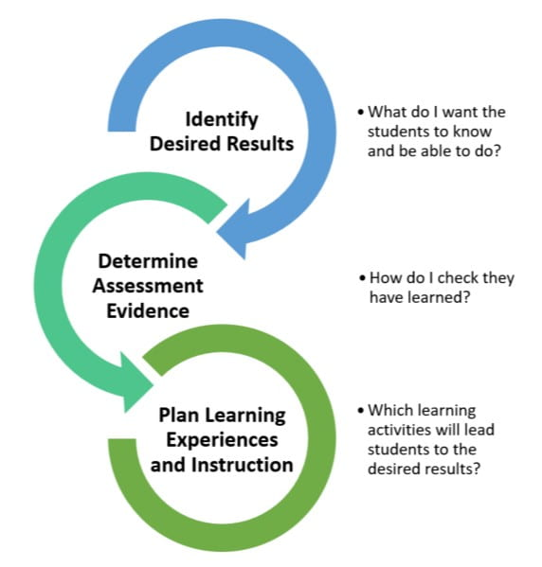


Why?
Engage learners
Reflect the world
Clarify relevance
Notes:
Liz

Slide 15

Design and Structure
Create an inclusive culture and humanize your syllabus
  Visual and easy to scan
  Website tools – increase accessibility
  Liquid syllabus
Focus on small changes that
make a BIG impact
  Language
Notes:
Kendra
Link: Inclusion by Design Worksheet https://drive.google.com/file/d/0B0ulz5eHbyjYdmY0eF9ablRRcHM/view
Link: Liquid Syllabus Example https://sites.google.com/view/hosp-welcome
Link: How to Create a Liquid Syllabus: https://ccconlineed.instructure.com/courses/6771

Slide 16

Language
Best to use language that:
Welcomes and shows support.
Sets the tone for the culture of the class.
Builds sense of inclusivity.
Indicates that the course is learner focused.
Emphasizes student success.
Notes:
Teresa

Slide 17
Language that Humanizes
Suggestions | Instead of
"To be successful ..." | “You are required to…..”
“Here are strategies that can help you……” | “It is your responsibility to, ……”
"I understand things happen, contact me if you have questions or need help” | “There are no excuses. You should contact the instructor right away if…..”
“Late work is eligible for 70% of the original points.” | “Late work receives a 30% reduction.”
“You are encouraged to…..so that you can …..” | “Students are not allowed to …..”
“It is important to …..” | “It is mandatory…..”
“Together we will develop your skills by….” | “You will need to do the following…”
“Our common goal is to help you be successful…..” | “Any student who doesn’t attend class for X days will be automatically dropped.”
“You have the right to….” | “You are expected to….”
“Student Hours” | “Office Hours”
“Please be respectful to the learning environment…..” | "You will not be allowed into the classroom late."
Notes:
Teresa

Slide 18
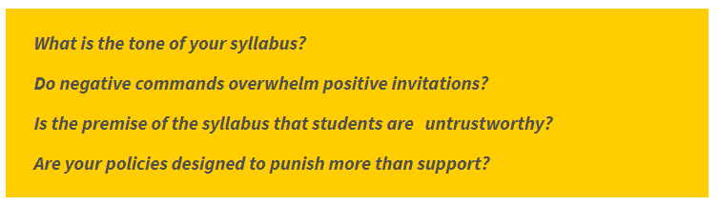

Reflect on Language & Tone
https://iteachu.uaf.edu/

Slide 19

Integrating Supports
Include references to campus resources and use language to normalize their use
Emphasize these are pre-paid services
Couple with stories of how students use these resources
Notes:
Liz

Slide 20

Student Syllabus Feedback
Liked the encouraging comments and/or
quotes throughout.
Syllabus is informative without feeling pressured.
Informed us what to expect and how we can do our best.
Welcoming tone throughout.
Could tell that the instructor wanted us to succeed and stressed they were always there to support us.
Detailed course assignments and due dates were helpful.
Included mental health services and links.
Many ways to show the instructor how you are learning.
Felt more personal than other syllabi.
Notes:
Teresa

Slide 21

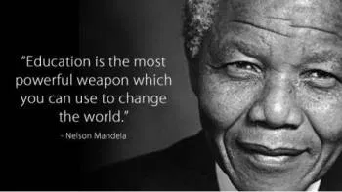
Student Syllabus Likes
Welcome to MAT 085! I want you to succeed in this course. We all learn differently because we build knowledge differently. You are not in this alone, reach out to me or your classmates for support! You got this!
BELIEVE IN YOURSELF and be prepared to work hard. ~Stella McCartney
I understand that technology problems can be a significant source of stress for students. I encourage you to contact me if you have difficulty accessing the necessary course materials or technology.
“Going to school, reading and doing our homework wasn’t just a way of passing time, it was our future.”
~ Malala Yousafzai, Pakistani Activist
"I love being wrong because that means, in that instant, I learned something new that day." Neil deGrasse Tyson

Slide 22

Faculty Buy-in, Roll Out, and Scale (Beginnings)
Background
Syllabus Design Team
Goals and Focus
  Accessibility
  Humanistic
  Clarity
Notes:
Kendra

Slide 23
Faculty Buy-in, Roll Out, and Scale (Student Survey 1)
Do you read your class syllabus?
  Yes, carefully (39.7%); Skim to find important info (69.7%); Not usually (0%)
How often do you look at the syllabus after the first day of class?
  Never (9.2%); 1-3 times (56.6%); 3-5 times (18.4%); 5 or more (15.8%)
Notes:
Kendra

Slide 24
Faculty Buy-in, Roll Out, and Scale (Student Survey 2)
What information do you find most helpful in a syllabus? Check all that apply.
Grading Policy (92.1%)
Course Schedule/Outline/Due dates (89.5%)
Course Requirements/Materials (82.9%)
Instructor Contact Info (81.6%)
Policies: Make-Up Work(69.7%) and Attendance (68.4%)
Notes:
Kendra

Slide 25
Faculty Buy-in, Roll Out, and Scale (Student Survey 3)
How likely are you to refer to the syllabus if you are experiencing challenges within the course?
 | 1 | 2 | 3 | 4
Not likely | 6.8% | 32.9% | 21.9% | 38.4% | Very Likely
Notes:
Kendra

Slide 26
Faculty Buy-in, Roll Out, and Scale (Student Survey 4)
Additional comments or suggestions about syllabi:
Appreciate assignment/course schedule – helpful for planning regardless of how tentative it is
Sometimes you have to search Moodle for more info that should be in the syllabus
Not clear – grading/assignment info under how to be successful
Informative – found everything I needed
Notes:
Kendra

Slide 27
Faculty Buy-in, Roll Out, and Scale (Template 1)
Syllabus: Course Guide for [[Insert class title]] ​
[[term]]​
If you need assistance accessing this course, contact Disability Access Services; contact information below:​
Email: disabilityservices@davidsonccc.edu​
Phone: (336) 249-8186 ext. 6342​
Disability Access Services (website)​
The syllabus is a guide for your success in this course. Refer back to this document throughout the course.​
Notes:
Kendra

Slide 28
Faculty Buy-in, Roll Out, and Scale (Template 2)
Before | After
Course Title and Instructor | Instructor Information
Course Information and Student Learning Outcomes Methods of Instruction and Evaluation | Course Information
Course Requirements | Course Materials
Methods of Instruction and Evaluation | Assessments
Notes:
Kendra

Slide 29
Faculty Buy-in, Roll Out, and Scale (Template 3)
Before | After
 | Student Success Strategies
Attendance Additional Policies | Course Policies
Davidson-Davie Policies and Information Students are responsible for reading this syllabus and the DDCC Policies and Information document. | Additional College Information and Policies For your success, please read this syllabus thoroughly along with the DDCC Information and Policies document [insert link]. Additionally, for more information about services and programs offered for Davidson-Davie students, please refer to the Davidson-Davie Student Resource Guide.
Notes:
Kendra

Slide 30

Faculty Buy-in, Roll Out, and Scale (Next Steps)
Feedback
Training
Implementation
Pilot
Notes:
Kendra

Slide 31
Reimagining Discussion
Opportunities in your Syllabi:
  Infuse welcoming language that creates a caring and supportive classroom culture?
  Thinking of your discipline, how can you validate students’ ability to be successful and communicate the belief that all students are expected to succeed?
  How can you use elements of the syllabi to create a partnership in which faculty and students work together to ensure success.
Notes:
Ruanda
Welcoming - Creating a classroom culture in which they feel cared for Communicate care and support
Use language and tone that makes students feel cared for and valued.
Convey sensitivity to students’ entering skill level, notes that aspects of the course can be challenging, and suggests that it is acceptable and beneficial for students to seek help, whether or not they are struggling.
Convey a willingness to work individually with students who need extra help.
Establish respect and inclusion as class norms
Set ground rules for respectful class discussion
Include a class anti-discrimination policy
Communicate commitment to talking through racist and discriminatory comments or behavior that arise in class or on campus
3. VALIDATING students’ ability to be successful Communicate belief that all students are expected to succeed
Articulate that students—regardless of their stated intentions—are capable of obtaining their educational goals.
Offer different types of assignments and forms of assessment that give students multiple ways to demonstrate their learning and strengths
5. CREATING A PARTNERSHIP in which faculty and students work together to ensure success
Communicate a commitment to working with students for their success
• State what you expect of students as learners, and what students can expect from you as an instructor
Articulate willingness to receive feedback from students about your teaching practices
Articulate willingness to use a variety of teaching approaches to foster learning
Communicate respect for students as learners
Articulate respect for students as autonomous, critical, and reflective learners
State how class and course objectives will help students succeed in future academic work, and advance career and life goals

Slide 32

This Photo by Unknown author is licensed under CC BY-SA.

Slide 33


