Slide 1
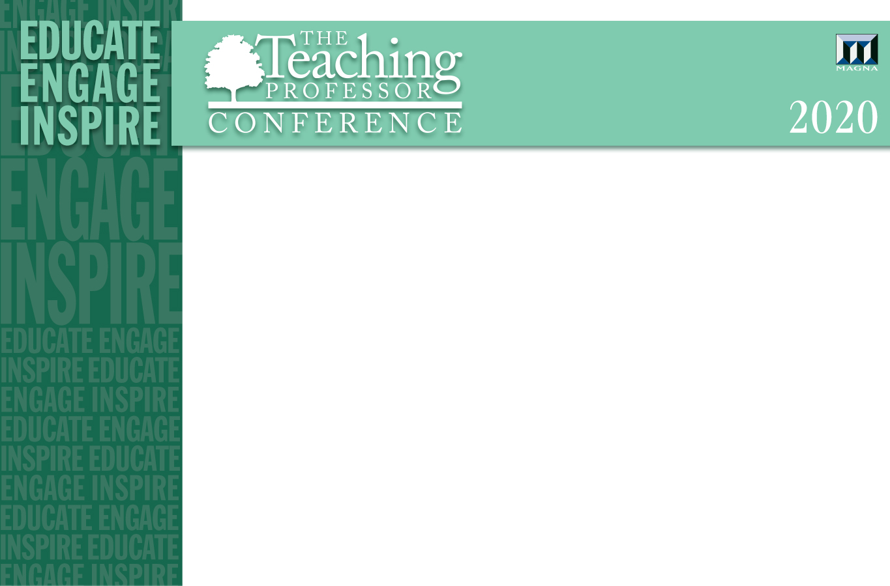
Stop Blaming Students!
Why We Must Teach Students, Not Content

Slide 2
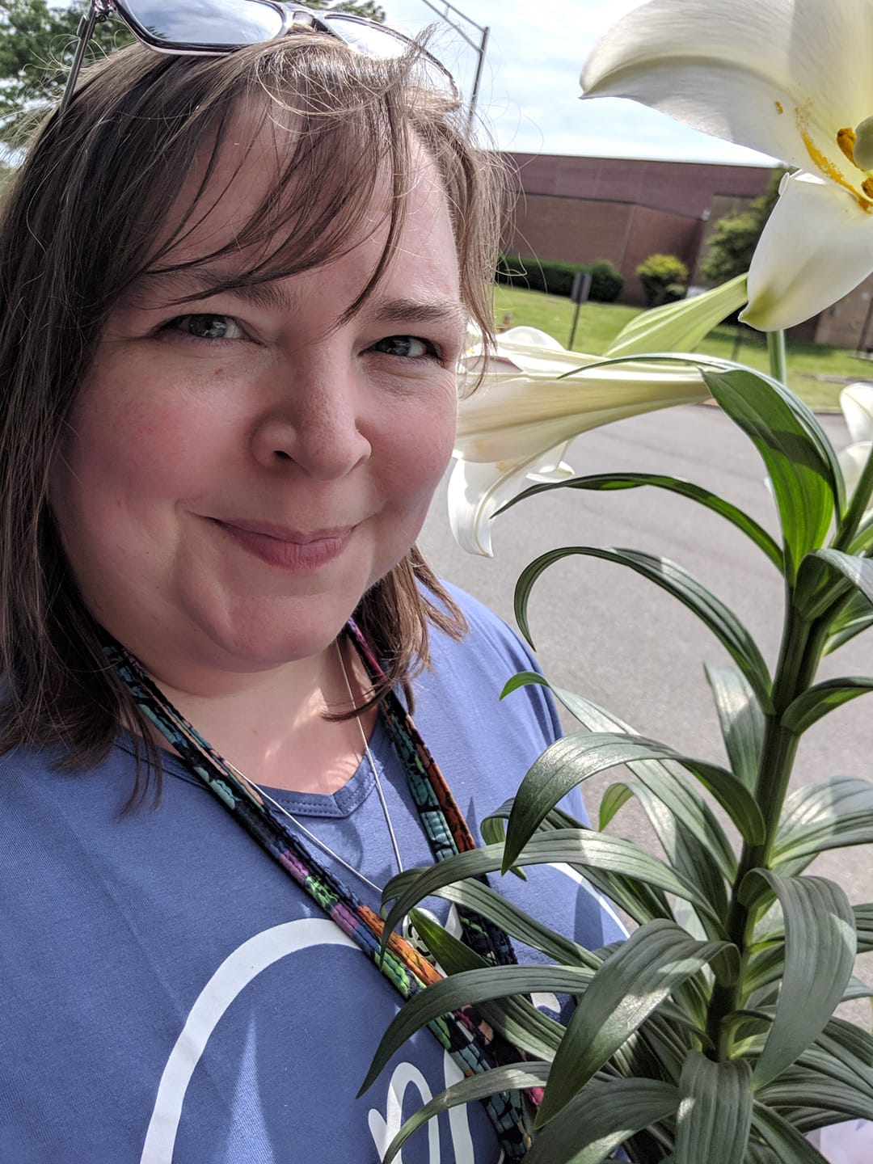
Presented by
Dr. Liz Norell
Assistant Professor, Political Science
Chattanooga State Community College
Notes:
I tool this image on the last day of classes in May 2019. The flower is one my students gave me at the end of the semester. I always feel bittersweet at the end of a semester.

Slide 3
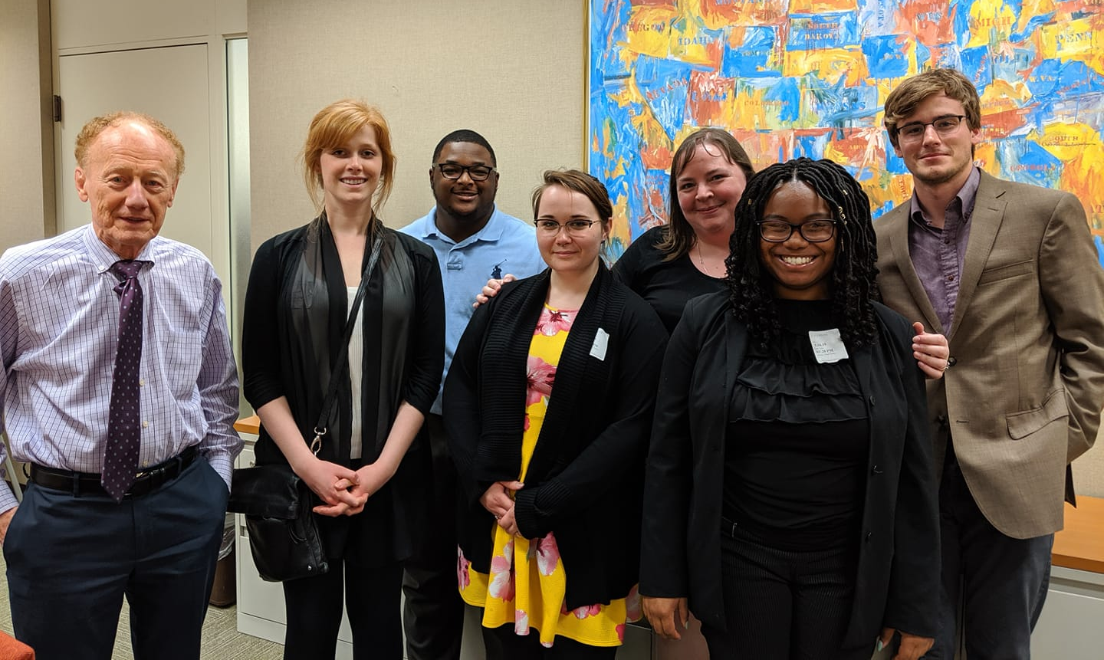
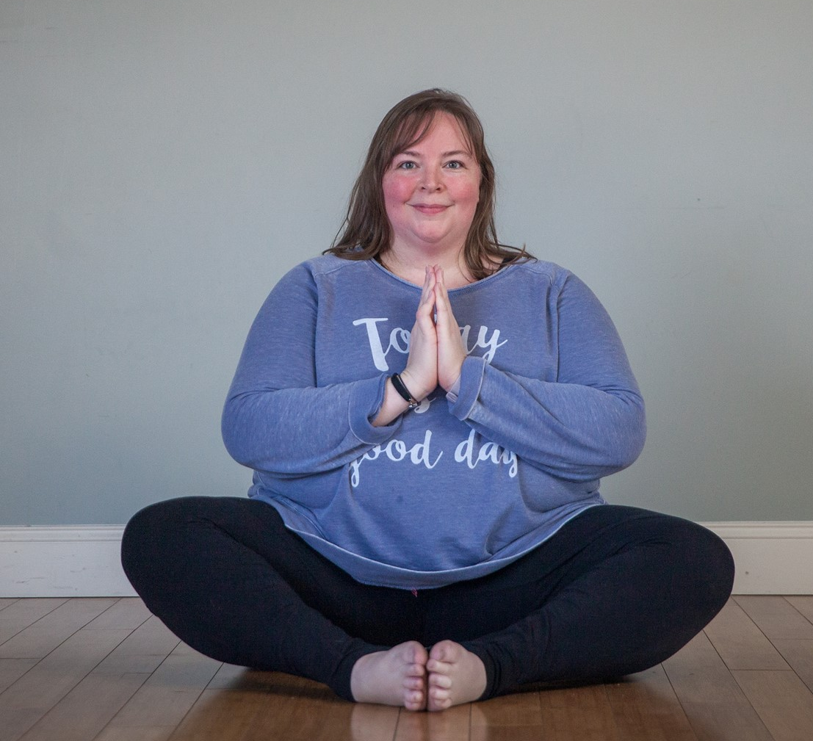
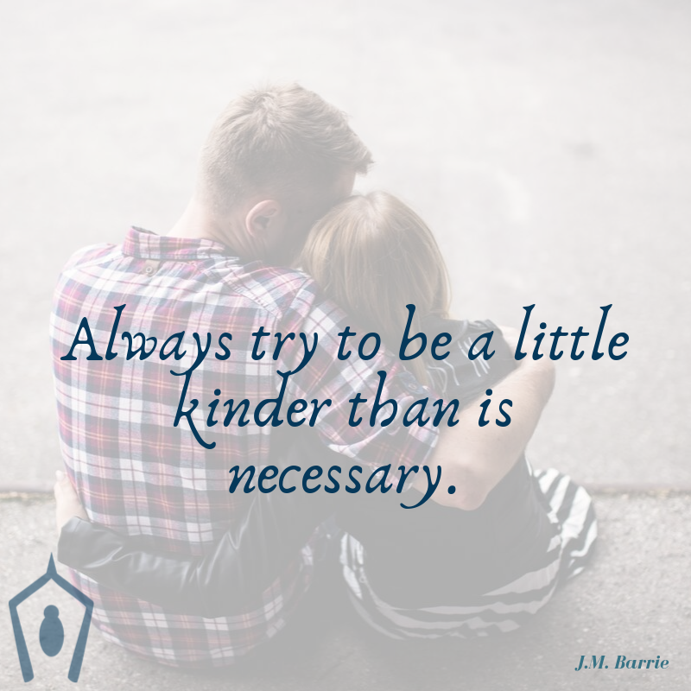
Why me?
Notes:
I teach political science – a discipline that tries to understand how institutions (including norms) can create, or impede, groups of people from making decisions. I got into this discipline wanting to understand how and why some people form more extreme political beliefs … and how we can use that knowledge to create a more respectful and effective world for all.
I’m also a yoga teacher and a life coach, so I bring to my teaching a wealth of knowledge and experience in how connected we all are, the importance of staying present and attuning to what is happening around us, and the importance of accepting others, just as they are, and supporting them in an ongoing process of becoming more of what they want to be.

Slide 4
We cannot assume college literacy.
Got something to jot down some thoughts? Grab it.
Notes:
We’re going to do a little exercise on what commonly-used higher ed lingo might communicate to us if we had never stepped foot on a college campus before.

Slide 5
What does this mean?
KOM 326
Notes:
Imagine you’re a first-generation college student. It’s your first day on a college campus, and you’re trying to figure out what building is “KOM,” which is what’s on your schedule, but there’s no building that starts with the letters K-O-M. How would you figure this out?
(By the way, it’s Kirksey Old Main. You totally figured that out, though, right?)

Slide 6
What does this mean?
TR
Notes:
Your class schedule meets on TR from 11:00-12:15. What does TR mean?
MWF is pretty clear, but wouldn’t “T” be Tuesday and “TR” be Thursday? That would make sense, wouldn’t it?

Slide 7
What does this mean?
office hours
Notes:
When you finally arrive, your professor hands you a syllabus (if you’re lucky) or pulls up the syllabus on the projector (assuming the tech is working), and the first thing you hear is “my office hours are _____”
If you’ve never heard of office hours, what would your first instinct be about what that means? Does it sound like time your professor is sitting in his/her office, waiting for you to show up? Or might it sound like time when your professor doesn’t want to be interrupted?

Slide 8
What does this mean?
bursar
Notes:
You’re at a pretty hip-to-students college and get a text message saying you need to see the bursar about your student account. What the heck is a bursar?

Slide 9
What does this mean?
You have reading assignments due.
Notes:
Your teacher really emphasizes that you’re going to need your books before the next class meeting, so make sure you get those. You’ve never had to get your own books before. Where do you go?
The library, right?

Slide 10
What does this mean?
student resources
Notes:
Your teacher tells you that there are lots of student resources available – so if you need help, just go to the student resource center.
What kinds of resources? What do you go there for?

Slide 11
What does this mean?
tutoring
Notes:
Your teacher also mentions there’s tutoring available in the student resource center. The teacher doesn’t mention how much it costs, though.
What is your assumption? Has tutoring ever been free for you before? Why would it be now?

Slide 12
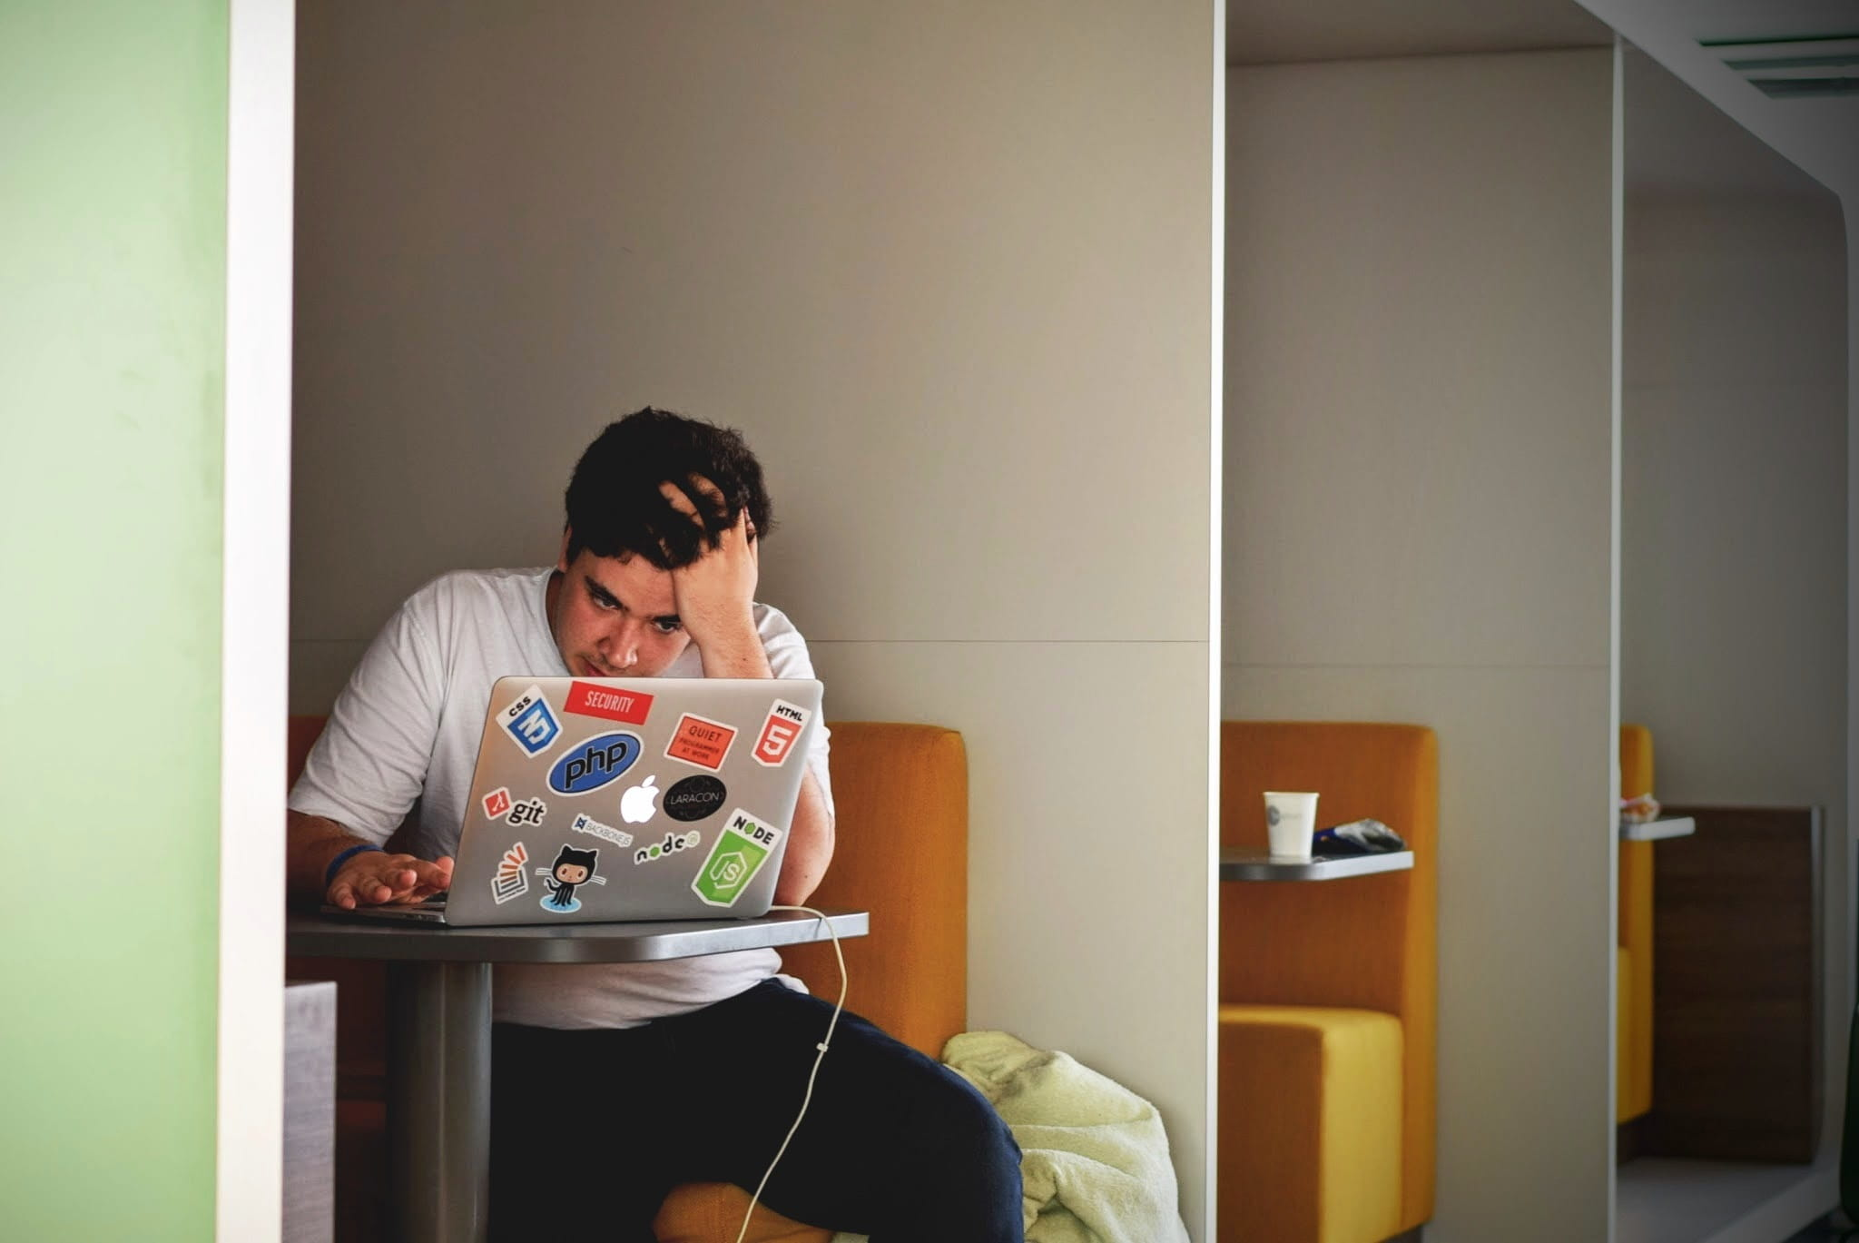
Notes:
By the end of your first day of college, are you still feeling like you’ve got the tools to succeed?
Royalty-free image from https://www.pikrepo.com/frtso/man-in-white-long-sleeve-shirt-sitting-on-chair/download, accessed 12 May 2020.

Slide 13
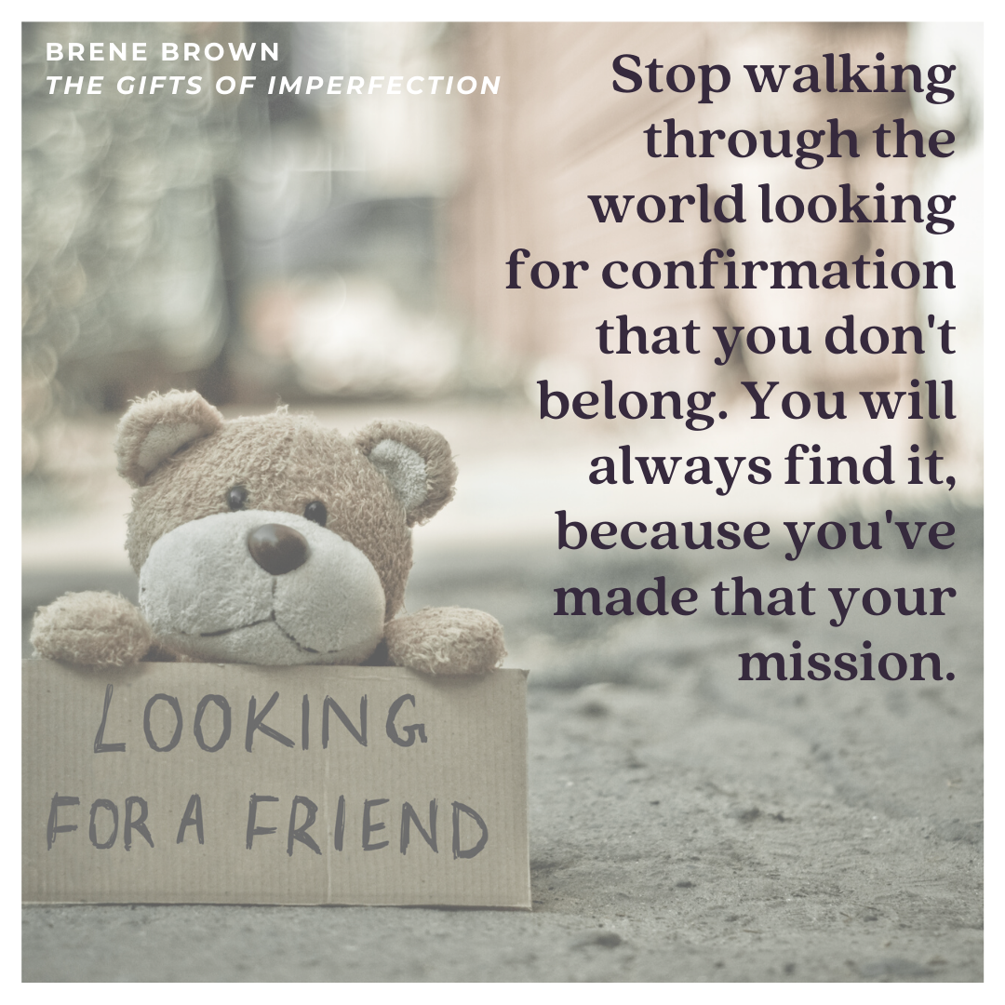
Notes:
While it’s true that our students’ mindsets are important in framing how they interact with our institutions, we have an important role to play in breaking down unnecessary barriers that might impede their sense of belonging.
Image created in Canva using royalty-free imagery.

Slide 14
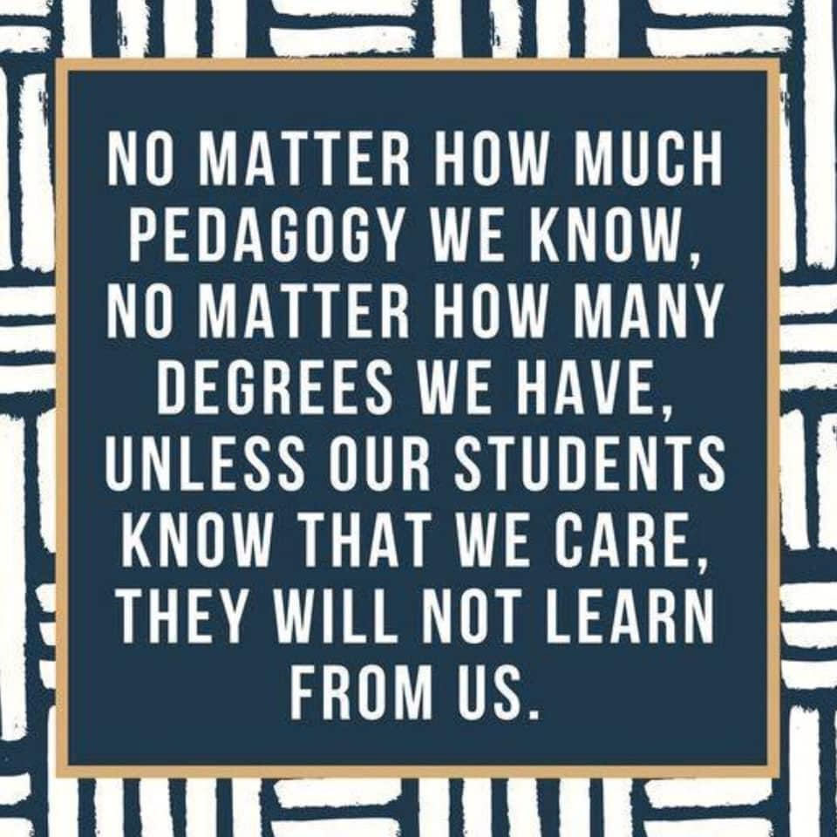
First principle of teaching

Slide 15
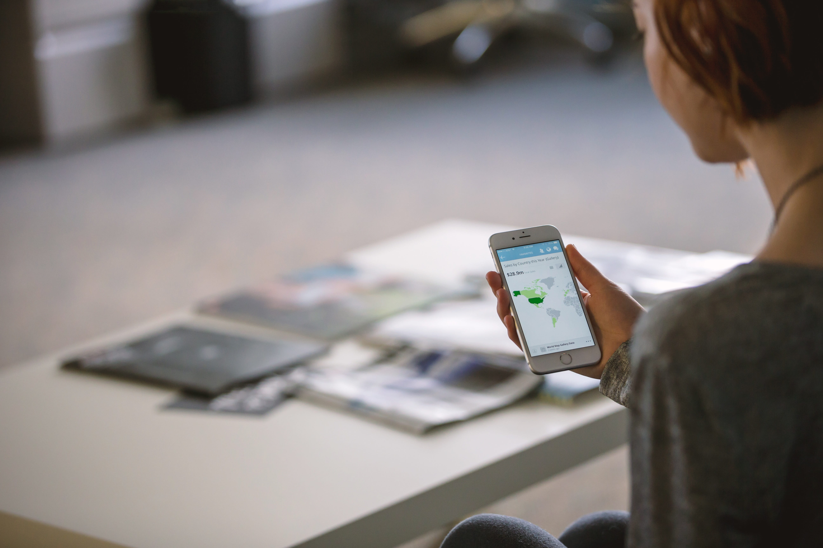
What is our value?
Notes:
A few years ago, educator Chris Emdin came to our campus to give an opening-of-school lecture to faculty. As the author of what he calls “reality pedagogy,” Emdin delivers a passionate, energetic call to faculty to reimagine their teaching as an act of empowering each student in the room. I distinctly remember him pulling his cell phone out of his pocket, holding it above his head, and asking, “When our students have the sum total of human knowledge in their hands, what do they need us for?”
Royalty-free photo downloaded from https://www.pikrepo.com/fnsiy/person-holding-white-android-smartphone, accessed 12 May 2020.

Slide 16

  Reflect
What did your best teachers do that made them so effective?
Notes:
Reflect on this question.
No, seriously, do it right now, before you move forward.
What was it that made them so effective? That you still remember? That made you think, maybe, you wanted to do this as a career, too?

Slide 17

Notes:
For me, the hallmark of a great teacher was someone who could see something in me that I hadn’t seen myself.
And they told me.
In almost every class I’ve ever taken, I’ve learned quite a lot, sometimes with ease, other times with a great deal of effort. But the teachers and moments that have stayed with me have done so because they drew out my best through encouragement, compassion, and faith in my abilities.
Royalty-free image downloaded from https://www.pikrepo.com/fmrql/woman-in-brown-coat-sitting-beside-man-in-brown-coat, accessed 12 May 2020.

Slide 18



Inspire
Structure
Coach
Notes:
I’ve been wrestling with this question for two years. I’ve ultimately come to believe that our role, as higher-education faculty, is to:
Inspire our students with our enthusiasm for our subjects,
Structure the material so they can build more expertise and familiarity, and
Coach them to achieve the goals they have set for themselves.

Slide 19
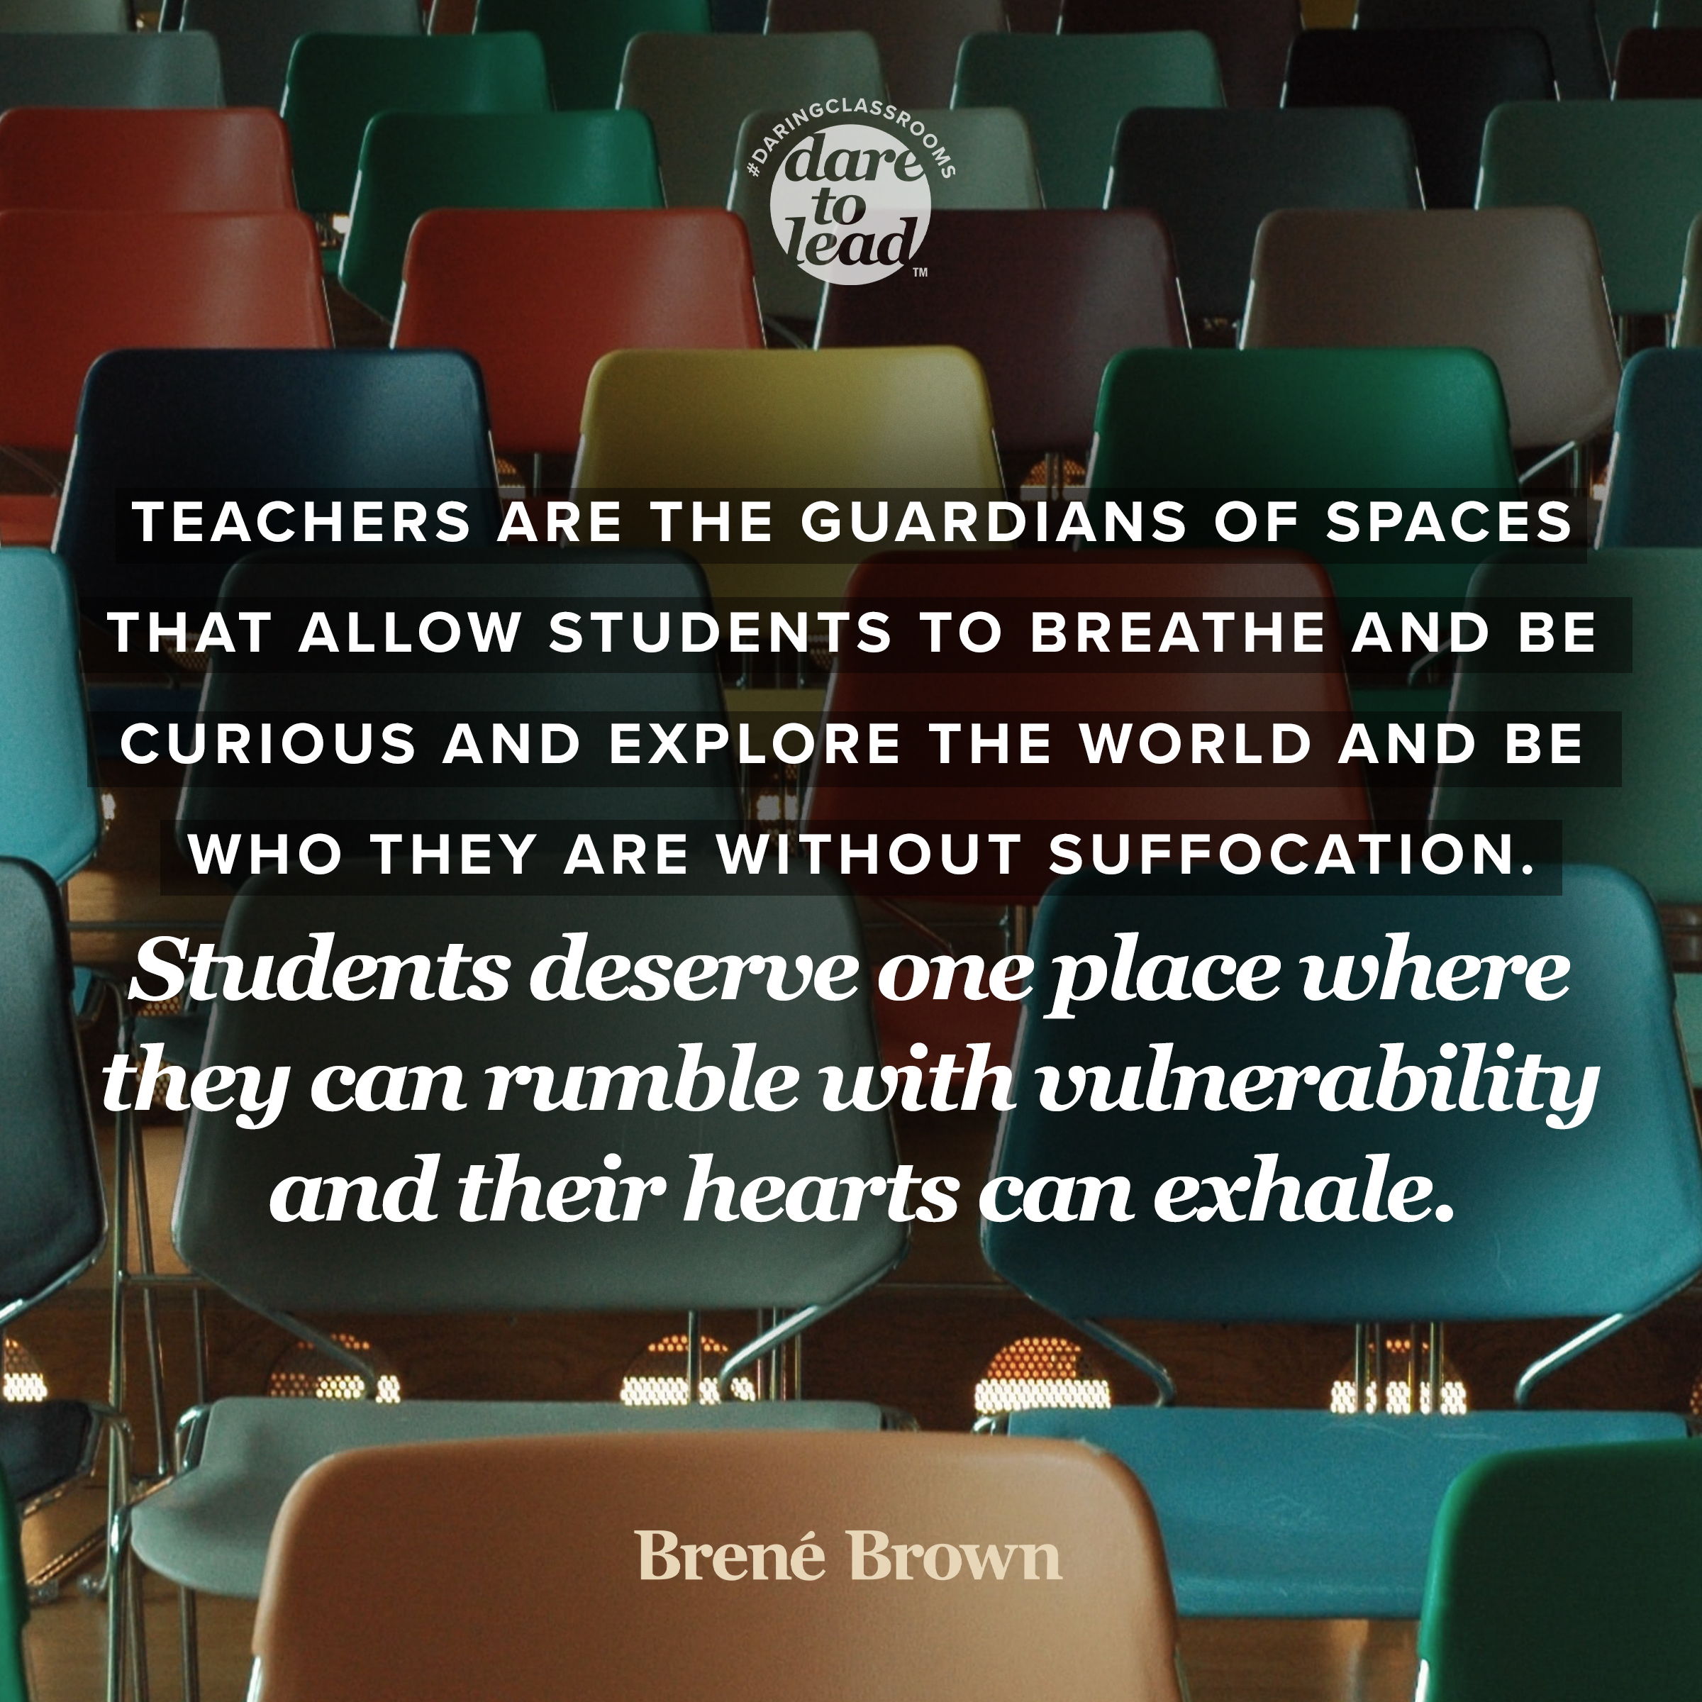
Notes:
Just as importantly, though, we are modeling for students the traits we want to see more of in the world. Higher education is a place where our students can learn how to cultivate knowledge. To seek understanding. To get excited about learning.
We model for our students things like:
CURIOSITY – when was the last time you shared with your students what unanswered questions or puzzles you’re mulling over?
VULNERABILITY / HUMANITY – when we show our students that we are human, we give them permission to do the same. How did you communicate your vulnerability during covid-19?
IMPERFECTION – if we got everything right, 100%, on the first try, education would be pointless. True learning happens when we fail, evaluate what happened / what went wrong, and try again. How are you showing your students your own imperfections?
COMPASSION – think about the quote from earlier: if your students think you don’t care about them, they will not be motivated to learn from you.

Slide 20
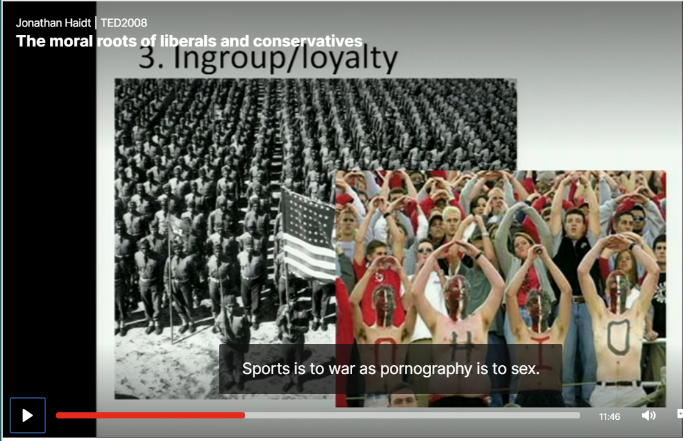
We are social creatures.
Notes:
Humans absolutely love to form groups. Social media has been as explosively popular as it is because it feeds into this most primal of our instincts, to surround ourselves with others and to figure out how we fit in with them.
Erich Fromm, a political theorist who was motivated to understand how presumably good people could be persuaded to do heinous things during World War II. His book, Escape From Freedom, advances a radical theory: We abhor freedom, because it doesn’t give us cues about whether we belong. Give a group of people freedom, Fromm says, and it won’t take long before that group has found a leader to follow. People give up freedom willingly and eagerly, he writes, because we have a deeply ingrained need to know that others around us accept and love us. Total freedom means total independence, which the human race has specifically evolved not to value.

Slide 21
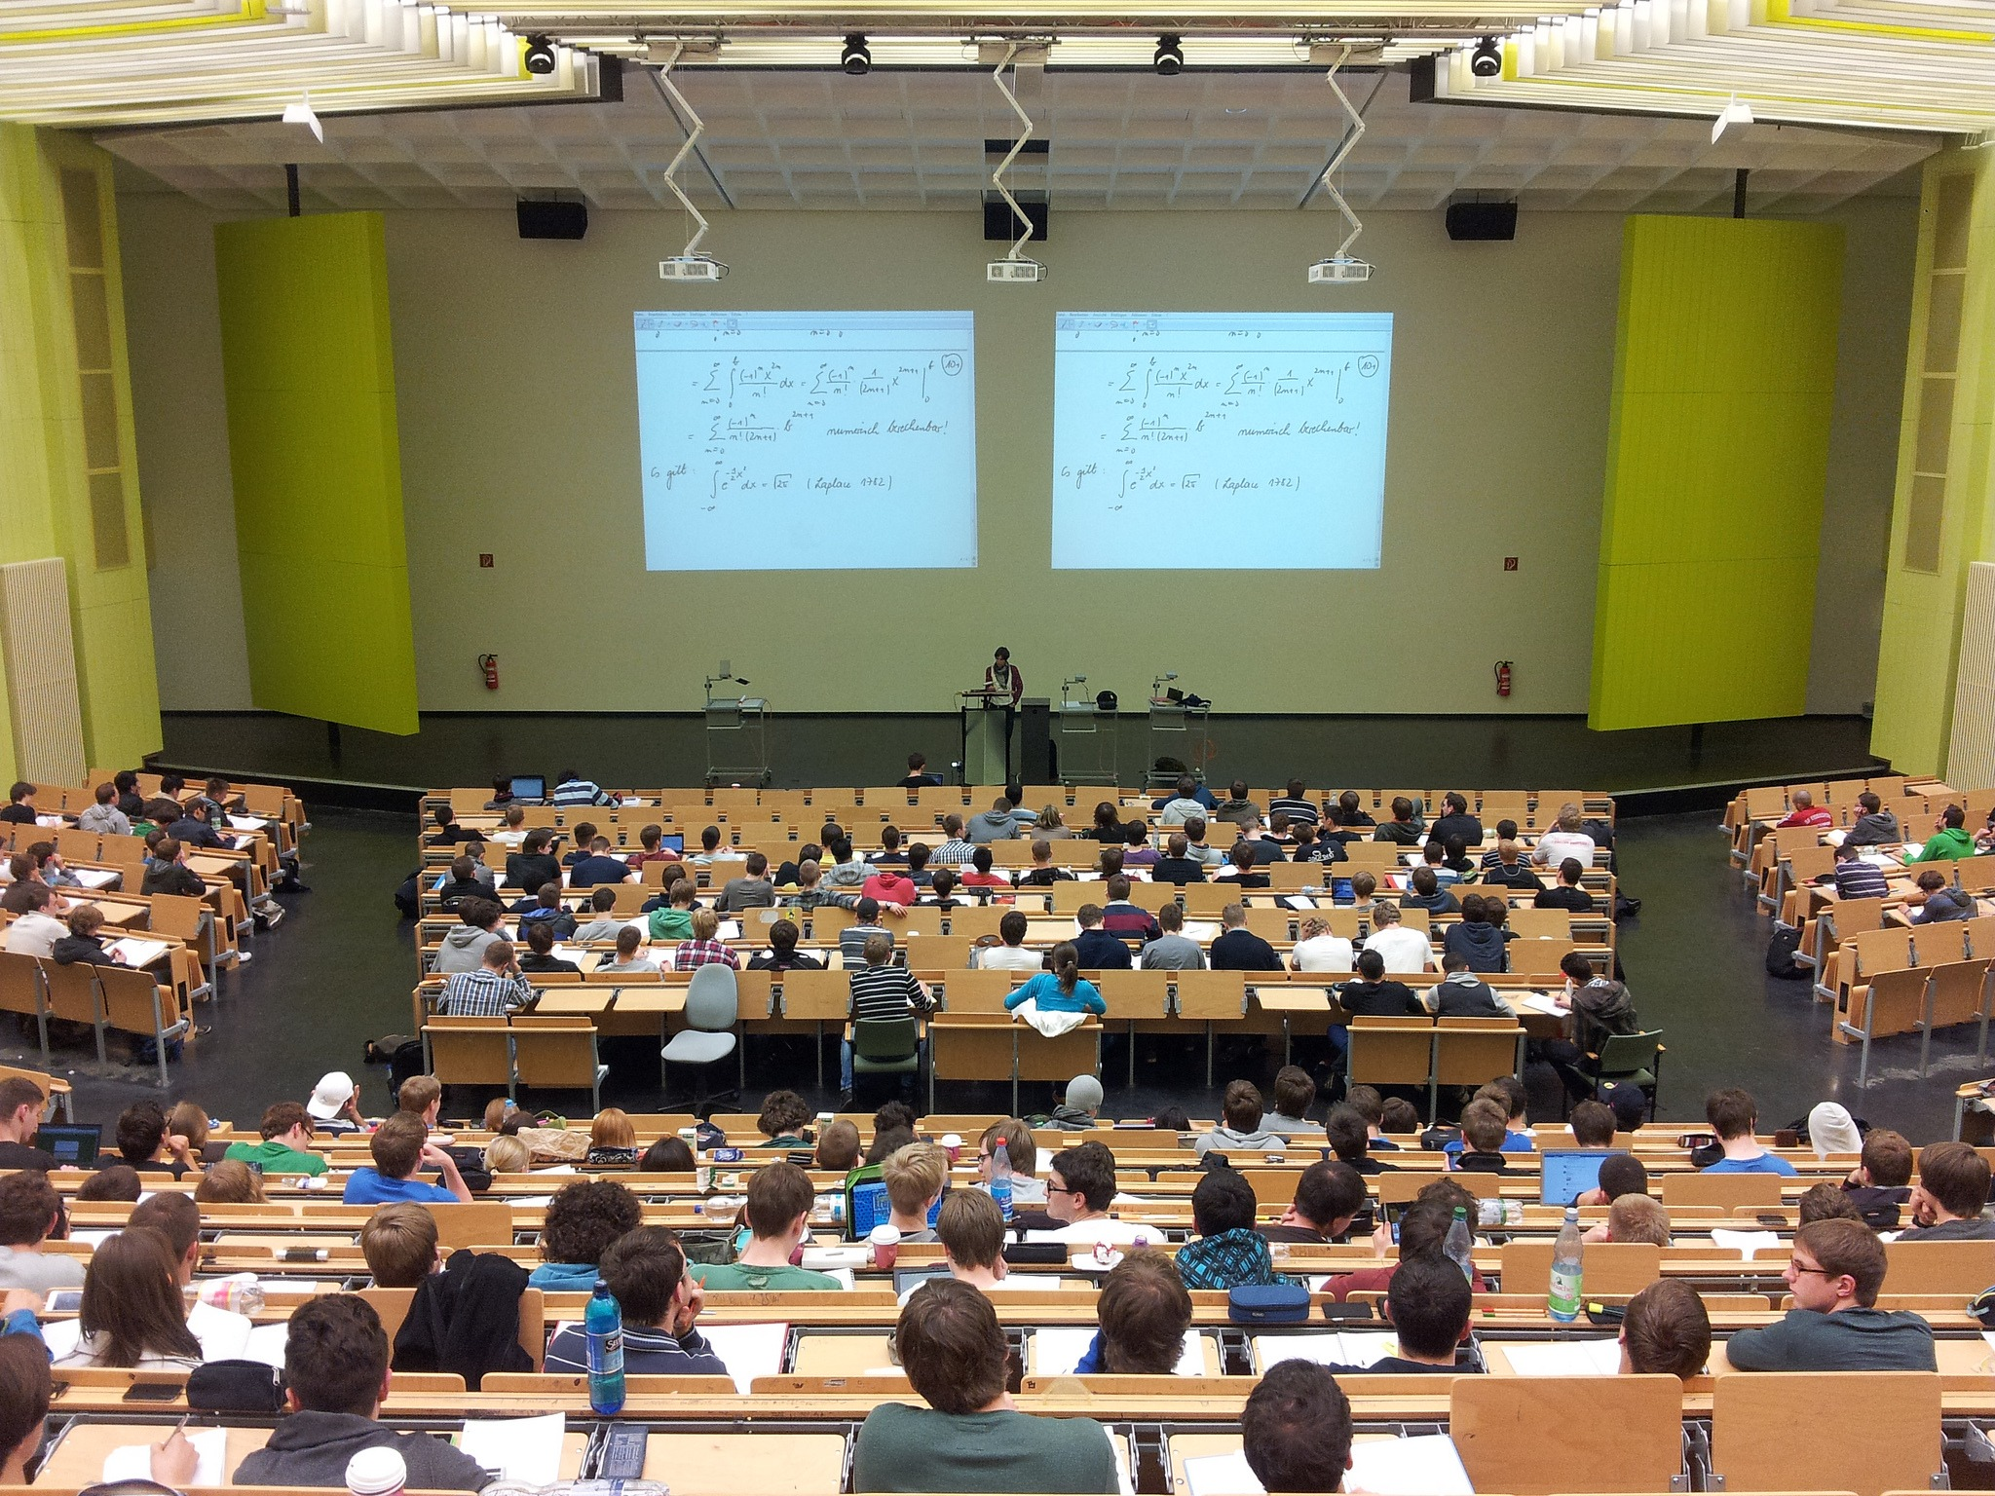
Notes:
The second you put two or more people near one another, something largely invisible begins to happen. We don’t always have language to describe it, but we’ve all experienced the way that emotions, thoughts, and cultures are transmitted through the ether, even when nobody is speaking.
This isn’t just something that the highly intuitive or especially attuned among us can sense; we can all find ourselves ‘catching’ the emotions of those around us. The book Connected looks at a vast array of research studies that demonstrate just how connected we are to others, largely by forces out of our consciousness.
Royalty-free image downloaded from https://www.pikrepo.com/fgylh/photo-of-class, accessed 12 May 2020.

Slide 22
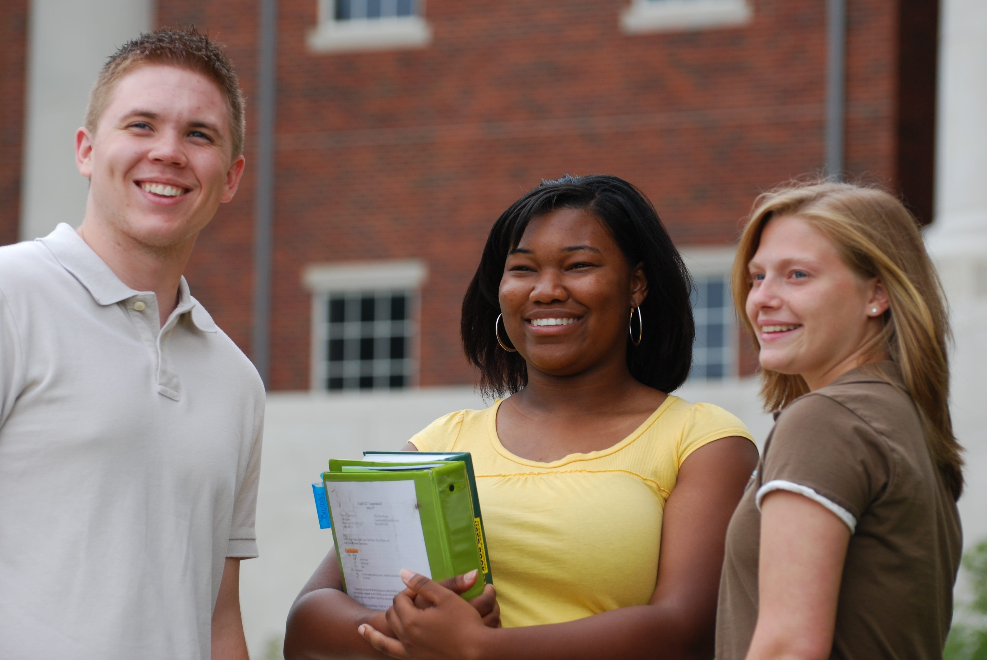
Notes:
For most students, it was probably at least a handful of the following concerns:
Am I in the right place? (right classroom/right class)
Do I belong here?
Is everyone else smarter than me?
How long will it take them to realize I’m not smart enough to be here?
Why does everyone else seem so much more confident than I feel?
Will the teacher be a jerk?
Will the teacher like me?
Can I be successful in this class?
Will the workload be manageable?
Will I have time to do all the work?
Am I smart enough to do all the work?
Can I afford to be here?
Will my kid/mom/dad/grandparent/pet get sick this semester?
Will my boss work around my school schedule?
How many hours of sleep do I really need every night?
Am I a fraud?
Will these other students like me?
Do I stand out?
Am I wearing the right clothes?
Will I fail at college?
Is this really going to help me get a better job?
Have I made a horrible mistake?
Will my car break down before the next class?
Will I have enough money to buy food this week?
Royalty-free image downloaded from https://www.pikrepo.com/fbhsn/woman-in-purple-tank-top-holding-green-book-beside-woman-in-white-button-up-shirt, accessed 12 May 2020.

Slide 23
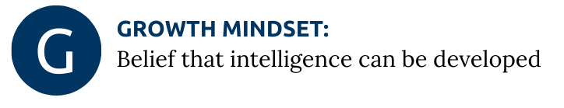
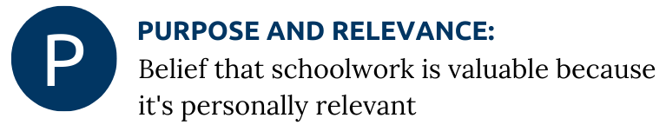
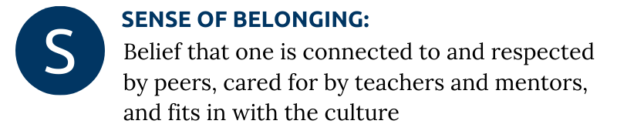
UVA Motivate Lab
Notes:
UVA’s Motivate Lab has been working in partnership with several TN community colleges over the last 2-3 years, implementing interventions to try to boost one or more of these elements… especially in math.
Take a minute or two to reflect on these and think: What can you do to boost your students’ motivation by talking about each of these things?
G: Can you offer students low-stakes opportunities to redo work? (I have a “Redo, Please” form that I include in my syllabus.)
P: Can you design assignments (and TILT those assignments, as much as possible/feasible) to boost the clarity of their relevance?
S: How do you create a culture of caring and inclusion? How do you let students know that you respect them? Care about them? (No matter what the quality of their work?)

Slide 24
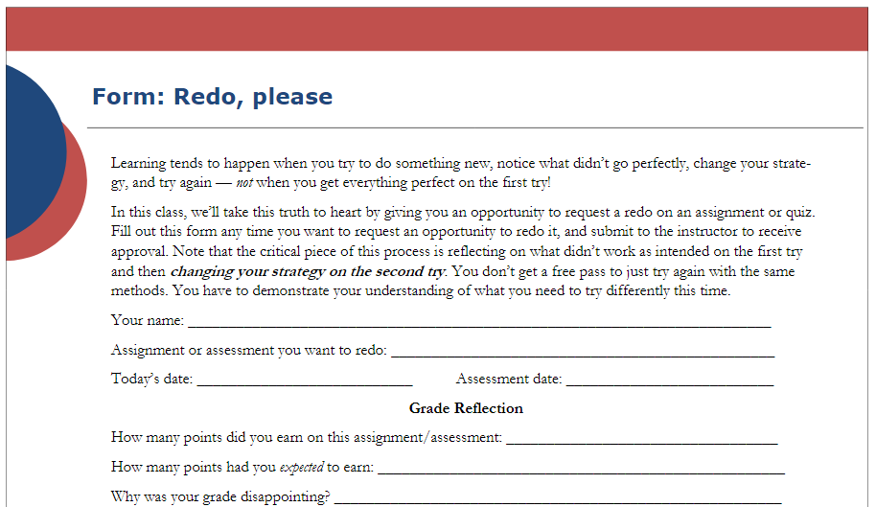
Notes:
G: Growth mindset
Every syllabus, every class – I offer students the opportunity to submit a “Redo, please” form to request to resubmit work. The full form will be available as a handout… please adapt to your purposes. The goal here is to model a growth mindset.
And I know you’ll ask: Do I get inundated with second and third attempts?
No. Rarely, in fact. But when I do, it almost always has paid off—both in terms of the grade and in terms of the learning.

Slide 25
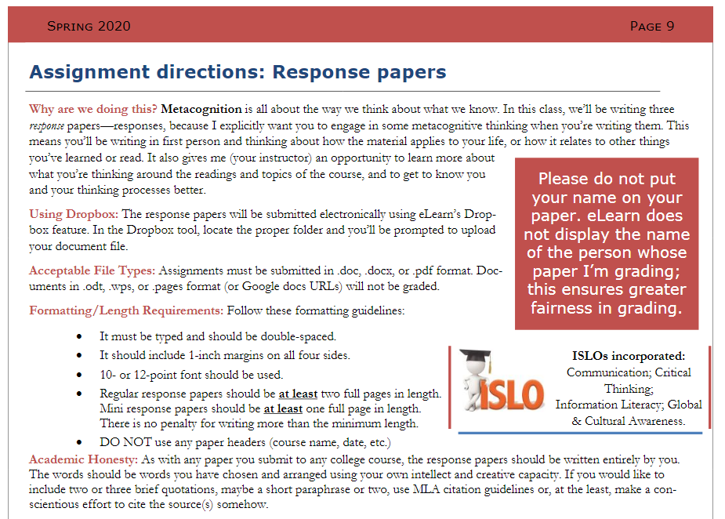
Notes:
P: Purpose and Relevance
Here’s an example of an assignment from my “visually easier” syllabus. A few things I’ve included in all assignments in the syllabus:
“Why are we doing this?” I explain the role this assignment plays in their learning.
Formatting requirements
Institutional Student Learning Outcomes (ISLOs) that this assignment touches on
Also note that I ask students to submit papers without names attached. I’ve enabled anonymous grading, and I explicitly tell them I don’t want to know whose work I’m evaluating. When I leave feedback, I’ll often say something like, “I’m not sure whose paper this is, but I want to commend your use of …”
To the extent possible, I’d prefer my relationship with each student be wholly independent of the grades I record for their work.
Notice that language, by the way. My grad school advisor once said, “I don’t give grades, I record them.” I LOVE THAT.

Slide 26
You might think that you're the only one who's struggling ... but you're not.
In grad school, I was working on a PhD in a field I'd never studied before (political science). EVERYONE knew more than me, I thought. I felt so dumb that first year.
And after three years of working on a PhD at Vanderbilt, I was kicked out of the program.
That's right.
I.
WAS.
KICKED.
OUT.
You are not the only one who isn't sure you belong. You're not the only one who worries you're not doing it right. You're not the only one who feels overwhelmed.
Everyone struggles. Including me.
Notes:
S: Social belonging
I post this message in my course’s LMS shell each semester, to let students know that failure is normal. (This is just an excerpt; the full message is in a handout.)

Slide 27
“Five years from now, my students will still know how to ___________.”
alternatives:
still understand ______________.”
still be able to _______________.”
Notes:
Take a few minutes, reflect, then fill in the blanks of this sentence.

Slide 28
  Reflect
Does your current syllabus place an emphasis on that goal?
Notes:
Now reflect on this question.
And if the answer is no – as I suspect it is – how could you rethink your syllabus, your course schedule, your assignments, and your approach to the class to make this goal more transparent – to you, AND to the students?

Slide 29
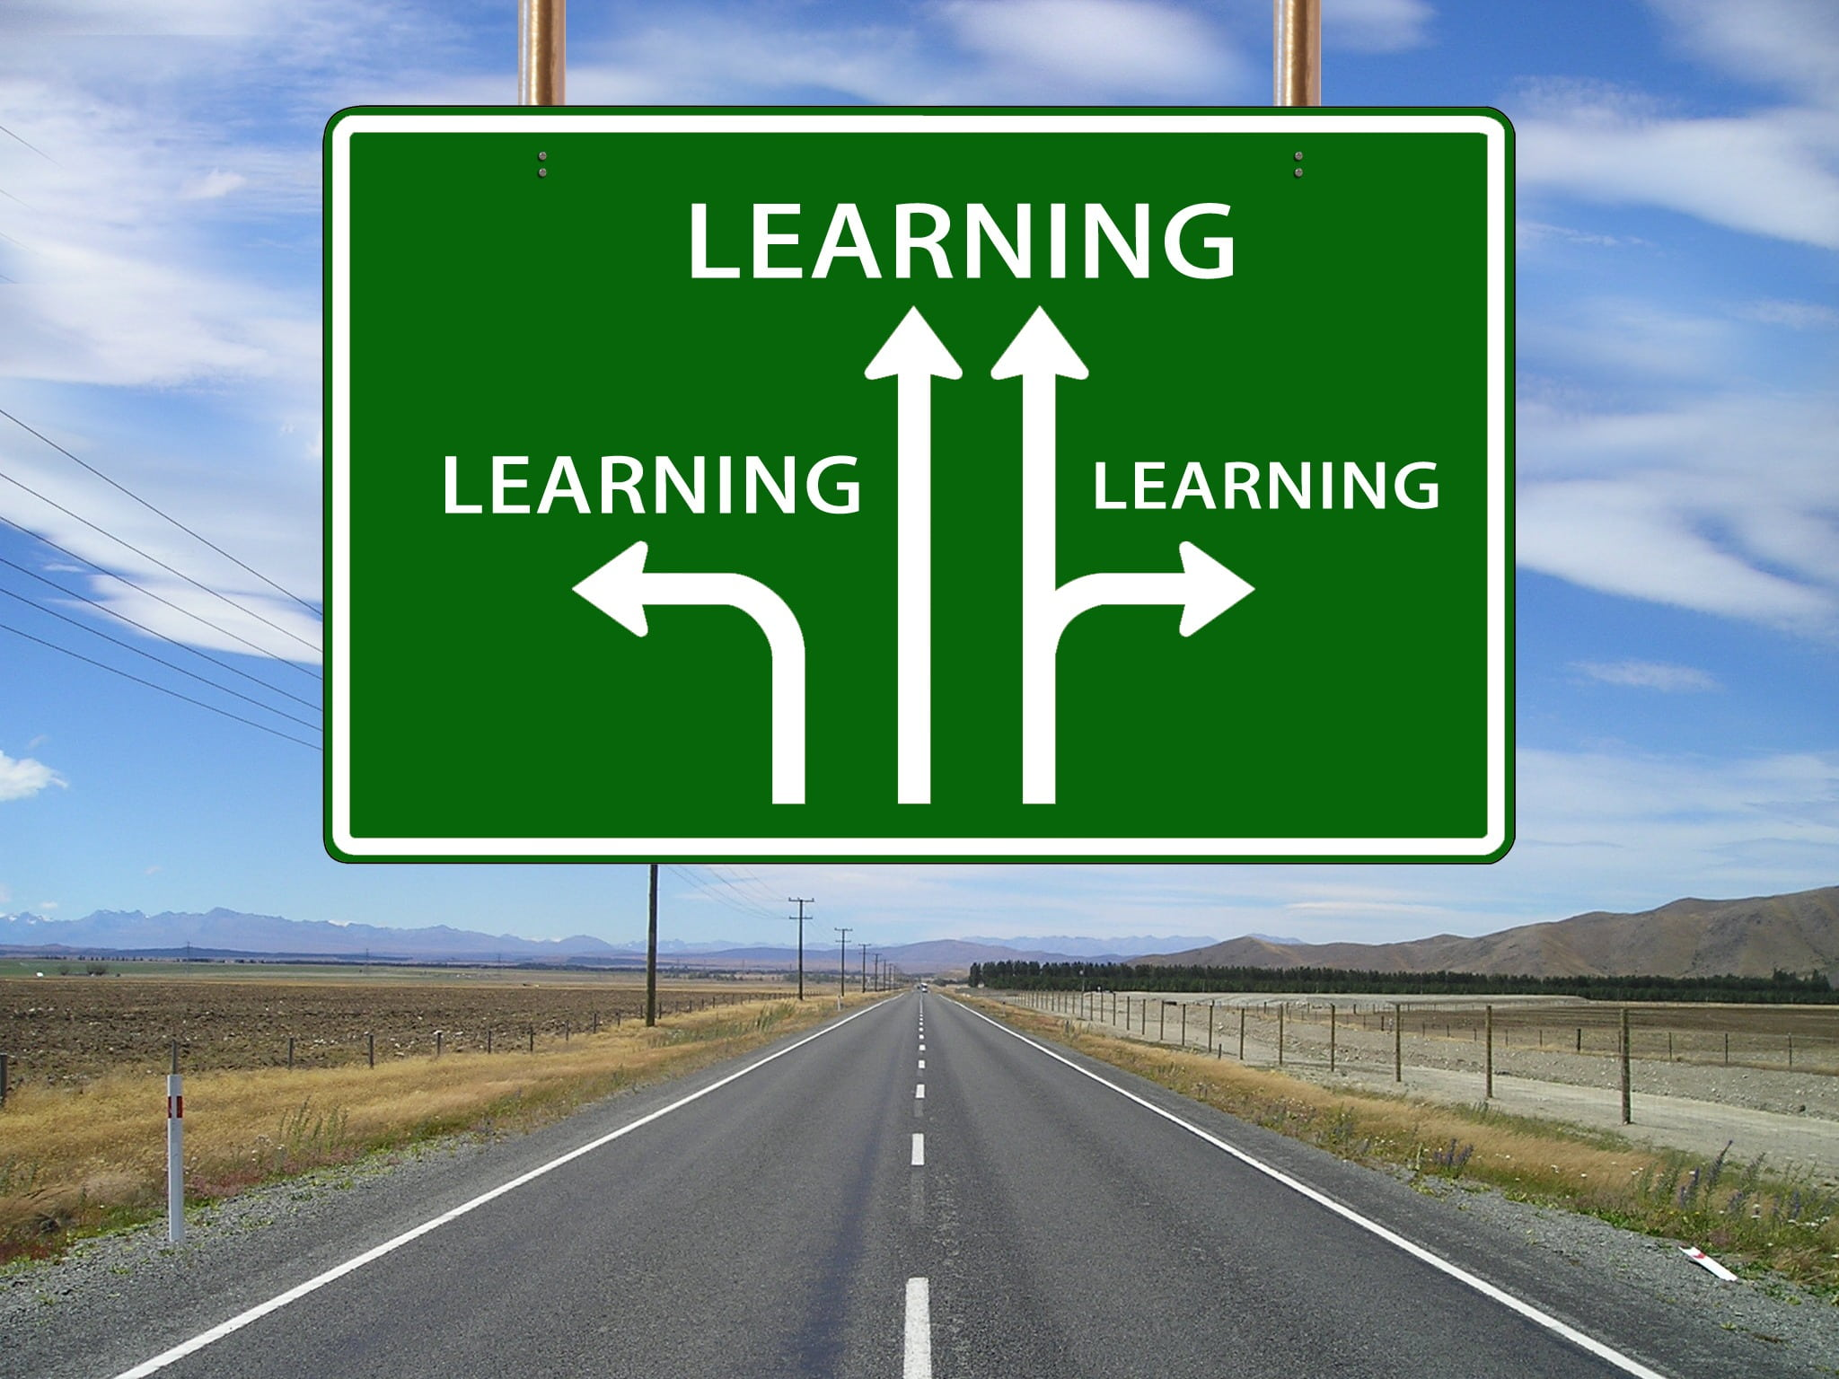
Notes:
I have a hard time imagining a more revolutionary task than assembling a group of people together to learn something new. What is more subversive than casting aside ignorance in favor of illumination?
But here’s the thing: LEARNING happens everywhere. Just because you don’t follow a 15-chapter, 15-week plan exactly the same way, semester after semester, doesn’t mean you have failed. Indeed, I would argue that the very best college classes are flashes in the pan; they seize the current moment in time and are attuned to what’s happening outside the classroom, in the students’ lives, and where the students’ (and faculty member’s) curiosities are leading.
If we can shift our mindset from “covering” a set of chapters to teaching the human beings currently in our classrooms, we will create a cascade of downstream shifts:
The content of our course will never grow stale, because every group of students is different. Not all classes need the same material. This can vary by what interests your students, what’s happening in the world, or any number of other factors.
Consequently, every new semester represents a clean slate for us as instructors. Because every new class is its own unique constellation of personalities, curiosities, and needs, each new class is also an opportunity for us to discover new nooks and crannies of the class material. Once, a student asked me about the 3/5ths Compromise in the Constitution, “But why was the ratio three-fifths? Why not one-half? Two-thirds? Five-sevenths?” It was the sort of question that would be easy to dismiss as an irrelevant one or a stalling tactic; in truth, though, it was a great question, one that nobody had thought to ask me in 17 years! The next class period began with a quiet reading of a short article I’d found on exactly that topic, followed by a class discussion of its implications.
Encouraging students’ curiosity and engaging with trying to find the answers to their questions has many, many benefits—for the students’ sense of agency over their own learning, and for keeping the material fresh for us as faculty. If higher education seeks to create generations of lifelong learnings, I can think of no better way to do so than to customize the course material to their particular interests.
Perhaps most importantly, shifting the focus to our students palpably demonstrates that they are important co-creators of their educational experience. Particularly for those students who come to college convinced they either don’t belong or are imposters, giving them the opportunity to be involved in charting the semester’s course is an exceedingly potent signal that they are not just along for a ride, possibly to be left behind. Nope, they are critical to the course and to their colleagues, including us as faculty.
Royalty-free image downloaded from https://www.pikrepo.com/fgdod/learning-signage-illustration, accessed 12 May 2020.

Slide 30
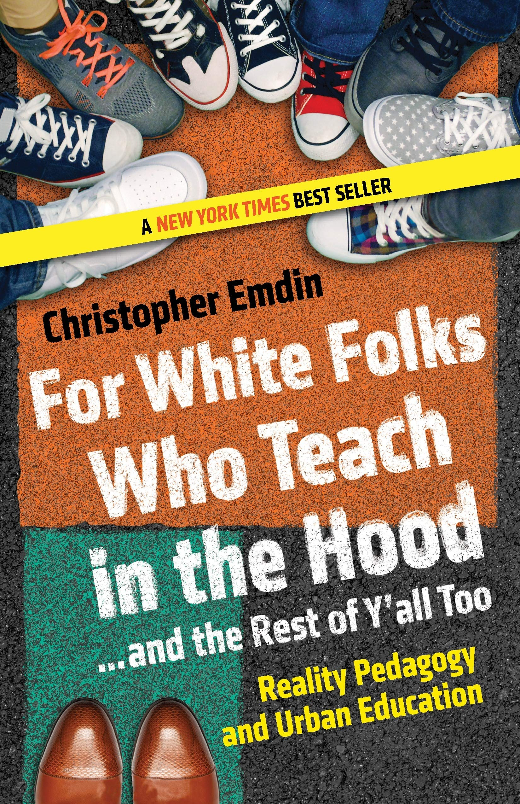


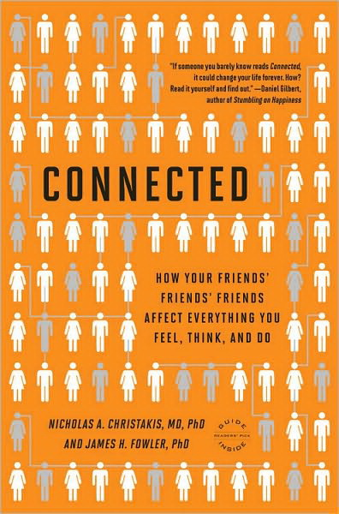
Resources mentioned in this presentation
Notes:
Resources mentioned in this presentation

Slide 31

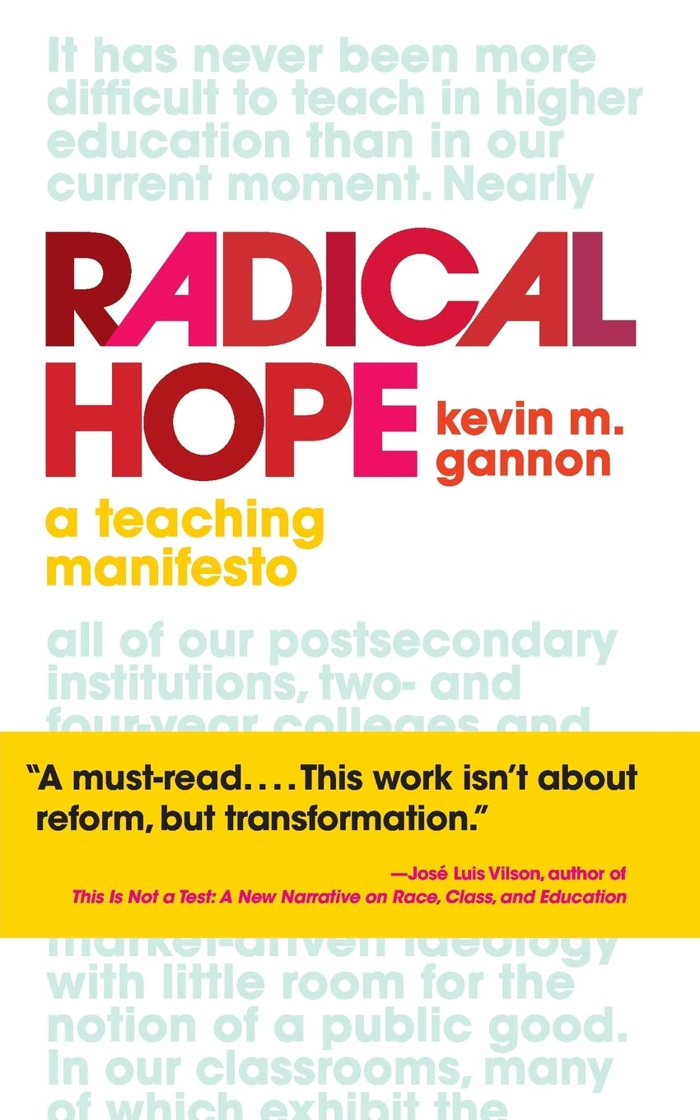
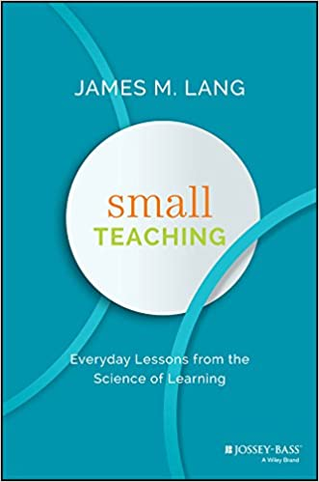

Other resources worth your time
Notes:
A few other resources I’ve found to be invaluable

Slide 32
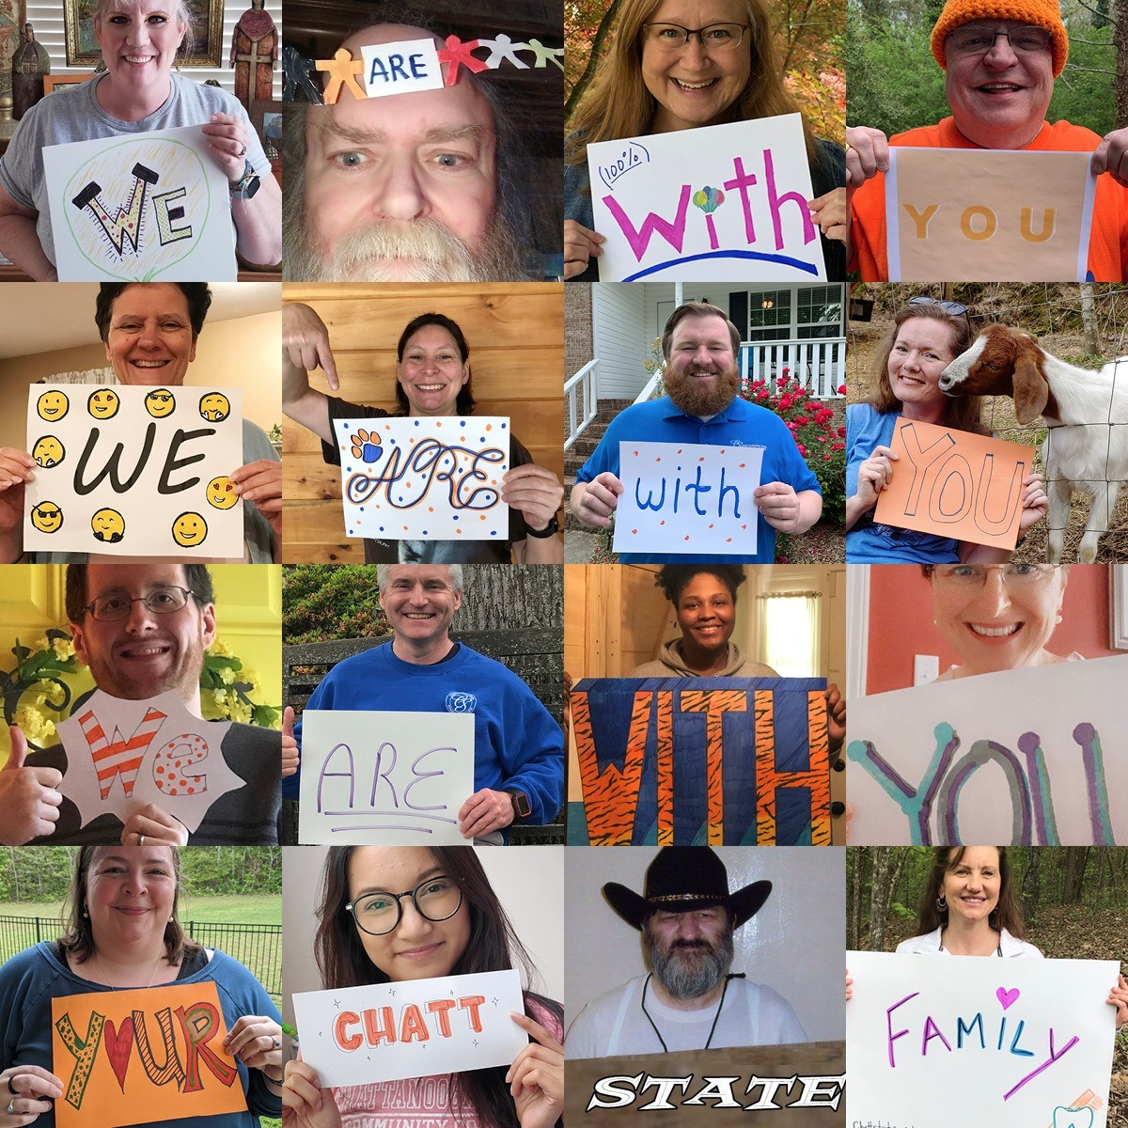
Thanks!
Dr. Liz Norell
elizabeth.norell@ chattanoogastate.edu
Notes:
I have so, so much more I want to say, but I think I’ll leave that there.
I hope you’ve found some takeaways to make your classrooms more student-centered, in lots of different ways, and found opportunities to improve student success, your professional satisfaction, and a more socially connected atmosphere.
Thank you for your attention. I’d love to hear your feedback!
Image from Chattanooga State Community College social media, posted during final exam week, Spring 2020.

