Slide 1

How to Boost Student Learning & Motivation with Ungrading
Dr. Liz Norell
April 2021

Slide 2
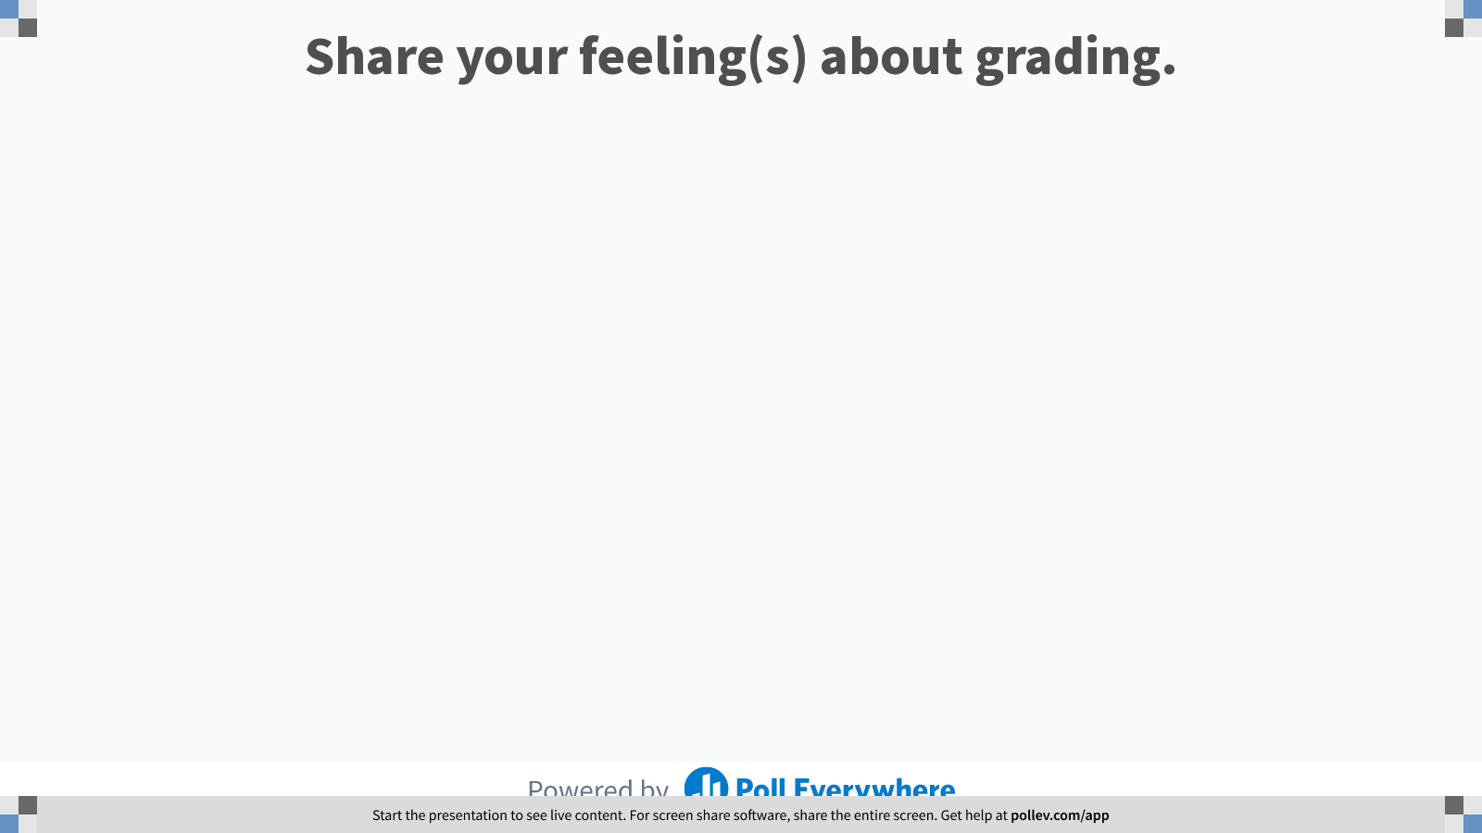
Notes:
Poll Title: Do not modify the notes in this section to avoid tampering with the Poll Everywhere activity.
More info at polleverywhere.com/support
Untitled word cloud
https://www.polleverywhere.com/free_text_polls/Lkv9BphKKTkutCMW1ZT5i

Slide 3



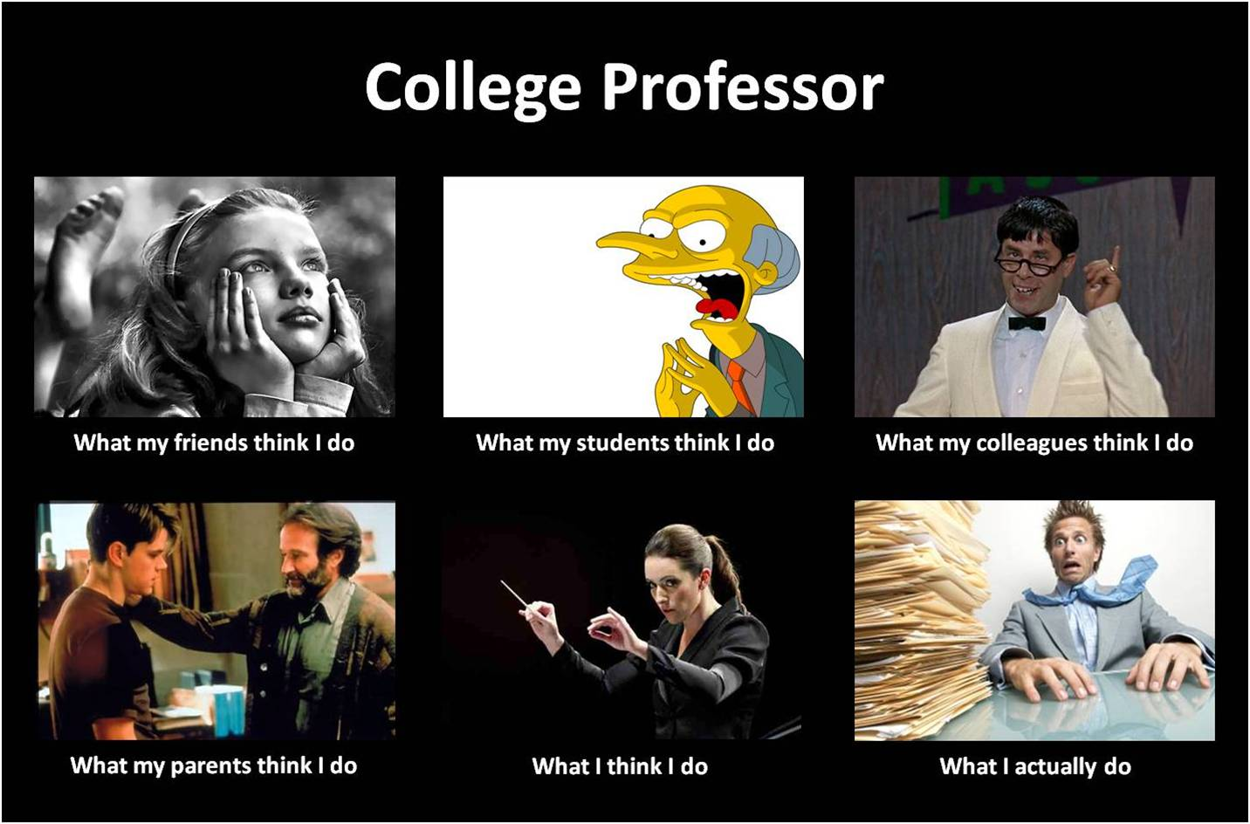

Slide 4
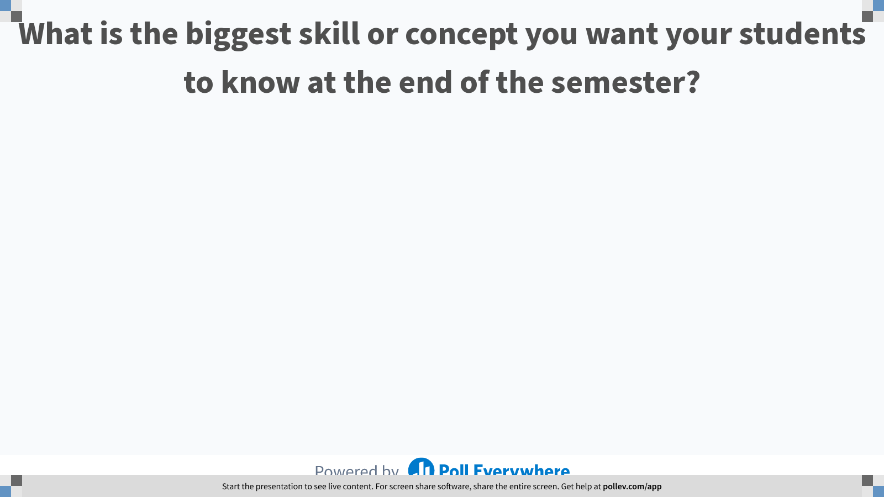
Notes:
Poll Title: Do not modify the notes in this section to avoid tampering with the Poll Everywhere activity.
More info at polleverywhere.com/support
What is the biggest skill or concept you want your students to know at the end of the semester?
https://www.polleverywhere.com/free_text_polls/KLKY1JEx9Szrum0HmLt2o

Slide 5
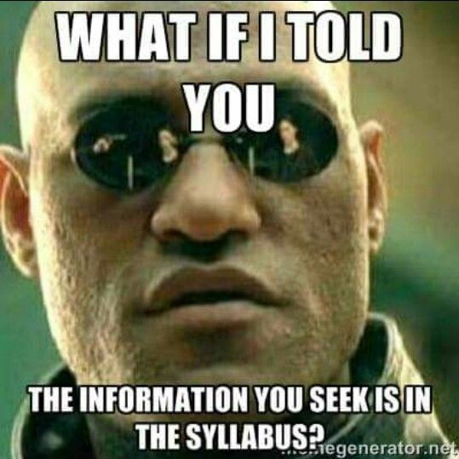

Slide 6



How do you relate to your students?
Notes:
Ask yourself this question: What do you think about your students?
Your students are ABSOLUTELY asking themselves this question about you.

Slide 7

“Our students cannot succeed in a learning environment in which they think they are devalued or seen as less-than.”
Notes:
Gannon, Kevin. 2020. Radical Hope: A Teaching Manifesto. Morganton, WV: West Virginia University Press. (p. 36)
Jesse Stommel writes in his chapter of Ungrading, “All of this requires exactly two pedagogical approaches:
Start by trusting students.
Realize ‘fairness’ is not a good excuse for a lack of compassion.” (p. 28)

Slide 8

Ungrading – eliminating the control-based function of grades, with all its attendant harm moving away from performance at the expense of learning
Notes:
Blum, Susan, ed. 2020. Ungrading: Why Rating Students Undermines Learning (and What to Do Instead). Morgantown, WV: West Virginia University Press. (This slide taken from Alfie Kohn’s foreward, page xv.)

Slide 9
What’s so wrong with grades?
They fail to communicate feedback.
High-stakes grades reward cheating and reduce intrinsic motivation.
Pitting students against each other reduces students’ sense of belonging and undermines community.
Creating adversarial relationships with faculty undermine supportive learning environments.
No two people are ever consistent in their grading.

Slide 10

“When instructors lament their students only seem to care about what’s on the exam, they fail to see that their emphasis on weeding people out has rendered grades existentially important for their students.”
Notes:
Gannon, Kevin. 2020. Radical Hope: A Teaching Manifesto. Morganton, WV: West Virginia University Press. (p. 24)

Slide 11

Of the top 20 medical schools, 18 use only pass-fail grades for preclinical courses (Deng & Wesevich 2016).
Why? Students’ grades in basic science courses show no meaningful correlation with their later quality as practicing physicians.
Notes:
Blum, Susan, ed. 2020. Ungrading: Why Rating Students Undermines Learning (and What to Do Instead). Morgantown, WV: West Virginia University Press. (This slide taken from Blum’s chapter, p. 4.)

Slide 12

We are naturally curious creatures.
Notes:
Gannon says: “What gives education vitality—critical thinking, exploration, creativity, play, the construction of knowledge—is snuffed out by the banking mode of pedagogy.” (p. 46)

Slide 13


What matters?
Notes:
As Jesse Stommel writes in Ungrading: “There is no room for student agency to breathe in a system of incessant grading, ranking, and scoring.” (p. 27)
When students need us to tell them “what matters” and what to do with knowledge, they lose agency.
The learning is not theirs.
It is something they require another person to give them.
(Gannon p. 47)

Slide 14
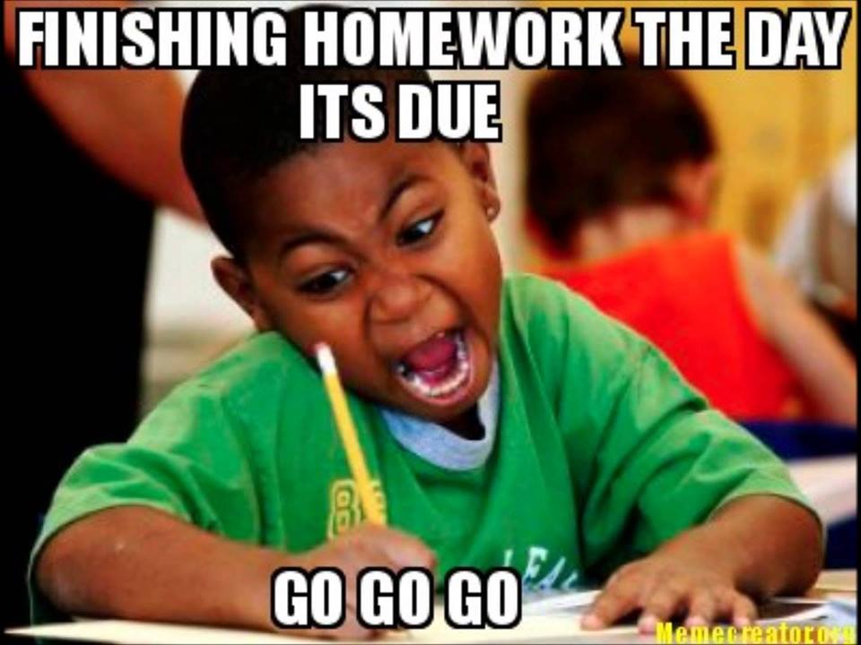

Slide 15

“If we want our students to learn, we have to pay attention to all of the things that either assist in or interfere with that learning.”
Notes:
Gannon p. 59

Slide 16
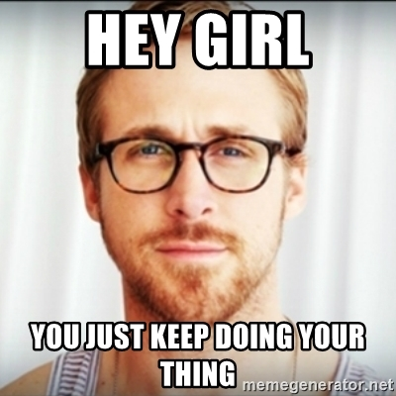
Notes:
I know, I know. You’re thinking, “There’s no way I can make this work. Sounds good for you, Liz, but it wouldn’t work in my discipline, in my department/division, or with my course materials.”

Slide 17
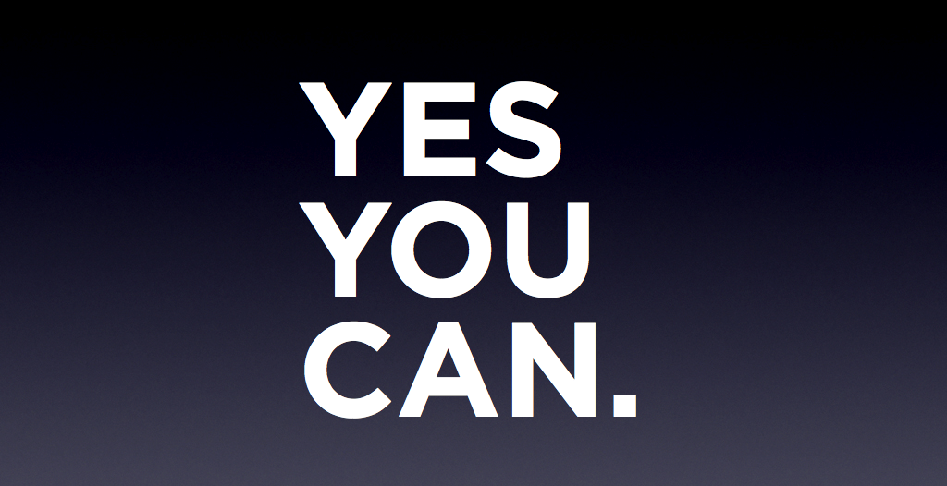

Slide 18
Sooo… how?
Grade-free zones (a portion of the semester)
Self assessment
Process letters
Minimal grading
Authentic assessment
Contract grading (sometimes called “specifications grading”)
Portfolios
Peer assessment
Student-made rubrics
Notes:
NOTE: This is borrowed heavily from Stommel’s chapter in Ungrading (see pp. 36-40).
Grade-free zones: Decide to grade only a few assignments or having the first third of the semester be grade-free
Self-assessment: improve students’ metacognition by having them assess their own work… then have a conversation with you (the instructor) about it
Process letters: Students write a letter describing how their learning and work evolved over the semester/term
Minimal grading: Peter Elbow’s “Grading Student Writing: Making It Simpler, Fairer, Clearer” describes this strategy as using very few gradations. For example, on a paper, you might assess it as:
Turned in or not (one gradation)
Pass/fail (two gradations)
Strong/satisfactory/weak (three gradations)
Authentic assessment: Instead of producing coursework, have your students produce something that shares their work—a film festival, an exhibition, etc.—so that their ‘assessment’ is really just the production of that moment of sharing out more widely. You might include talk-backs with the audience, and probably should include a reflective piece submitted to the instructor afterwards.
Contract grading: Keeps the focus on the work, rather than the student. Negotiating around the contract becomes a way for students to take agency of their learning and decide what effort they can put forward.
Portfolios: Crafting a digital identity that includes (but is not limited to) coursework can help students to develop their metacognitive skills and share their work after the course ends.
Peer assessment: this can be formal or informal, and is particularly useful when working in groups.
Student-made rubrics: While rubrics can be problematic in general, giving students the opportunity to engage in metacognition and higher-level thinking by designing an appropriate rubric for work is helpful; it creates student agency and becomes an act of learning itself.

Slide 19
Language shifts
Grades vocabulary | Ungrading vocabulary
grading | assessing
score | assess
“What did I get?” | “What did I learn?”
“This is wrong.” | “Try another way.”
problem | challenge, opportunity
judgment or criticism | feedback
get good grades | achieve proficiency or mastery
Source: Starr Sackstein (2015)
Notes:
Sackstein, Starr. 2015. Teaching Students to Self-Assess: How Do I Help Students Reflect and Grow as Learners? Alexandria, VA: ASCD.

Slide 20
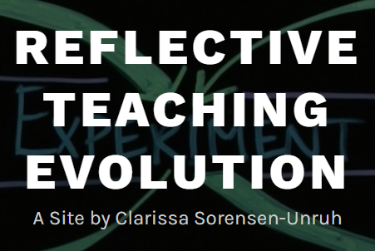
But... I teach STEM!?!
Notes:
Sorensen-Unruh is a chemistry professor who has embraced ungrading. Learn more about how she does it on her web site: https://clarissasorensenunruh.com/

Slide 21
Just a few benefits
Reduce stress (for students AND you)
Help students form new learning habits
Make room for creative work
Promote better communication
Open up new course design possibilities
Notes:
From Laura Gibbs’s chapter in Ungrading, see pp. 98-100.

Slide 22
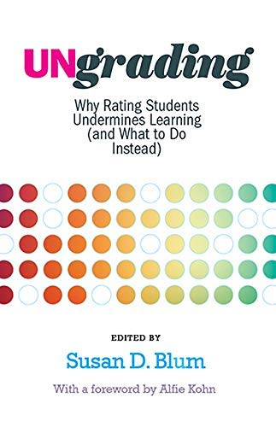
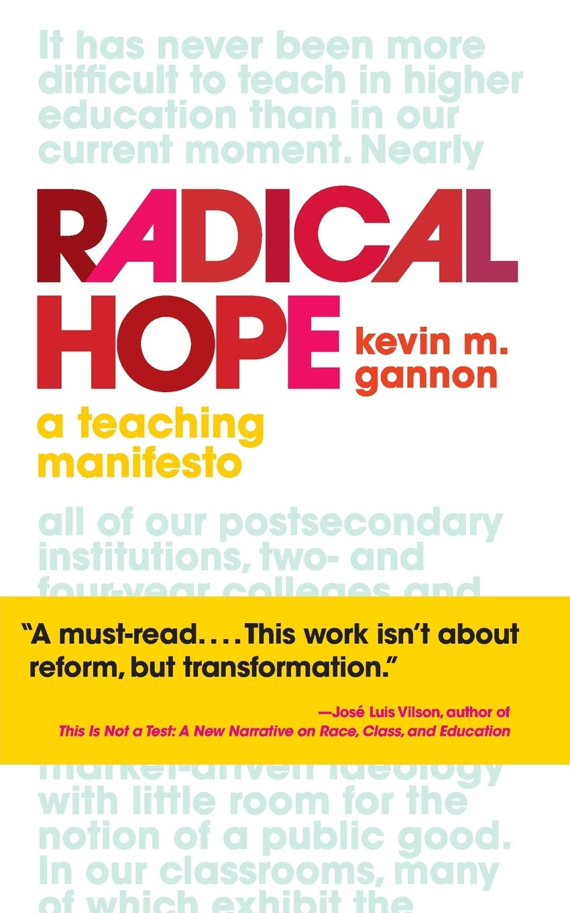
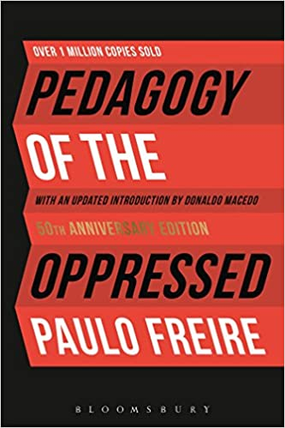
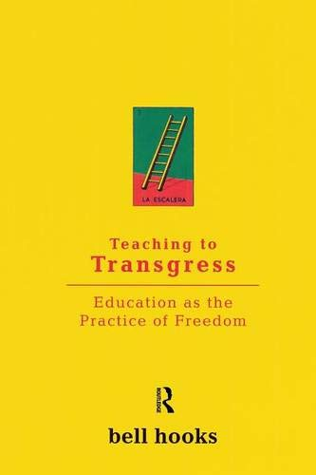
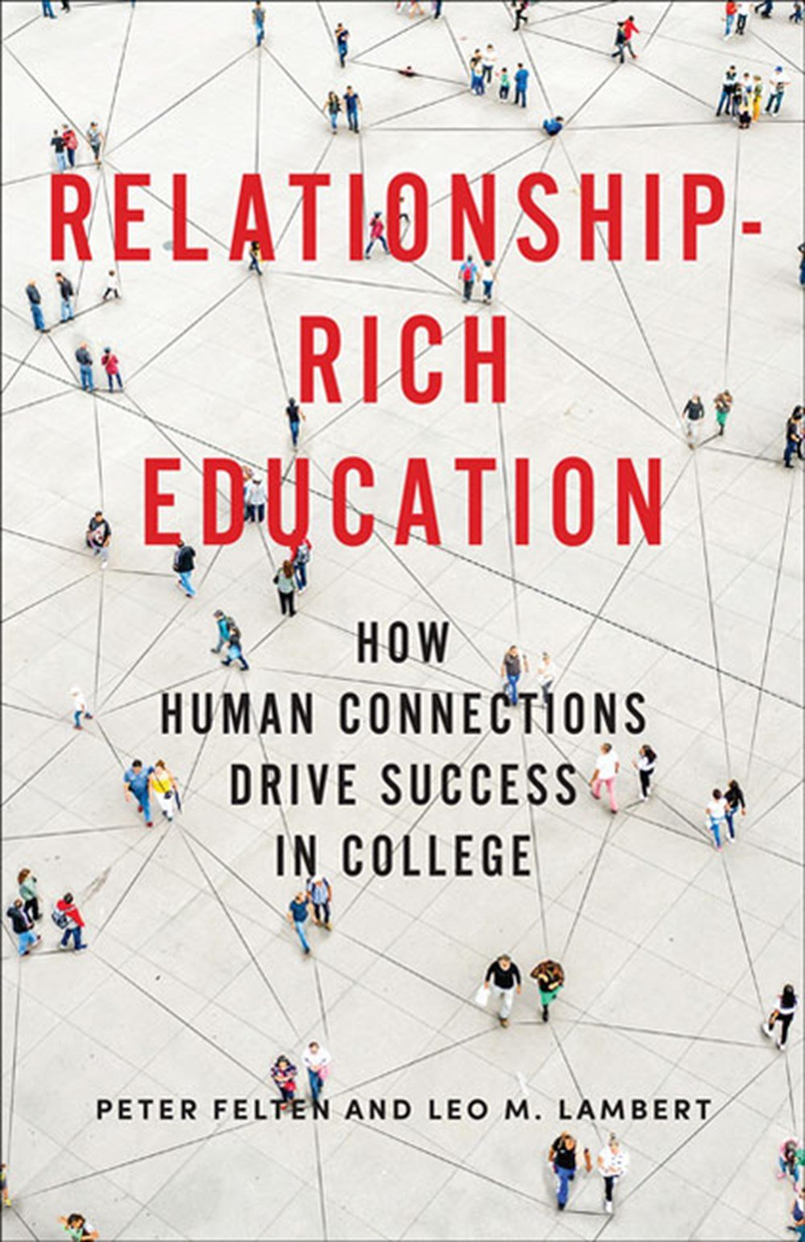
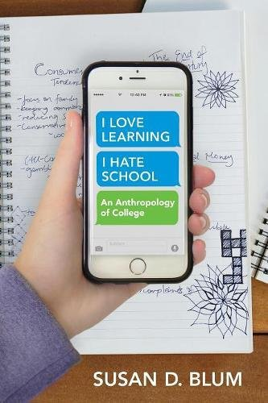
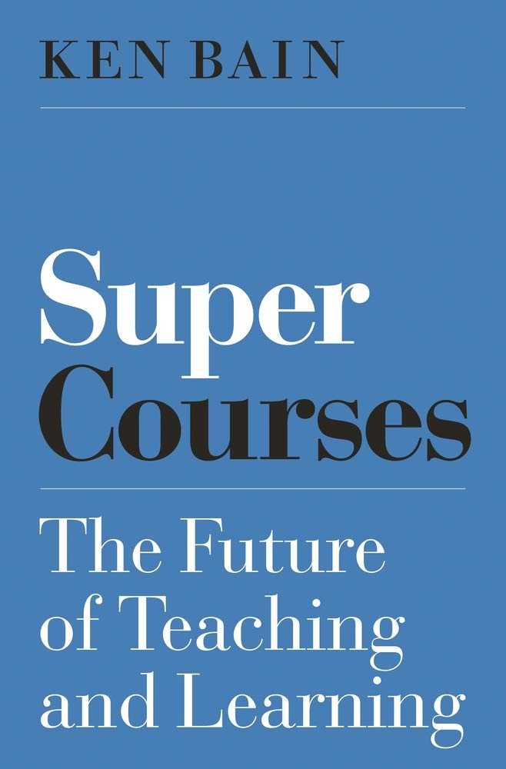
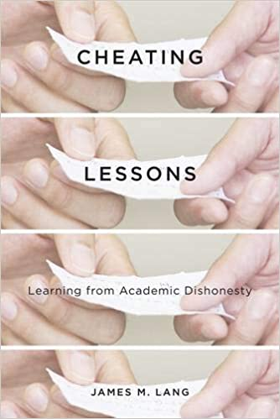
Great resources

Slide 23
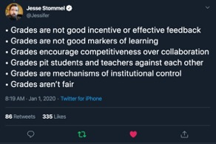
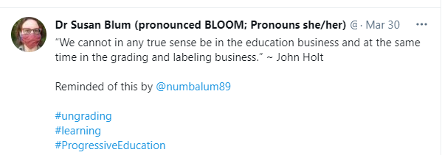
People to follow
Notes:
And a very few choice links to continue learning:
https://www.chronicle.com/article/grades-can-hinder-learning-what-should-professors-use-instead/?bc_nonce=f3tifpo2zoqg492u3b2dg&cid=reg_wall_signup
https://www.jessestommel.com/ungrading-a-bibliography/
https://static1.squarespace.com/static/5c26244750a54f7729ccb76b/t/5cf92987dcae1c00018a83bd/1559832968992/geekypedagogy.com+Ungrading+Bib.pdf
https://docs.google.com/document/d/1yKqmxvpRZyVO5oqRQ5ox4ysotRf0PWTl2-qsatgr68Y/edit#heading=h.48xubhljoqze
https://www.facebook.com/groups/277181926058422/

