Slide 1
Creating a Classroom Community

Slide 2
Notes:
Royalty-free photos from Pexels.com.

Slide 3
“Imposter syndrome is structural (rather than personal). Evidence suggests that imposter feelings are both ubiquitous and patterned. Individuals who do not fit the norm for ‘professors’ a century ago are more likely to report imposter feelings..”
Loleen Berdahl, Academia Made Easier Substack (2023)
Notes:
Berdahl highlights the prevalence of imposter syndrome in higher ed in her January 2023 newsletter: https://loleen.substack.com/p/how-to-capture-the-power-of-impostor.

Slide 4
“Stop walking through the world looking for confirmation that you don’t belong. You will always find it because you’ve made that your mission. Our call to courage is to protect our wild heart against constant evaluation, especially our own. No one belongs here more than you.”
Brenė Brown, Braving the Wilderness (2017)

Slide 5
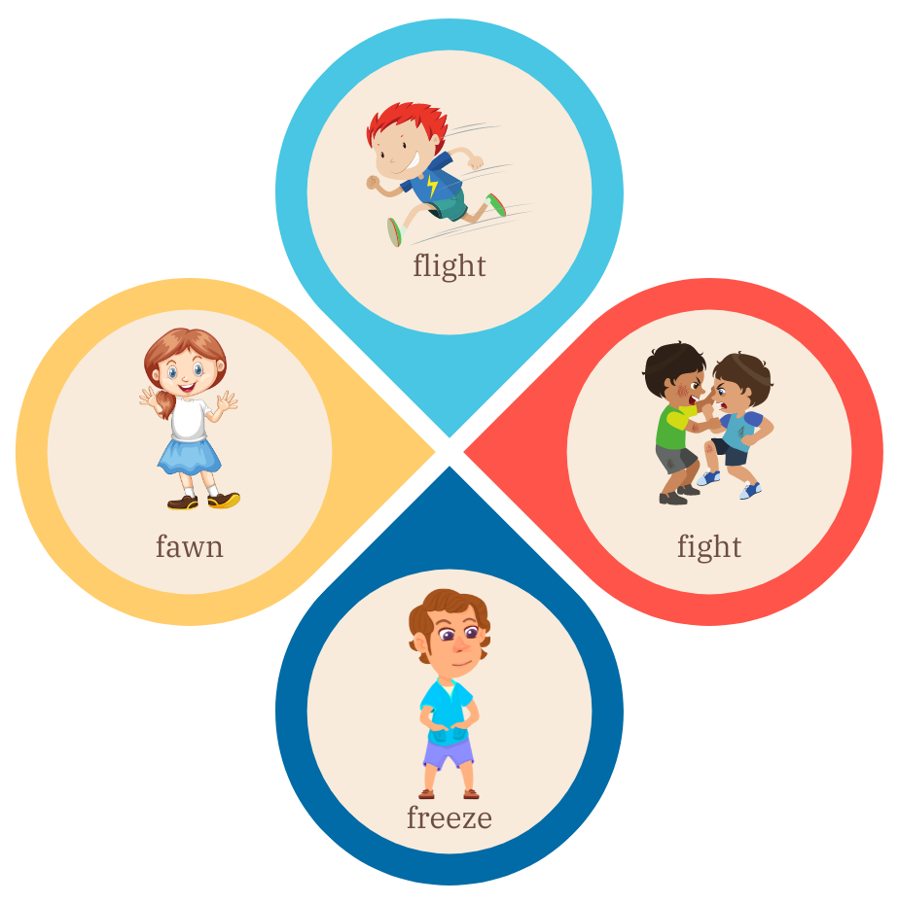
Four responses to stress
Notes:
Fight: Tight jaw, grinding teeth, crying or yelling, anger, burning stomach.
Flight: Fidgety, tense, trapped, restless energy, darting eyes, moving legs/feet/arms.
Freeze: Sense of dread, pale, stiff, heavy, cold, numb, dissociating from your body, loud pounding heart.
Fawn: Lack of boundaries, overdependence on another’s opinions, turning into a ‘yes’ machine.

Slide 6
The body in stress
Headaches
Heartburn
Shortness of breath
Pounding heart
Depression
Insomnia
Weakened immune system (more vulnerable to illness)
Higher blood sugar
Higher blood pressure
Stomachache
Tense muscles
Notes:
This is happening to your students!
Fear
Test anxiety
Avoidance behaviors
Memory impairment
All of these lead us away from learning.
See more at https://www.healthline.com/health/stress/effects-on-body.
Royalty-free images from Pexels.com

Slide 7
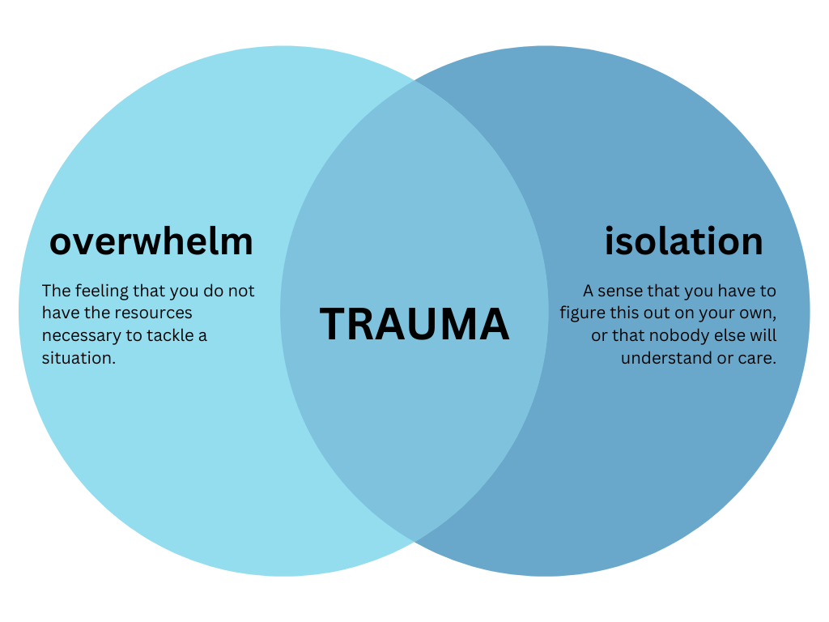
When community fails…
Notes:
Ann Kelley & Sue Marriott (2018) suggest in their podcast episode, “How Good Boundaries Actually Bring Us Closer,” that we can think of trauma as what happens when we pair overwhelm with isolation. Listen here: https://therapistuncensored.com/episodes/tu81-how-good-boundaries-actually-bring-us-closer-with-guest-juliane-taylor-shore/.

Slide 8
A thought experiment
Notes:
Royalty-free image from Pexels.com
Let’s try a thought experiment. Think back to an experience from your past where you felt truly in community with others. This might have been in a traditional classroom setting, such as a high school or college class where you felt the grip of excitement at exploring a topic you found highly engaging. It might have been a moment with friends where you were playing a round of Cards Against Humanity or enjoying a band you particularly love. Or maybe you were playing softball in an adult league, going kayaking on a summer afternoon, or spending time with family members whom you especially enjoy being around. What was it about that moment that felt so deeply communal? What were the physical sensations that let you know you were in community with others? How did it feel in your body?
Got that memory in mind? Good. Now I want to ask you two other questions that might take you by surprise at first: How did you feel about yourself at that moment? Did you accept yourself? Embrace yourself? Perhaps even celebrate the fact that you have an interest that others share with you? Or were your self-reflections less positive? It might even be the case that you entirely forgot yourself, instead finding yourself fully immersed in the moment.

Slide 9
Create opportunities for students to get to know you and each other.

Slide 10
Trust generators
Selective vulnerability: Sharing a personal experience that demonstrates you are human, not perfect.
Familiarity: Becoming a more familiar fixture in another person’s life through everyday interactions.
Similarity of interests: Identifying likes, dislikes, hobbies, etc. with others.
Concern: Demonstrating genuine concern for issues or events important to another person.
Competence: Exuding skill, knowledge, and the will to help and support others.
Notes:
Culturally Responsive Teaching & the Brain: Promoting Authentic Engagement and Rigor Among Culturally and Linguistically Diverse Students (2015)

Slide 11
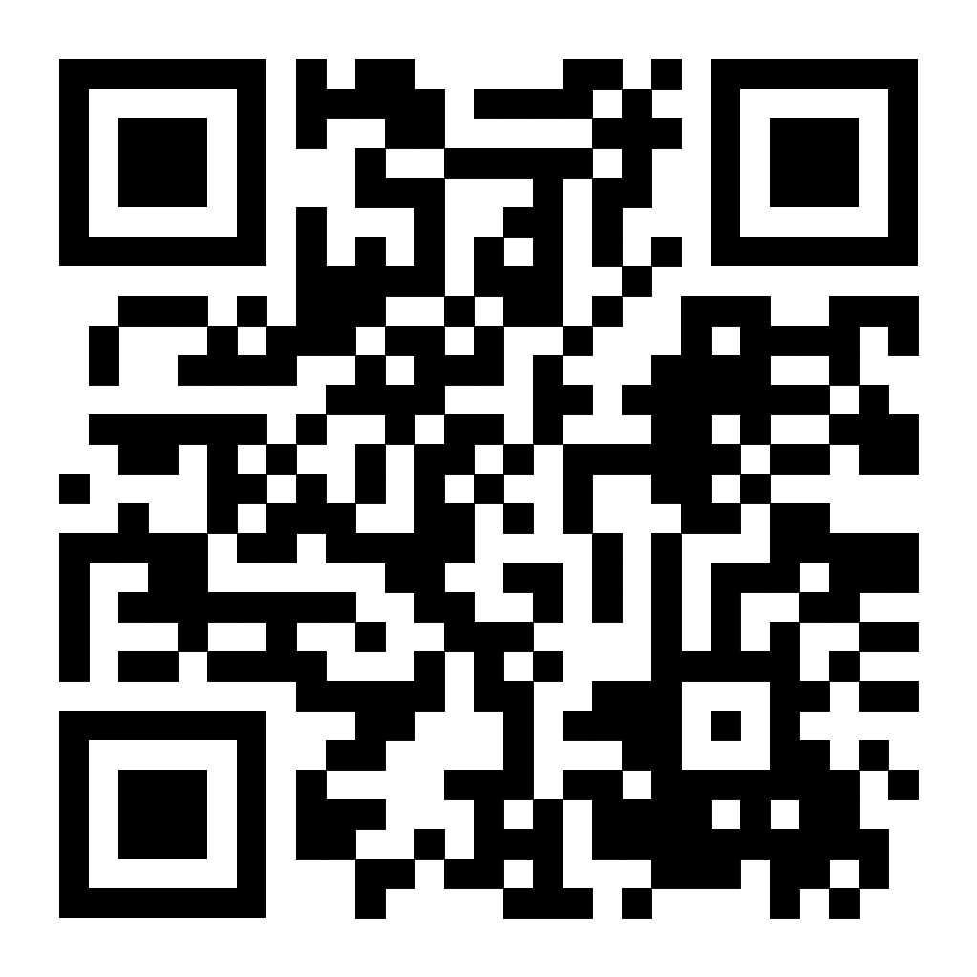
https://tinyurl.com/GTOjam2023
NOTE: Using a mobile device will require downloading the Jamboard app
Crowdsourcing strategies to build community
Notes:
This goes to a Jamboard, where my plan is to have each table generate ideas (a different slide for each one) on how to build community. Hopefully this will yield a rich set of ideas they can use going forward.

Slide 12
Building rapport: Strategies
Collect a first-day form with pertinent student information
One great question to ask: “What else would you like me to know about you?”
Share something about yourself
What do you love about your discipline?
How have you struggled academically, and how did you overcome those challenges?
What’s your favorite hobby? Hometown? Pet’s name?
Employ the “Think-Pair-Share” or group work to help students learn from one another
If it feels comfortable, invite students to co-create or give input on class guidelines

Slide 13
Policy you should know: Preferred names
Some students will have a legal name and a preferred name that appears in parentheses on the class roll. It is UM policy that instructors always refer to students by their preferred name.
It is good practice to invite students to provide their preferred names, name pronunciation, and pronouns on the first day of class, perhaps through a first-day form. Model this practice by telling students how to refer to you and sharing your pronouns.
“Expertise from various fields, including educational psychology, sociology, and biology note the impact of calling individuals by their names. It allows for better human connection and fosters more trust, empathy, and positive communication.” Addy et al., What Inclusive Instructors Do (2021)
Notes:
UM Center for Inclusion and Cross-Cultural Engagement Preferred Name Policy
UM LGBTQIA+ Programming and Initiatives Information on pronouns
Addy, T. M., Dube, D., Mitchell, K.A., and SoRelle, M.E. (2021). What inclusive instructors do: Principles and practices for excellence in college teaching. Stylus.

Slide 14
Policy you should know: Consensual relationships
The University of Mississippi’s Consensual Relationships Policy states that graduate students may not exercise “any evaluative, teaching function or supervision” over students with whom they are in a sexual or romantic relationship. “Whenever an employee has had, or in the future might reasonably be expected to have, academic responsibility or authority over a student, such relationships are prohibited.”
Notes:
UM Consensual Relationships Policy

Slide 15
“We teach who we are. … When I do not know myself, I cannot know who my students are.”
Parker Palmer, The Courage to Teach (2007)
Notes:
Palmer, Parker. 2007. The Courage to Teach: Exploring the Inner Landscape of a Teacher’s Life, 10th anniversary edition. San Francisco: John Wiley & Sons.

Slide 16
Know yourself, know your students
Reflection questions (for later):
What student behaviors upset me the most? Try to determine why these behaviors bother me. What assumptions am I making about the motivations behind the behaviors? Is it possible there might be different explanations for the behaviors?
What behaviors among my peers upset me the most? (repeat the same process)
What challenges, issues, and or concerns are causing me the most stress right now?
When was the last time I felt genuinely proud of something I’d done or said?
When do I feel uncomfortable? Describe the environment, feelings, or people who inspire those feelings. Explore what about that situation gives rise to feelings of discomfort.
What puts me on the defensive? In what circumstances do I feel defensiveness arising? Is it predictable or seemingly at random?
What feels most motivating right now? What makes me feel so excited to pursue that?

Slide 17
Caveats & positionality

Slide 18
Communicating with students
Think of an especially good or especially bad communicator in your life. What makes communicating with them easy or difficult?

Slide 19
Communicating with students
What do students need to know to succeed in the course?
The goals of the course and TA sessions
Classroom policies and procedures
Major assignments and due dates
How they will be assessed and receive feedback
How and where to ask questions or get help
How and when to communicate with your and your faculty member
Productive study habits
How and where to access other university resources
How and when will you communicate this information?
Via a syllabus created by the faculty member
Via a policy sheet specific to discussion or lab sections
Via Blackboard
Over email
Verbally, in class
A combination of the above
What information do students need now? What can wait until later? How can you present course information without overwhelming students?

Slide 20
Communicating with students: Strategies
Decrease cognitive load
Make sure information is accessible to students
Clearly label and organize information
Present key information and course content in multiple modalities, when possible
Streamline communication and limit communication platforms

Slide 21
Communicating with students: Strategies
Create an inclusive and welcoming environment
Use language that is positive and motivating rather than punitive
“Students must comply with…” → “We share a responsibility to…”
“I only accept…” → “To receive full credit, I encourage you to…”
Consider what aspects of the “hidden curriculum” you can make visible to students
Office hours
External resources
Communicate high expectations and your belief in students’ ability to achieve them

Slide 22
Policy you should know: Disability accommodations
Some students with disabilities will require accommodations in order to succeed in your course. If you’re an instructor of record, Student Disability Services will communicate with you about the nature of these accommodations and how to provide them. If you’re a teaching assistant, your faculty member will communicate with you, and you should direct any questions about accommodations to them.
There may also be students in your class with undiagnosed disabilities and/or who are not registered with Student Disability Services. We recommend designing all courses, course materials, and lesson plans with accessibility in mind.
Notes:
UM Student Disability Services information for instructors
UM Policy on Students with Disabilities
Vanderbilt University Center for Teaching, Creating Accessible Learning Environments
Universal Design for Learning Guidelines

Slide 23
Communicating with students
FAQ: What if students don’t understand me when I speak?
Be transparent with students about any potential barriers to communication at the beginning of the class
Speak as deliberately as possible and pause frequently to check for comprehension
Assure students that they can ask for clarification at any time

Slide 24
Policy you should know: Tutoring by GAs
The University of Mississippi’s policy on Tutoring by Graduate Assistants states that “No one who is teaching a section of a course may also accept payment for tutoring a student in that section.” This applies to tutoring within university units, in non-university agencies, and by private arrangement.
Notes:
UM Tutoring by Graduate Assistants Policy

Slide 25
Navigating classroom challenges
Activity: Discuss one of the following case studies with your table.
You’re a TA for a psychology course. During one of your breakout sessions, you notice that a student in the back of the room is asleep and snoring. What do you do?
You’re teaching a small history seminar. During one of your discussions, the issue of police brutality is raised. The conversation quickly becomes heated, and a few especially vehement students begin to talk over one another. What do you do?
You’re a TA for a chemistry lab. During your lab sessions, you notice that one student group seems consistently dysfunctional. Two of the group members, both men, often ignore the input of the woman in their group, and conduct the experiment largely by themselves. What do you do?

Slide 26
Navigating classroom challenges: Strategies
Avoid making assumptions about student behavior or motivations
Approach every situation with curiosity and compassion
Know that you are always permitted to remove yourself and other students from an unsafe environment
Make use of campus resources to help you and your students

Slide 27
Policy you should know: Title IX
Title IX of the Education Amendments of 1972 states that
No person in the United States, shall, on the basis of sex, be excluded from participation in, be denied the benefits of, or be subjected to discrimination under any education program or activity receiving Federal financial assistance.
Sexual harassment, which, under Title IX, includes sexual assault and certain forms of relationship violence, is prohibited under Title IX and the University’s Title IX Policy.
The University requires its employees to report instances of sex-based discrimination, sexual harassment, sexual misconduct or interpersonal violence that they learn about to the Assistant Director of Equal Opportunity and Regulatory Compliance (EORC)/Title IX Coordinator. You are a mandatory reporter.
Notes:
UM Employee Guide for Reporting Sexual Harassment, Interpersonal Violence, or Sexual Misconduct
What is Title IX? and Title IX FAQ
UM Title IX Policy

Slide 28
What strategies will you use to create community in your classroom?

