Slide 1
Dispelling myths about Autism in Adults
Liz Norell June 29, 2023

Slide 2
What have you heard about autism?

Slide 3
CDC definition
Autism spectrum disorder (ASD) is a developmental disability that can cause significant social, communication, and behavioral challenges.
Notes:
For someone with autism, the scene here on the left (NIOSA) is a literal nightmare

Slide 4
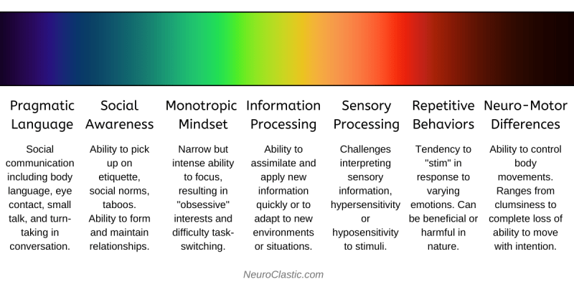
Notes:
‘Spectrum’ is problematic.
We tend to think of a “spectrum” as a left-right continuum. That is inaccurate when we talk about autism.
Neurodivergence manifests differently in each person.

Slide 5
Put another way…

Slide 6
Overlapping traits with autism, adhd, and giftedness

Slide 7
Common autistic qualities
Hyper-sensitive/hyper-reactive to even small stimuli around us.
Trouble distinguishing between information/sensory data that should be ignored vs. attended to.
Highly focused on details.
Deeply deliberative and analytical.
Processing information/new situations requires more time and energy.
Notes:
From Unmasking Autism: Discovering the New Faces of Neurodiversity by Devon Price, Ph.D.

Slide 8
Common autistic behaviors
Stimming—repetitively and intensely.
Easily losing track of time (forgetting to eat or take breaks).
Rewatching the same movies or TV shows over and over.
Aversion to bright colors, uncomfortable clothing, trying new things (especially food).
Noticeable anxiety.
Unusual eye contact—extreme in either direction.
Notes:
From Unmasking Autism: Discovering the New Faces of Neurodiversity by Devon Price, Ph.D.

Slide 9
Common autistic needs
Clear expectations, such as: specific plans with details about time, place, and what is likely to happen. Specific, measurable outcomes or goals.
Explicit messaging, such as: giving direct explanations of feelings. Not punishing or judging people for failing to read between the lines.
Reduced sensory/social load, such as: allowing people to express emotions and opinions via text, email, or handwritten note. Giving people alone time to reflect on their feelings and beliefs. Providing frequent breaks from socializing, or quiet spaces people can retreat to.

Slide 10
Children vs. adults
Most diagnostic tools were designed to measure Autism in children—specifically, male children. They poorly diagnose Autism in adults—especially female adults.
A lack of awareness about the traits associated with Autism can lead us to mistakenly interpret the behavior of another as incomprehensible, manipulative, aggressive, self-centered, obstinate, or actively hostile.
Notes:
In turn, this creates environments—in and out of the classroom—that prohibit flourishing, belonging, and success.
Inclusion requires awareness.

Slide 11
Healthy autistic behaviors
Intense studying of a new favorite topic.
Not noticing sounds or social signals when focusing on an engrossing task.
Needing to know exactly what to expect before entering an unfamiliar situation.
Sticking to a very rigid schedule and rejecting deviations to that schedule.
Taking a long time to think before responding to a complex question.
Spending hours or days alone sleeping and recharging after a socially demanding event or stressful project.
Needing “all the information” before coming to a decision.
Not knowing how they feel or needing a few days to figure out how they feel about something.
Needing a rule or instruction to “make sense” before they can follow it.
Not putting energy toward expectations that seem unfair or arbitrary, such as wearing makeup or elaborate grooming.
Notes:
From Unmasking Autism: Discovering the New Faces of Neurodiversity by Devon Price, Ph.D.

Slide 12
OK, Great. But… Why are you talking about this, liz?

Slide 13
My story

Slide 14
Clinical manifestation
“Relatively mild stressors may be sufficient to precipitate a major crisis. Associates are likely to comment about her overconcern regarding issues and events over which she has no control.”
“Others are likely to view her as impatient and hostile. As a result, her relationships with others are probably under stress due to her frustration with the inability or unwillingness of those around her to keep up with her plans and possibly unrealistic demands.”
“She describes herself as being more wary and sensitive in interpersonal relationships than the average adult. Others are likely to see her as tough-minded, skeptical, and somewhat hostile.”

Slide 15
Emotions & empathy in autistics
Notes:
Eye contact
Floods of emotions
Fairness
Justice
FOCUS!!!

Slide 16
Autism in the workplace
“Fit” as an interview/hiring criterion
Acceptance/normalization of mental health discussions
Communication styles
Clarity in expectations
Trust, emotional safety, and ongoing efforts to improve
Physical spaces & needs

Slide 18
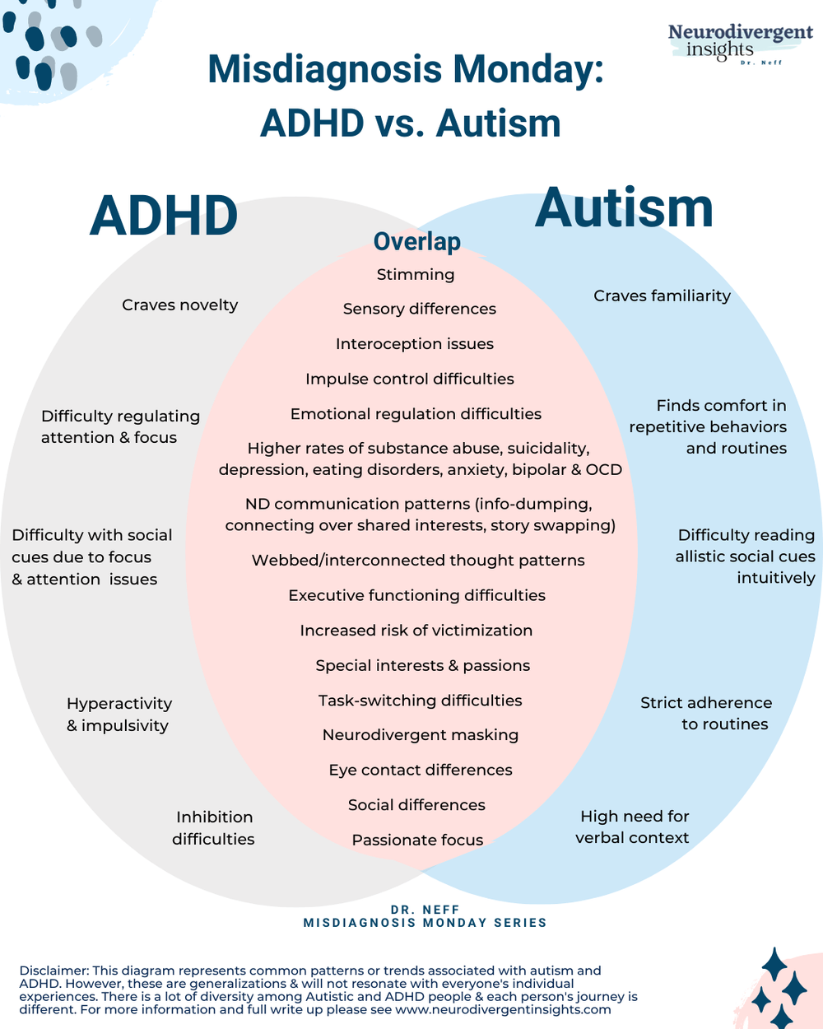
Notes:
https://neurodivergentinsights.com/misdiagnosis-monday/adhd-vs-autism

Slide 19
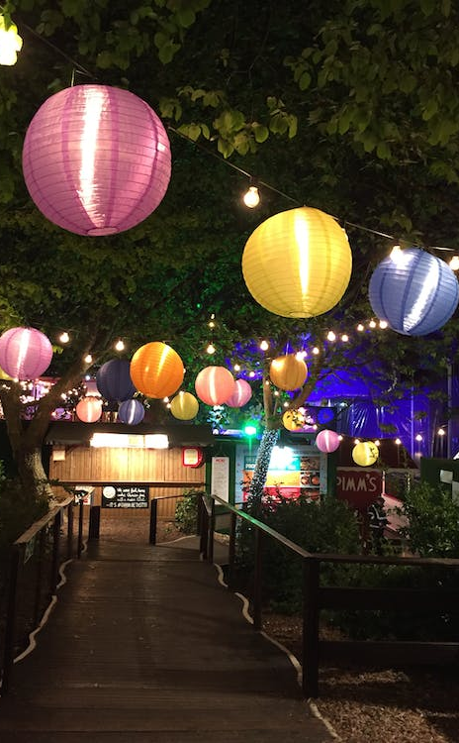
Building better public spaces
Visual
Make lights dimmable
Use diffused light sources, rather than overhead/fluorescent lights
Limit visual noise (non-essential visual elements)
Auditory
Ensure speakers use microphones consistently
Equip spaces with materials that absorb/dampen echo
Notes:
From Unmasking Autism: Discovering the New Faces of Neurodiversity by Devon Price, Ph.D.

Slide 20
Building better public spaces
Tactile
Adopt a relaxed dress code
Normalize the use of stress balls, doodling, etc.
Space out chairs, including some near corners or barriers
Smells/tastes
Use distance/barriers to keep kitchen/bathroom smells out of other areas
Tell attendees the exact menu beforehand
Provide ‘bland’ foods as a backup
Notes:
From Unmasking Autism: Discovering the New Faces of Neurodiversity by Devon Price, Ph.D.

Slide 21
Final thoughts
Avoid interpreting the behavior of others through your own experiences. Theirs are different. Ask, don’t assume. Check your assumptions often.
Before commenting on someone else’s behavior, ask yourself what you hope to gain by doing so. If it’s not important to the purpose of the gathering, ignore it.
Be mindful of the sensory experience in your spaces. How’s the lighting? Ambient noise? Temperature? Smell?
Notes:
Talk about student

Slide 22
Notes:
https://erikengdahl.se/autism/isnt/ntscreening.html

Slide 23
A little fun. ☺
Diagnostic criteria for 666.00 Neurotypic Disorder
A. Qualitative impairment in independent social interaction as manifested by the following:
(1) marked delusional sense of awareness of the existence or feelings of others (e.g., treats a person as if he or she were an extension of himself; behaves as if clairvoyant of another person's distress; apparently projects own concepts and needs onto others)
(2) extreme or abnormal seeking of comfort at times of distress (e.g., constantly comes for comfort even when ill, hurt, or tired; seeks comfort in a stereotyped way, e.g., cries, whines needs demands for attention whenever hurt)
(3) constant or mindless imitation (e.g., always wave bye-bye; copies mother's domestic activities; mechanical imitation of others' actions whenever perceived to be in context)
(4) constant or excessive social play (e.g., always actively participates in simple games; prefers group play activities; involves other children in play only as long as the other children are exactly like themselves with no differences "mirrored images")
(5) gross impairment in ability to make peer friendships (e.g., obsessive interest in making peer friendships with other Neurotypics; despite interest in making friends and afore mentioned delusion of clairvoyance, demonstrates lack of understanding for those who are different and an obsessive rigidity for social convention, for example, constantly seeks attention/positive reinforcement while staring mocking or laughing at others while they stim and rock and remain mute)
Notes:
From the Institute for the Study of the Neurologically Typical: https://erikengdahl.se/autism/isnt/

Slide 24
A little fun. ☺
B. Qualitative impairment in verbal and nonverbal communication, and in imaginative activity, as manifested by the following:
(1) blatant overuse of all modes of communication, such as communicative babbling, facial expression, gesture, mime, or spoken language
(2) markedly abnormal nonverbal communication, as in the use of eye-to- eye gaze, facial expression, body posture, or gestures to initiate or modulate social interaction (e.g., anticipates and enjoys being held, does not stiffen when held, constantly looks at the other person or smiles when making a social approach, compulsively greets parents or visitors, insists on invasively stares into the eyes of others in social situations)
(3) excessive imaginative irrelevant activity, such as playacting of adult roles, fantasy characters, or animals, lack of interest in computers or other logical fulfilling pastimes
(4) marked abnormalities in the production of speech, including volume, pitch, stress, rate, rhythm, and intonation (e.g., gregarious grandiose tone, overly emotional or syrupy melody, or overcontrolled pitch)
(5) marked abnormalities in the form or content of speech, including stereotyped and repetitive use of speech (e.g., immediate mindless or mechanical repetition of NT peers' latest 'in' or catch phrases) (e.g., "whatever" to mean "I am saying I disagree with you but I want you to be upset by my saying so in this way"); idiosyncratic use of words of phrases (e.g., "are you dissing me?" to mean "don't disrespect me"); or frequent irrelevant remarks (e.g., starts talking about the behavior of autistics at a table nearby during a meal at a restaurant)
(6) marked impairment in the ability to refrain from initiating a conversation or once initiated to sustain a full thought during conversation with others, despite adequate speech (e.g., unable to stay on topic/on thought due to the interjections from other Neurotypics)

Slide 25
A little fun. ☺
C. Markedly restricted repertoire of activities and interests, as manifested by the following:
(1) inability or lack of understanding for or interest in stereotyped body movements, e.g., hand-flicking or -twisting, spinning, head-banging (except for during certain types of rock concerts), complex whole-body movements
(2) persistent lack of awareness or inability to perceive parts of objects (e.g., seeing 'a windmill' but failing to see the existence of the many beautiful finite parts which comprise the whole object, oblivion to feelings of texture of materials, spinning wheels of toy cars) or has an attachment to unusual objects (e.g., insists on driving around in a BMW, wearing Rolex watches, carrying a cellular phone or briefcase)
(3) marked oblivion to changes in aspects of environment, e.g., when a vase is moved from usual position
(4) unreasonable insistence in sameness in others in precise detail, e.g., insisting that exactly the same social behaviors always be followed when shopping
(5) markedly restricted range of interest and a preoccupation with one narrow interest, e.g., interested only in status quo climbing, impressing friends, or in pretending to be smarter or better than they are.

