Slide 1
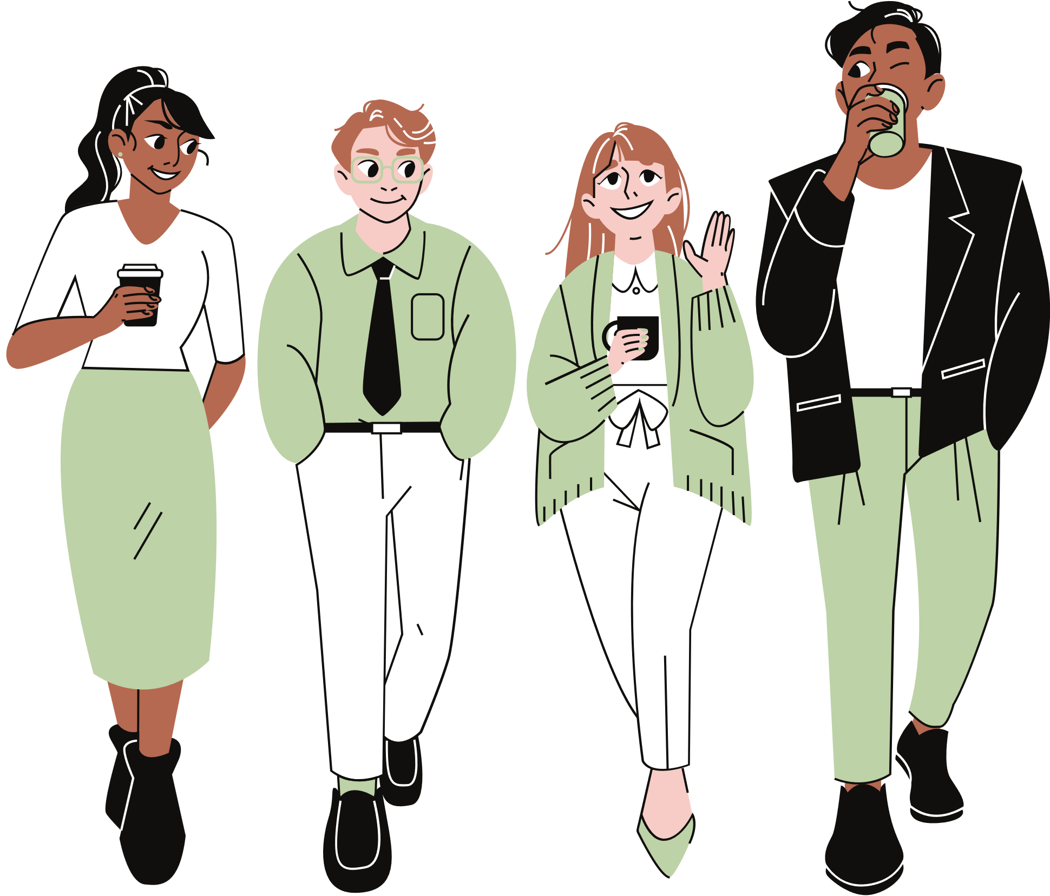
WHAT INSTRUCTORS
NEED TO KNOW ABOUT NEURODIVERGENT
STUDENTS
Dr. Liz Norell
Center for Excellence in
Teaching & Learning

Slide 2


ABOUT THE FACILITATOR
Dr. Liz Norell
Associate director of instructional support
Liz works with instructors who want to improve their teaching, including those who study and write about their efforts to create meaningful learning for students.
Liz was diagnosed with anxiety at age 39 and as autistic at age 46.

Slide 3
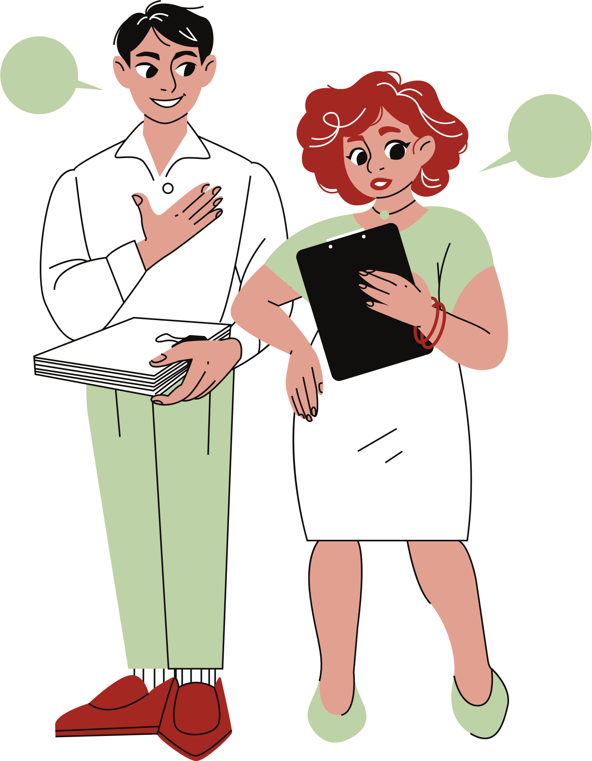
SESSION GOALS
1
Definitions
Challenges
2
What makes traditional classrooms challenging for ND students?
Strategies
3
How can you mitigate these challenges?
4
Key takeaways

Slide 4


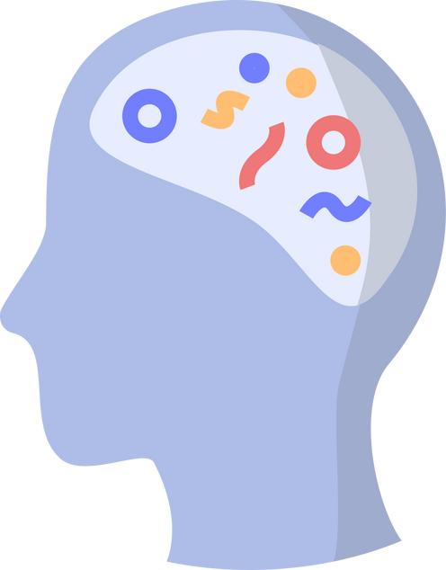

DEFINITIONS
Neurodiversity
the diversity of human minds -- a biological reality in groups of people
Neurodivergent (ND)
having a mind that functions in ways that diverge significantly from the dominant societal standards of “normal”
Neurotypical (NT)
having a style of neurocognitive functioning that falls within the dominant societal standards of “normal”
Notes:
Neurodiversity is the umbrella under which ND + NT fall

Slide 5

NEURODIVERGENT BRAINS CAN HAVE...
Autism
Dyslexia
(Asperger’s syndrome is no longer used in clinical diagnoses, but was a form of Autism)
Difficulty with reading
Dyspraxia
Difficulty with coordination
ADHD
(Once called ADD, which is no longer used in clinical settings)
Bipolar disorder
(No longer called manic-depression)
Down syndrome
OCD
Social anxiety
Dyscalculia
(A specific type of anxiety disorder)
Difficulty with math
Tourette syndrome
Dysgraphia
Difficulty with writing
... and more
Notes:
Also talk about medical model vs. social model of disability
Use identity-first language

Slide 6

AUTISM
Things you might notice:
  Repetitive movements, like rocking, tapping, or picking at things
  Unusual eye contact (too little or too much)
  Overly eager desire to share information
  Anxiety during transitions or unexpected events
  “The lights are too loud”
  Needing something explained multiple times
  Meltdowns (including crying) for no apparent reason
  Fixation on minor details
  Seemingly distracted gaze out a window or at something on the wall

Slide 7

ADHD
Things you might notice:
  Cannot seem to talk fast enough to get ideas out
  Bursts of speech
  Paralyzing reaction to negative feedback
  “A racecar brain with bicycle breaks”
  Crave novelty, excitement, and challenge
  Work better when around someone else (”body doubling”)
  Appear to be “lazy” (but this is a mischaracterization)
  Difficulty sitting still--often fidgeting or needing to move
  Easily distracted by something interesting

Slide 8
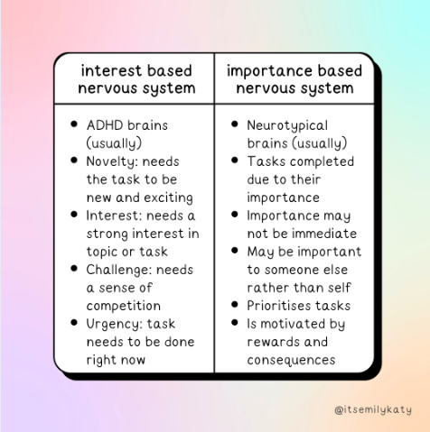
INTEREST-BASED NERVOUS SYSTEMS
VS.
IMPORTANCE-BASED NERVOUS SYSTEMS
Notes:
“Authentically Emily” has both ADHD and Autism (sometimes called Audie). Find her work here: https://www.authenticallyemily.uk/.

Slide 9
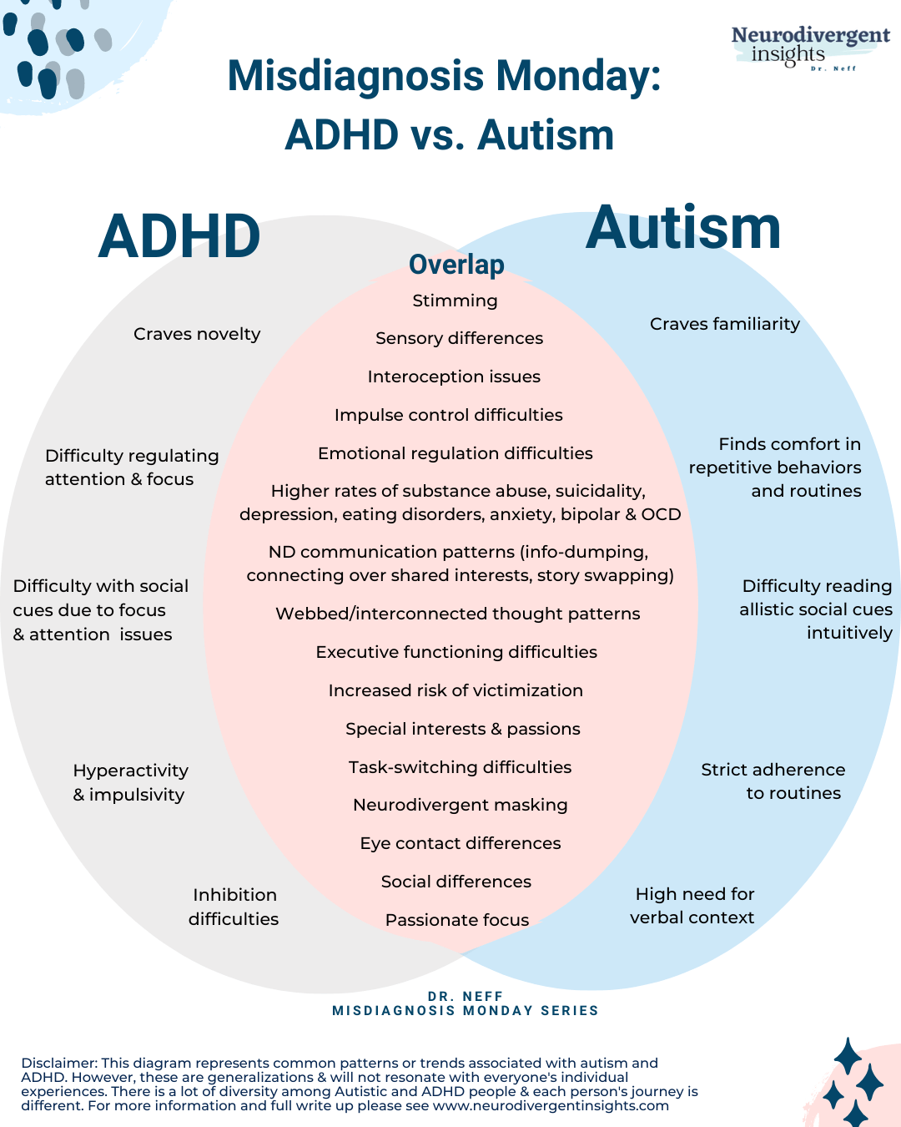
Notes:
Dr. Neff is a late-diagnosed Autistic-ADHD psychologist. Find her work here: https://neurodivergentinsights.com/misdiagnosis-monday/adhd-vs-autism.

Slide 10
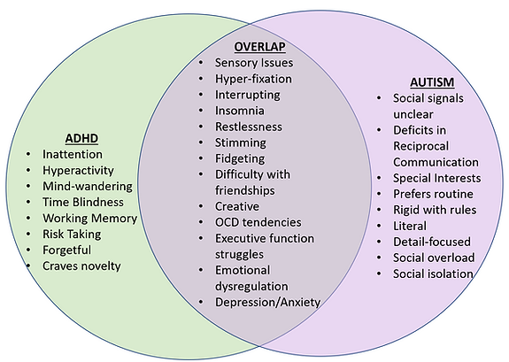
AuDHD
Notes:
The term “auDHD” is a relatively new way of expressing dual diagnoses with ADHD and Autism. Read more at https://www.neurodiversecouplescounseling.com/audhd.

Slide 11




THE ADA & YOU
Accommodations are the law.
Once a reasonable accommodation is deemed necessary, you must comply.
Diagnoses are confidential.
Faculty and staff (except those in the SDS) are not entitled to diagnoses or medical documentation.
Equitable access is the goal.
Our responsibility is to ensure every student has equitable access to academic success.
Notes:
The official government site about the ADA is here: https://www.ada.gov/topics/intro-to-ada/
Information on seeking accommodations is available at Ask JAN (the Job Accommodations Network): https://askjan.org/, including resources for employers who are tasked with the process of determining reasonable accommodations.

Slide 12
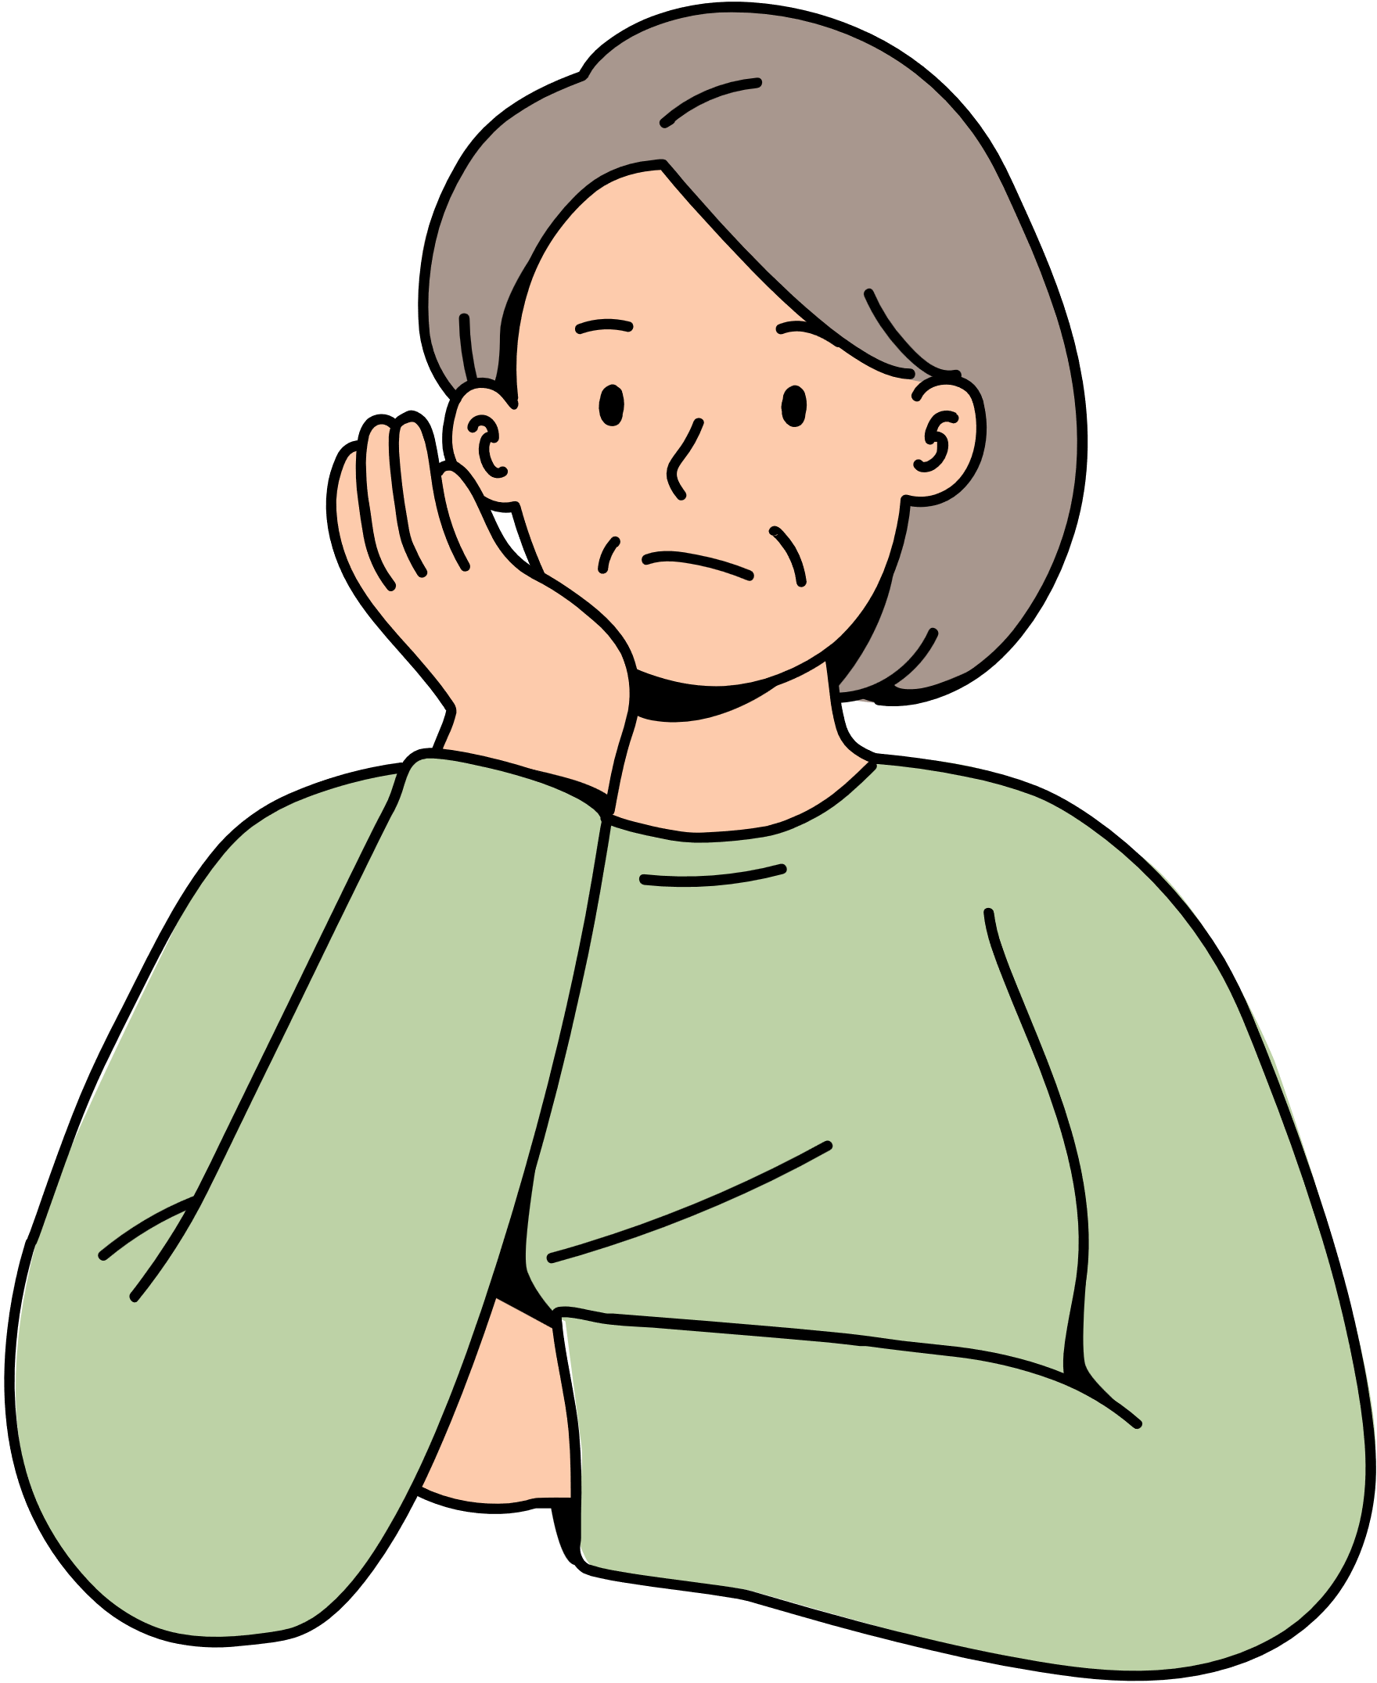
CHALLENGES
The traditional classroom is not designed to accommodate the challenges our neurodivergent learners bring into learning spaces.

Slide 13

#1: SENSORY OVERLOAD
  Bright lights, especially direct and fluorescent
  Background noise or constant interruptions
  Uncomfortable seating
  Crowded spaces
  Unstructured or unpredictable movement
  Strong smells
  Unfamiliar foods or drinks

Slide 14

#2: UNCLEAR COMMUNICATION
  Sarcasm
  Inside jokes
  Nonverbal communication
  Unstated social norms
  Unclear terminology
  Verbal instructions or over-reliance on lectures

Slide 15
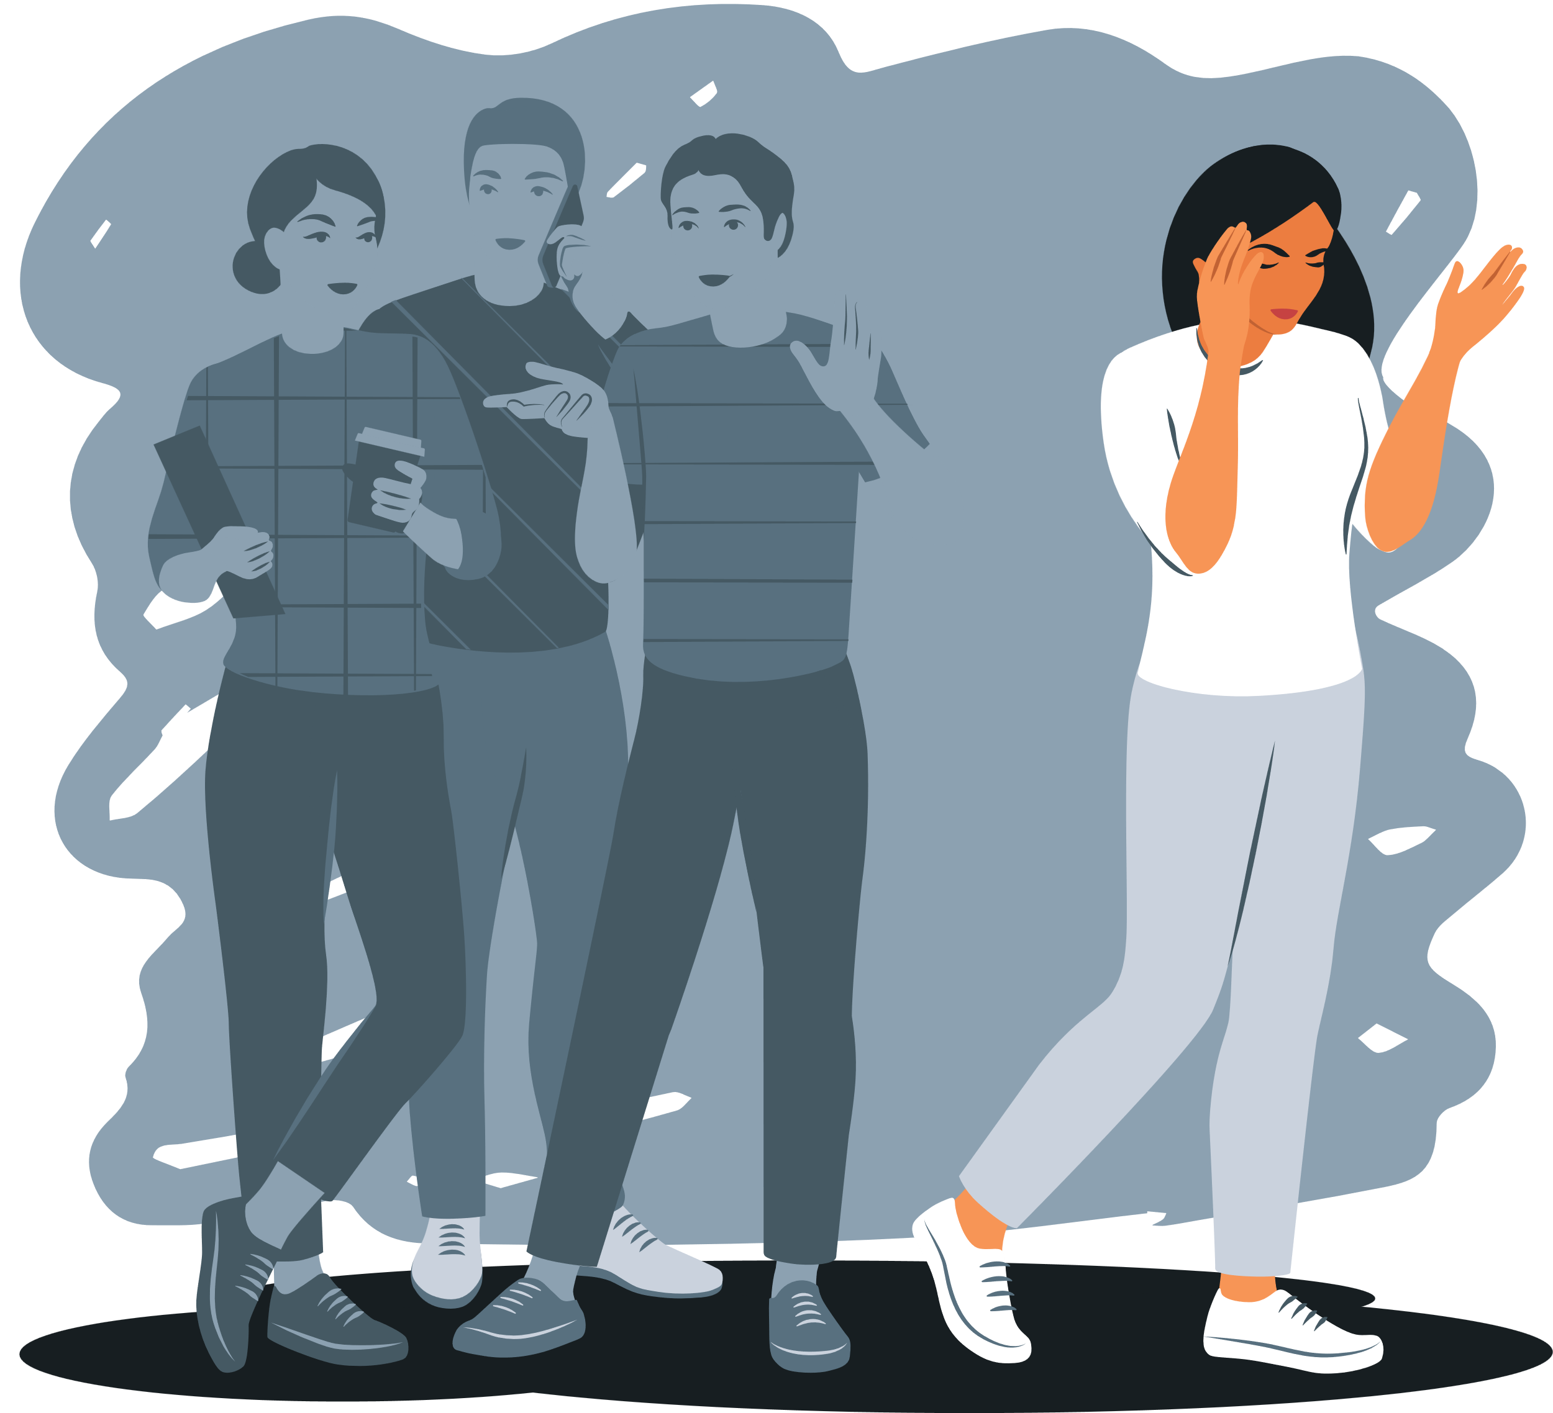
#3: SOCIAL DISCOMFORT
  Uncertainty is everywhere:
    Group work nightmares
    Unclear social norms
    Forced interactions
  Reduced cognitive bandwidth
  Shame around stimming

Slide 16
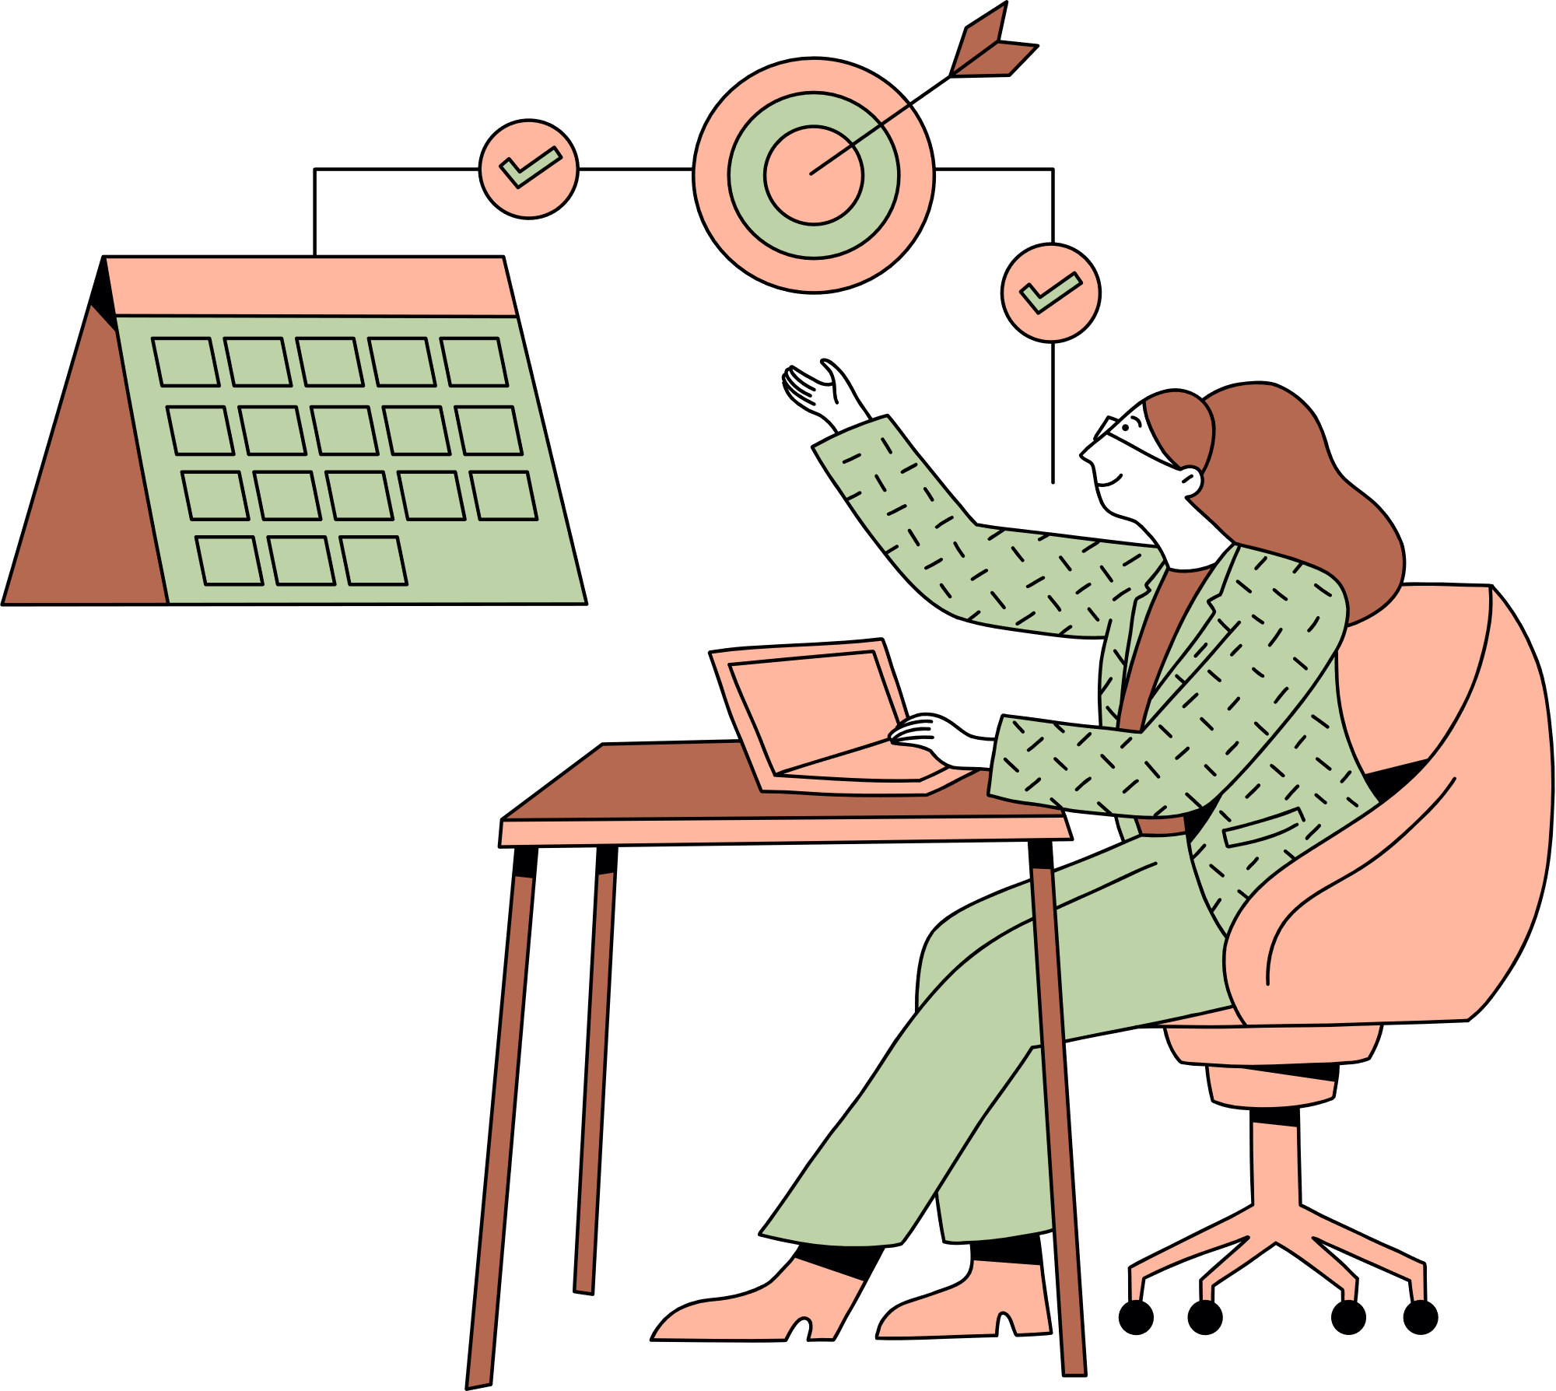
#4: EXECUTIVE FUNCTIONING
  Prioritizing work / time management
  How to take notes, tests, etc.
  Rejection sensitive dysphoria (RSD)
  Due dates vs. do dates
  Managing unique grading systems, approaches, syllabi, LMS organization, etc.

Slide 17

STRATEGIES
Ideas for welcoming neurodivergent students ... and creating opportunities for them to succeed

Slide 18

#1: MANAGE SENSORY INPUT
  Dim the lights or use diffuse/indirect lighting
  Limit cross-talk and echoing noise
  Ensuring accessible seating options
  Design room layouts for ease of movement
  Communicate clearly when movement is involved
  Request limits on food, drink, and other smells
  Share menus in advance and ensure some blander options
  Explicitly allow rearranging furniture and/or movement/fidgeting/doodling/etc.

Slide 19
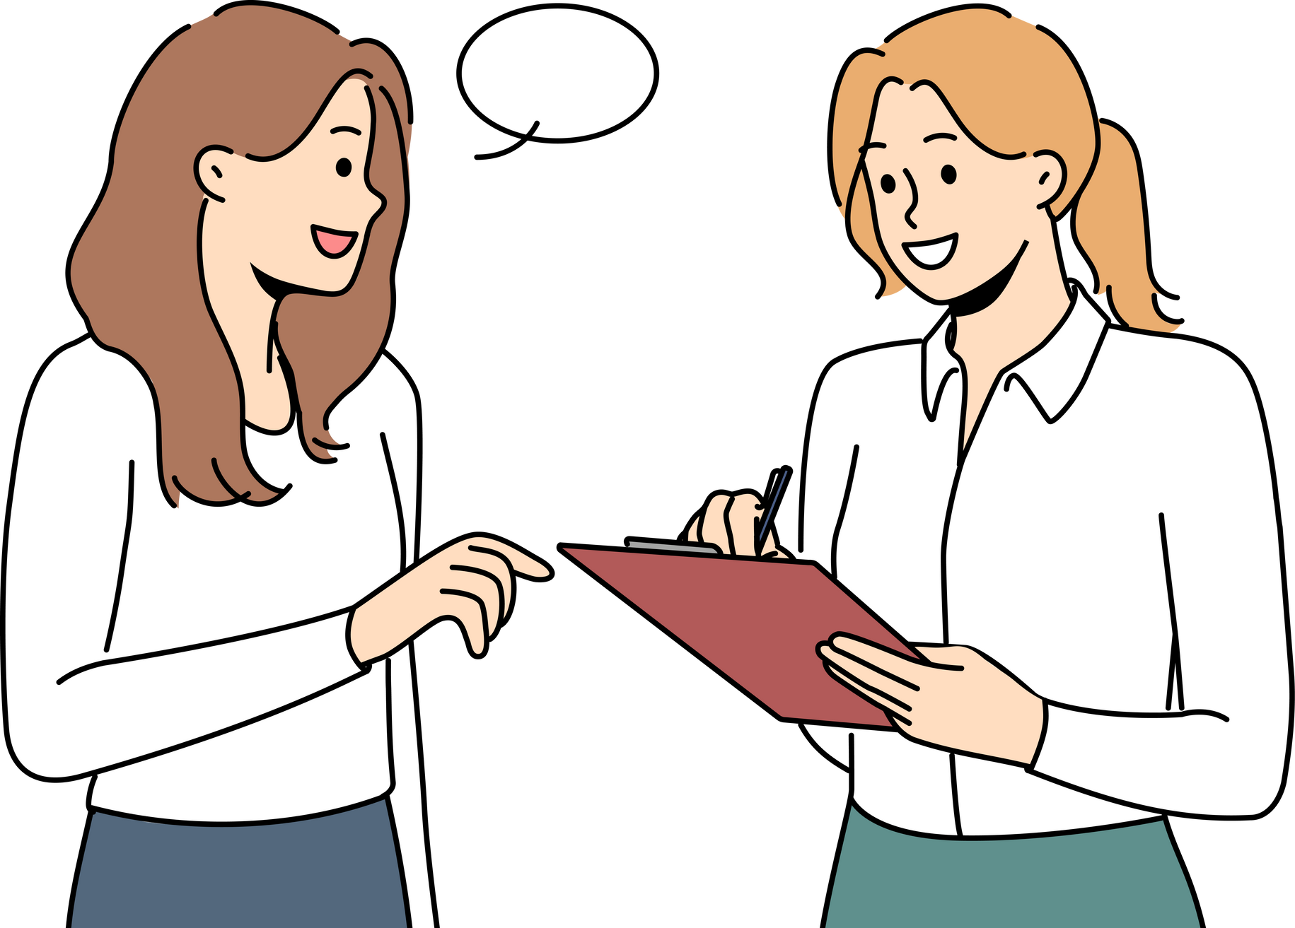
#2: COMMUNICATE CLEARLY
  State expectations explicitly and in multiple modes
  Limit sarcasm or inside jokes
  Monitor (or ask a trusted colleague to monitor) your nonverbal communication
  Clearly state any social norms you’re invoking
  Define terminology in concrete terms
  Provide written instructions and other written/audio/video ways to access important material

Slide 20

#3: INTENTIONAL SOCIAL INTERACTIONS
  Normalize stimming behaviors
  Clearly define roles and purpose of social interactions, including an option to work alone
  Provide alternative ways (other than oral communication) for collaboration/interaction

Slide 21

#4: CREATE (FLEXIBLE) STRUCTURES
  Remove/hide unnecessary LMS material/features
  Infuse how-to directions everywhere a specific skill is needed
  Scaffold assignments to create meaningful and regular deadlines
  Assume good intentions & allow for mistakes

Slide 22

WITH OUR COLLEAGUES
  “Fit” as an interview/hiring criterion
  Acceptance/normalization of mental health discussions
  Communication styles
  Clarity in expectations
  Trust, emotional safety, and ongoing efforts to improve
  Physical spaces & needs

Slide 23

NOTHING FOR US
WITHOUT US
Notes:
Resources for further exploration:
Episode 384 of Teaching in Higher Ed features Karen Costa, who is working on a book about ADHD in higher education: https://teachinginhighered.com/podcast/supporting-adhd-learners/
Season 4, episode 6 of The Agile Academic features Rebecca Pope-Ruark with Dr. Katie Rose Guest Pryal, who talks about mental health, neurodiversity, and being well in higher education: https://theagileacademic.com/podcast/
Sarah Silverman runs occasional webinars on neurodiversity for educators (usually pay-what-you can): https://sarahemilysilverman.com/workshop-an-introduction-to-neurodiversity-for-educators/

Slide 24
THANK YOU FOR ATTENDING TODAY!
I welcome your thoughts!
Liz Norell
eanorell@olemiss.edu
Hill Hall 215
Notes:
It’s unfair to place the burden of LIVING with these neurodivergences along with ADVOCATING for equitable opportunities for success on the same person. Regardless of your position, you have the power to make UM a more inclusive space for all—especially the students in your classes (or with whom you work) who may not have the means or courage to obtain or disclose a diagnosis.

Slide 25
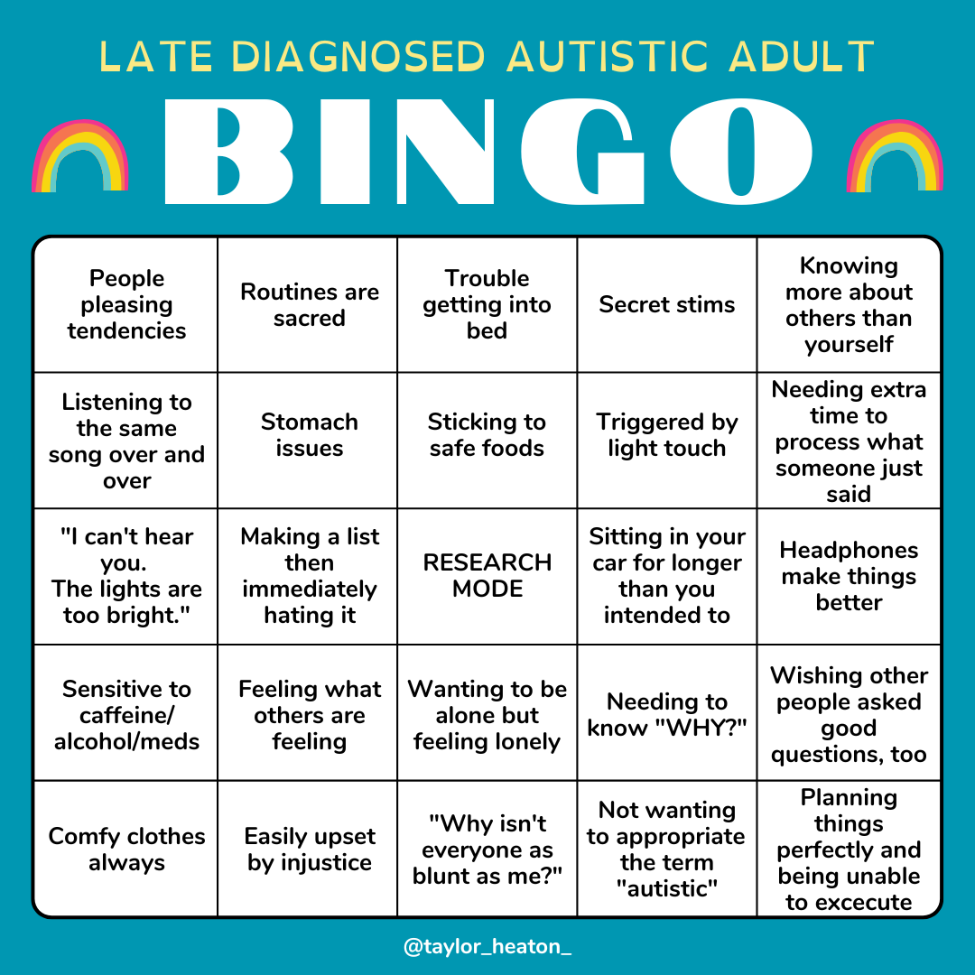

Slide 26
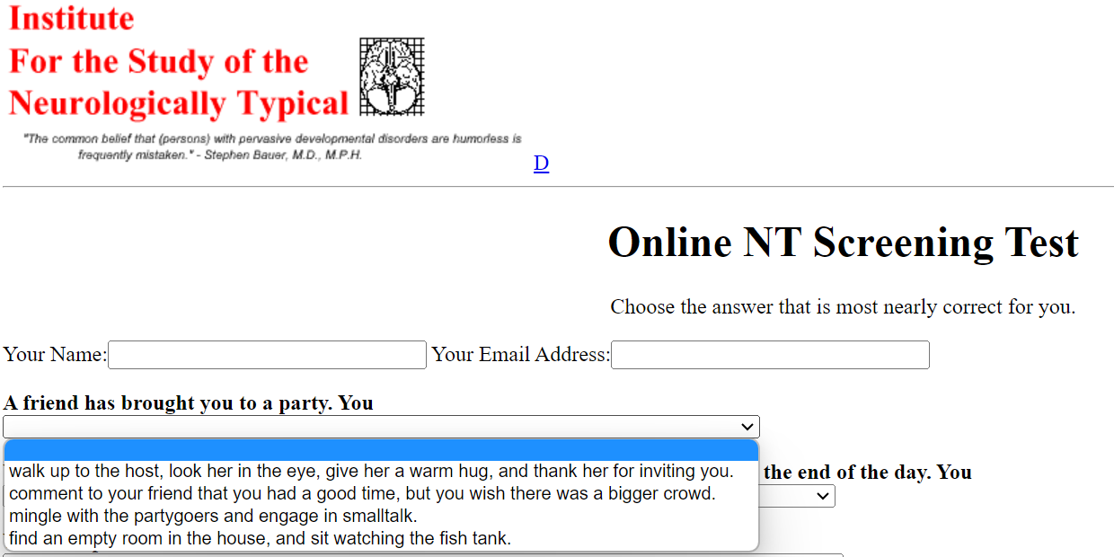
Notes:
https://erikengdahl.se/autism/isnt/ntscreening.html

Slide 27
A little fun. ☺
Diagnostic criteria for 666.00 Neurotypic Disorder
A. Qualitative impairment in independent social interaction as manifested by the following:
(1) marked delusional sense of awareness of the existence or feelings of others (e.g., treats a person as if he or she were an extension of himself; behaves as if clairvoyant of another person's distress; apparently projects own concepts and needs onto others)
(2) extreme or abnormal seeking of comfort at times of distress (e.g., constantly comes for comfort even when ill, hurt, or tired; seeks comfort in a stereotyped way, e.g., cries, whines needs demands for attention whenever hurt)
(3) constant or mindless imitation (e.g., always wave bye-bye; copies mother's domestic activities; mechanical imitation of others' actions whenever perceived to be in context)
(4) constant or excessive social play (e.g., always actively participates in simple games; prefers group play activities; involves other children in play only as long as the other children are exactly like themselves with no differences "mirrored images")
(5) gross impairment in ability to make peer friendships (e.g., obsessive interest in making peer friendships with other Neurotypics; despite interest in making friends and afore mentioned delusion of clairvoyance, demonstrates lack of understanding for those who are different and an obsessive rigidity for social convention, for example, constantly seeks attention/positive reinforcement while staring mocking or laughing at others while they stim and rock and remain mute)
Notes:
From the Institute for the Study of the Neurologically Typical: https://erikengdahl.se/autism/isnt/

Slide 28
A little fun. ☺
B. Qualitative impairment in verbal and nonverbal communication, and in imaginative activity, as manifested by the following:
(1) blatant overuse of all modes of communication, such as communicative babbling, facial expression, gesture, mime, or spoken language
(2) markedly abnormal nonverbal communication, as in the use of eye-to- eye gaze, facial expression, body posture, or gestures to initiate or modulate social interaction (e.g., anticipates and enjoys being held, does not stiffen when held, constantly looks at the other person or smiles when making a social approach, compulsively greets parents or visitors, insists on invasively stares into the eyes of others in social situations)
(3) excessive imaginative irrelevant activity, such as playacting of adult roles, fantasy characters, or animals, lack of interest in computers or other logical fulfilling pastimes
(4) marked abnormalities in the production of speech, including volume, pitch, stress, rate, rhythm, and intonation (e.g., gregarious grandiose tone, overly emotional or syrupy melody, or overcontrolled pitch)
(5) marked abnormalities in the form or content of speech, including stereotyped and repetitive use of speech (e.g., immediate mindless or mechanical repetition of NT peers' latest 'in' or catch phrases) (e.g., "whatever" to mean "I am saying I disagree with you but I want you to be upset by my saying so in this way"); idiosyncratic use of words of phrases (e.g., "are you dissing me?" to mean "don't disrespect me"); or frequent irrelevant remarks (e.g., starts talking about the behavior of autistics at a table nearby during a meal at a restaurant)
(6) marked impairment in the ability to refrain from initiating a conversation or once initiated to sustain a full thought during conversation with others, despite adequate speech (e.g., unable to stay on topic/on thought due to the interjections from other Neurotypics)

Slide 29
A little fun. ☺
C. Markedly restricted repertoire of activities and interests, as manifested by the following:
(1) inability or lack of understanding for or interest in stereotyped body movements, e.g., hand-flicking or -twisting, spinning, head-banging (except for during certain types of rock concerts), complex whole-body movements
(2) persistent lack of awareness or inability to perceive parts of objects (e.g., seeing 'a windmill' but failing to see the existence of the many beautiful finite parts which comprise the whole object, oblivion to feelings of texture of materials, spinning wheels of toy cars) or has an attachment to unusual objects (e.g., insists on driving around in a BMW, wearing Rolex watches, carrying a cellular phone or briefcase)
(3) marked oblivion to changes in aspects of environment, e.g., when a vase is moved from usual position
(4) unreasonable insistence in sameness in others in precise detail, e.g., insisting that exactly the same social behaviors always be followed when shopping
(5) markedly restricted range of interest and a preoccupation with one narrow interest, e.g., interested only in status quo climbing, impressing friends, or in pretending to be smarter or better than they are.

